Slide 1
Enterprise Spark
Au:- Amit S Khedkar

Slide 2

Hadoop Overview for Developers

Slide 3
Objectives
After completing this lesson, students should be able to:
Describe the characteristics and types of Big Data
Hadoop data lifecycle management strategies
Describe and use HDFS
Explain the purpose and function of YARN
Notes:
By the end of this lesson, the student should be able to:
Describe the characteristics and types of Big Data
Define HDP and how it fits into overall data lifecycle management strategies
Describe and use HDFS
Explain the purpose and function of YARN

Slide 4
Defining Big Data

Slide 5
What Makes Data "Big" Data?
The term Big Data comes from the computational sciences
It is used to describe scenarios where the volume, rate of creation, and types of data threaten to overwhelm the tools used to store and process it
Three V’s | Description
VOLUME | Petabytes and more, spurred by exponential growth in computers, sensors, social media, and regulatory requirements.
Velocity | Gigabytes per *second,* and faster, plus new data and new ways to create data are generated an an increasing rate.
Variety | Structured, semi-structured, unstructured. Databases, XML, JSON, text, photo, video, audio, etc.
Notes:
What what makes data big? Where did the phrase Big Data come from and what does it mean?
The term Big Data comes from the computational sciences. Specifically, it is used to describe scenarios where the volume and variety of data types overwhelm the existing tools to store and process it.
In 2001, the industry analyst Doug Laney described Big Data using the three V’s of volume, velocity, and variety.
Volume
Volume refers to the amount of data being generated. Think in terms of gigabytes, terabytes, and petabytes. Many systems and applications are just not able to store, let alone ingest or process, that much data.
Many factors contribute to the increase in data volume. This includes transaction-based data stored for years, unstructured data streaming in from social media, and the ever increasing amounts of sensor and machine data being produced and collected.
There are problems related to the volume of data. Storage cost is an obvious issue. Another problem is filtering and finding relevant and valuable information in large quantities of data that often contains not-valuable information.
You also need a solution to analyze data quickly enough in order to maximize business value today and not just next quarter or next year.
Velocity
Velocity refers to the rate at which new data is created. Think in terms of megabytes per second and gigabytes per second.
Data is streaming in at unprecedented speed and must be dealt with in a timely manner in order to extract maximum value from the data. Sources of this data include logs, social media, RFID tags, sensors, and smart metering.
There are problems related to the velocity of data. These include not reacting quickly enough to benefit from the data. For example, data could be used to create a dashboard that could warn of imminent failure or a security breach. Failure to react in time could lead to service outages.
Another problem related to the velocity of data is that data flows tend to be highly inconsistent with periodic peaks. Causes include daily or seasonal changes or event-triggered peak loads. For example, a change in political leadership could cause an a peak in social media.
Variety
Variety refers to the number of types of data being generated. Varieties of data include structured, semi-structured, and unstructured data arriving from a myriad of sources. Data can be gathered from databases, XML or JSON files, text documents, email, video, audio, stock ticker data, and financial transactions.
There are problems related to the variety of data. This include how to gather, link, match, cleanse, and transform data across systems. You also have to consider how to connect and correlate data relationships and hierarchies in order to extract business value from the data.

Slide 6
Common Types of Data in Hadoop
There are six types of data commonly found in Hadoop.
Sentiment data: how customers react
Clickstream data: website visitor behavior
Sensor or machine data: data from remote devices
Geographic data: location-based data
Server log data: failure and security logs
Text: email, web pages, documents, etc.
Notes:
Six types of data are commonly found in Hadoop. These include sentiment data, clickstream data, sensor or machine data, geographic/geolocation data, server log data, and text.
The type of Big Data that ends up in Hadoop typically fits into one of the following categories:
Sentiment: Clickstream: Capture and analyze website visitor's data trails and optimize your website
Sensor/Machine: Discover Patterns in data streaming automatically from remote sensors and machines
Geographic: Analyze location-based data to manage operations where they occur
Server Logs: Research log files to diagnose and process failures and prevent security breaches
Text: Understand patterns in text across millions of web pages, emails and documents
Sentiment: Understand how your customers feel about your brand and products right now
Sentiment data is unstructured data containing opinions, emotions, and attitudes. Sentiment data is gathered from social media like Facebook and Twitter. It is also gathered from blogs, online product reviews, and customer support interactions.
Enterprises use sentiment analysis to understand how the public thinks and feels about something. They can also track how those thoughts and feelings change over time.
It is used to make targeted, real-time decisions that improve performance and improve market share. Sentiment data may be analyzed to get feedback about products, services, competitors, and reputation.
Clickstream: Capture and analyze website visitor's data trails and optimize your website
Clickstream data is the data trail left by a user while visiting a Web site. Clickstream data can be used to determine how long a customer stayed on a Web site, which pages they most frequently visited, which pages they most quickly abandoned, along with other statistical information.
This data is commonly captured in semi-structured Web logs.
Clickstream data is used, for example, for path optimization, basket analysis, next-product-to-buy analysis, and allocation of Web site resources.
Hadoop makes it easier to analyze, visualize, and ultimately change how visitors behave on your Web site.
Sensor/Machine: Discover Patterns in data streaming automatically from remote sensors and machines
A sensor is a converter that measures a physical quantity and transforms it into a digital signal. Sensor data is used to monitor machines, infrastructure, or natural phenomenon.
Sensors are everywhere these days. They are on the factory floor and they are in department stores in the form of RFID tags. Hospitals use biometric sensors to monitor patients and other sensors to monitor the delivery of medicines via intravenous drip lines. In all cases these machines stream low-cost, always-on data.
Hadoop makes it easier for you to rapidly collect, store, process, and refine this data. By processing and refining your data you can identify meaningful patterns that provide insight to make proactive business decisions.
Geographic: Analyze location-based data to manage operations where they occur
Geographic/geolocation data identifies the location of an object or individual at a moment in time. This data may take the form of coordinates or an actual street address.
This data might be voluminous to collect, store, and process; just like sensor data. In fact, geolocation data is collected by sensors.
Hadoop helps reduce data storage costs while providing value-driven intelligence from asset tracking. For example, you might optimize truck routes to save fuel costs.
Server Log: Research log files to diagnose and process failures and prevent security breaches
Server log data captures system and network operation information. Information technology organizations analyze server logs for many reasons. These include the need to answer questions about security, monitor for regulatory compliance, and troubleshoot failures.
Hadoop takes server-log analysis to the next level by speeding and improving log aggregation and data center-wide analysis. In many environments Hadoop can replace existing enterprise-wide systems and network monitoring tools, and reduce the complexity and costs associated with deploying and maintaining such tools.
Text: Understand patterns in text across millions of web pages, emails and documents
Text is often used for text-based data generated that doesn’t neatly fit into one of the above categories, as well as combinations of categories in order to find patterns across different text-based sources.

Slide 7
Hadoop Introduction

Slide 8
What is Hadoop?
Hadoop:
Is a collection of open source software frameworks for the distributed storing and processing of large sets of data
Is scalable and fault tolerant
Works with commodity hardware
Processes all types of Big Data
Hadoop design goals:
Use inexpensive, enterprise-grade hardware to create very large clusters
Achieve massive scalability through distributed storage and processing
Notes:
Hadoop is a collection of open source software frameworks for the distributed storing and processing of large sets of data. Hadoop development is a community effort governed under the licensing of the Apache Software Foundation. Anyone can help to improve Hadoop by adding features, fixing software bugs, or improving performance and scalability.
Hadoop clusters are scalable, ranging from as few as one machine to literally thousands of machines. It is also fault tolerant. Hadoop services achieve fault tolerance through redundancy.
Clusters are created using commodity, enterprise-grade hardware, which not only reduces the original purchase price, but potentially also reduces support costs too.
Hadoop also uses distributed storage and processing to achieve massive scalability. Large datasets are automatically split into smaller chunks, called blocks, and distributed across the cluster machines. Not only that, but each machine commonly processes its local block of data. This means that processing is distributed too, potentially across hundreds of CPUs and hundreds of gigabytes of memory.
HDP is an enterprise-ready collection of frameworks (sometimes referred to as the HDP Stack) that work within Hadoop that has been tested and is supported by Hortonworks for business clients.

Slide 9
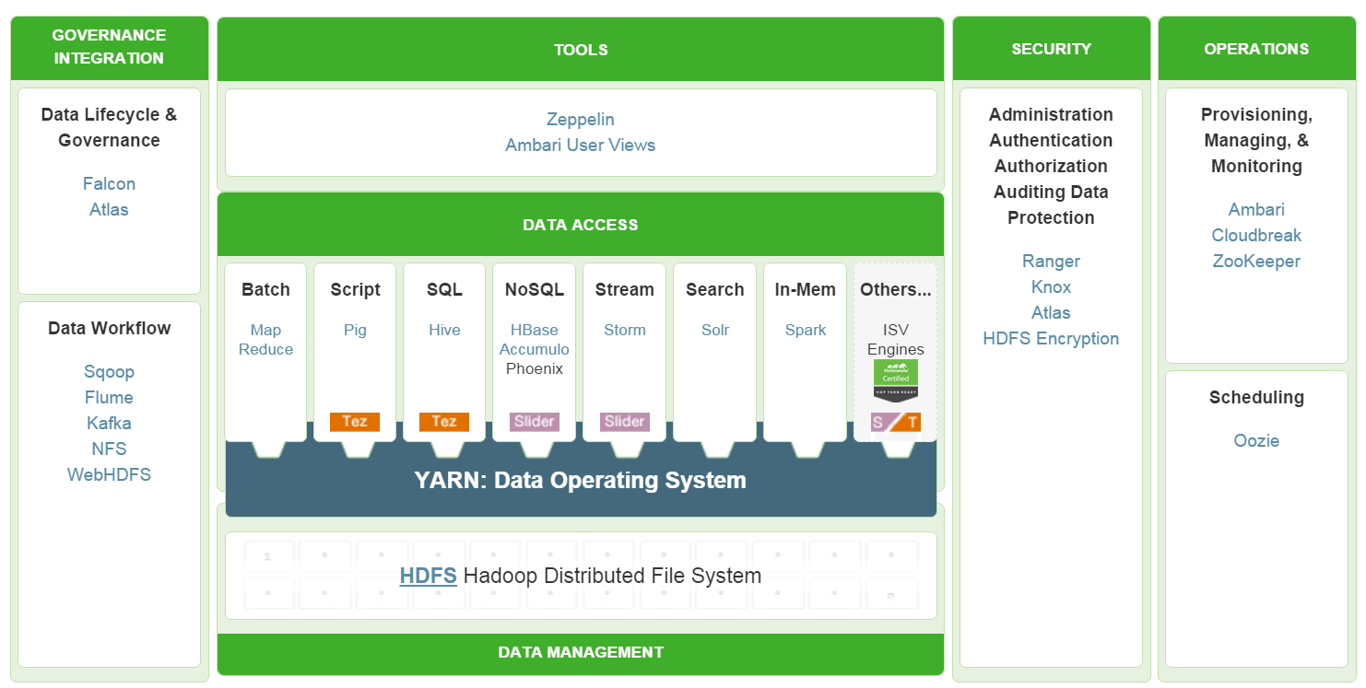
Enterprise ready Hadoop Platforms
Ref – https://hortonworks.com/products/data-center/hdp/
Notes:
Hadoop is not a monolithic piece of software. It is a collection of software frameworks. Most of the frameworks are part of the Apache software ecosystem. The picture illustrates the Apache frameworks that are part of the Hortonworks Hadoop distribution.
So why does Hadoop have so many frameworks and tools? The reason is that each tool is designed for a specific purpose. The functionality of some tools overlap but typically one tool is going to be better than others when performing certain tasks.
For example, both Apache Storm and Apache Flume ingest data and perform real-time analysis. But Storm has more functionality and is more powerful for real-time data analysis.

Slide 10
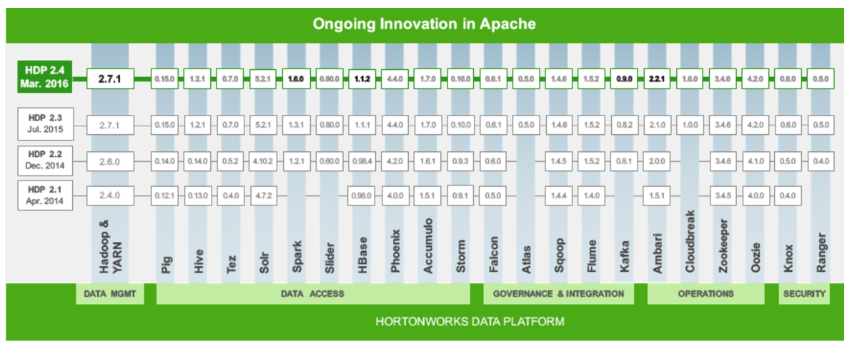
Hadoop distros - HDP
Ref – https://hortonworks.com/products/data-center/hdp/
Notes:
HDP is an open enterprise version of Hadoop distributed by Hortonworks. It includes a single installation utility that installs many of the Apache Hadoop software frameworks. Even the installer is pure Hadoop.
The primary benefit is that Hortonworks has put HDP through a rigorous set of system, functional, and regression tests to ensure that versions of any frameworks included in the distribution work seamlessly together in a secure and reliable manner.
Because HDP is an open enterprise version of Hadoop, it is imperative that it uses the best combination of the most stable, reliable, secure, and current frameworks.

Slide 11
Data Management and Operations Frameworks
Framework | Description
Hadoop Distributed File System (HDFS) | A Java-based, distributed file system that provides scalable, reliable, high-throughput access to application data stored across commodity servers
Yet Another Resource Negotiator (YARN) | A framework for cluster resource management and job scheduling
Framework | Description
Ambari | A Web-based framework for provisioning, managing, and monitoring Hadoop clusters
ZooKeeper | A high-performance coordination service for distributed applications
Cloudbreak | A tool for provisioning and managing Hadoop clusters in the cloud
Oozie | A server-based workflow engine used to execute Hadoop jobs
These brief descriptions are provided for quick convenience. More detailed descriptions are available online
Notes:
There are two data management frameworks: HDFS and YARN.
HDFS is a Java-based distributed file system that provides scalable, reliable, high-throughput access to application data stored across commodity servers. HDFS is similar to many conventional file systems. For example, it shares many similarities to the Linux file system. HDFS supports operations to read, write, and delete files. It supports operations to create, list, and delete directories. HDFS is described in more detail in another lesson.
YARN is a framework for cluster resource management and job scheduling. YARN is the architectural center of Hadoop that enables multiple data processing engines such as interactive SQL, real-time streaming, data science, and batch processing to co-exist on a single cluster. YARN is described in more detail in another lesson.
The four operations frameworks are Apache Ambari, Apache ZooKeeper, Cloudbreak, and Apache Oozie.
Ambari is a completely open operational framework for provisioning, managing, and monitoring Hadoop clusters. It includes an intuitive collection of operator tools and a set of RESTful APIs that mask the complexity of Hadoop, simplifying the operation of clusters. The most visible Ambari component is the Ambari Web UI, a Web-based interface used to provision, manage, and monitor Hadoop clusters. The Ambari Web UI is the "face" of Hadoop management.
ZooKeeper is a coordination service for distributed applications and services. Coordination services are hard to build correctly, and are especially prone to errors such as race conditions and deadlock. In addition, a distributed system must be able to conduct coordinated operations while dealing with such things as scalability concerns, security concerns, consistency issues, network outages, bandwidth limitations, and synchronization issues. ZooKeeper is designed to help with these issues.
Cloudbreak is a cloud agnostic tool for provisioning, managing, and monitoring of on-demand clusters. It automates the launching of elastic Hadoop clusters with policy-based autoscaling on the major cloud infrastructure platforms including Microsoft Azure, Amazon Web Services, Google Cloud Platform, OpenStack, and Docker containers.
Oozie is a server-based workflow engine used to execute Hadoop jobs. Oozie enables Hadoop users to build and schedule complex data transformations by combining MapReduce, Apache Hive, Apache Pig, and Apache Sqoop jobs into a single, logical unit of work. Oozie can also perform Java, Linux shell, distcp, SSH, email, and other operations.

Slide 12
Data Access Frameworks
Framework | Description
Pig | A high-level platform for extracting, transforming, or analyzing large datasets
Hive | A data warehouse infrastructure that supports ad hoc SQL queries
HCatalog | A table information, schema, and metadata management layer supporting Hive, Pig, MapReduce, and Tez processing
Cascading | An application development framework for building data applications, abstracting the details of complex MapReduce programming
HBase | A scalable, distributed NoSQL database that supports structured data storage for large tables
Phoenix | A client-side SQL layer over HBase that provides low-latency access to HBase data
Accumulo | A low-latency, large table data storage and retrieval system with cell-level security
Storm | A distributed computation system for processing continuous streams of real-time data
Solr | A distributed search platform capable of indexing petabytes of data
Spark | A fast, general purpose processing engine use to build and run sophisticated SQL, streaming, machine learning, or graphics applications.
Notes:
Apache Pig is a high-level platform for extracting, transforming, or analyzing large datasets. Pig includes a scripted, procedural-based language that excels at building data pipelines to aggregate and add structure to data. Pig also provides data analysts with tools to analyze data.
Apache Hive is a data warehouse infrastructure built on top of Hadoop. It was designed to enable users with database experience to analyze data using familiar SQL-based statements. Hive includes support for SQL:2011 analytics. Hive and its SQL-based language enable an enterprise to utilize existing SQL skillsets to quickly derive value from a Hadoop deployment.
Apache HCatalog is a table information, schema, and metadata management system for Hive, Pig, MapReduce, and Tez. HCatalog is actually a module in Hive that enables non-Hive tools to access Hive metadata tables. It includes a REST API, named WebHCat, to make table information and metadata available to other vendors’ tools.
Cascading is an application development framework for building data applications. Acting as an abstraction layer, Cascading converts applications built on Cascading into MapReduce jobs that run on top of Hadoop.
Apache HBase is a non-relational database. Sometimes a non-relational database is referred to as a NoSQL database. HBase was created for hosting very large tables with billions of rows and millions of columns. HBase provides random, real-time access to data. It adds some transactional capabilities to Hadoop, allowing users to conduct table inserts, updates, scans, and deletes.
Apache Phoenix is a client-side SQL skin over HBase that provides direct, low-latency access to HBase. Entirely written in Java, Phoenix enables querying and managing HBase tables using SQL commands.
Apache Accumulo is a low-latency, large table data storage and retrieval system with cell-level security. Accumulo is based on Google’s Bigtable but it runs on YARN.
Apache Storm is a distributed computation system for processing continuous streams of real-time data. Storm augments the batch processing capabilities provided by MapReduce and Tez by adding reliable, real-time data processing capabilities to a Hadoop cluster.
Apache Solr is a distributed search platform capable of indexing petabytes of data. Solr provides user-friendly, interactive search to help businesses find data patterns, relationships, and correlations across petabytes of data. Solr ensures that all employees in an organization, not just the technical ones, can take advantage of the insights that Big Data can provide.
Apache Spark is an open source, general purpose processing engine that allows data scientists to build and run fast and sophisticated applications on Hadoop. Spark provides a set of simple and easy-to-understand programming APIs that are used to build applications at a rapid pace in Scala. The Spark Engine supports a set of high-level tools that support SQL-like queries, streaming data applications, complex analytics such as machine learning, and graph algorithms.

Slide 13
Governance and Integration Frameworks
Framework | Description
Falcon | A data governance tool providing workflow orchestration, data lifecycle management, and data replication services.
WebHDFS | A REST API that uses the standard HTTP verbs to access, operate, and manage HDFS
HDFS NFS Gateway | A gateway that enables access to HDFS as an NFS mounted file system
Flume | A distributed, reliable, and highly-available service that efficiently collects, aggregates, and moves streaming data
Sqoop | A set of tools for importing and exporting data between Hadoop and RDBM systems
Kafka | A fast, scalable, durable, and fault-tolerant publish-subscribe messaging system
Atlas | A scalable and extensible set of core governance services enabling enterprises to meet compliance and data integration requirements
Notes:
Apache Falcon is a data governance tool. It provides a workflow orchestration framework designed for data motion, coordination of data pipelines, lifecycle management, and data discovery. Falcon enables data stewards and Hadoop administrators to quickly onboard data and configure its associated processing and management on Hadoop clusters.
WebHDFS uses the standard HTTP verbs GET, PUT, POST, and DELETE to access, operate, and manage HDFS. Using WebHDFS, a user can create, list, and delete directories as well as create, read, append, and delete files. A user can also manage file and directory ownership and permissions. Administrators can manage HDFS.
The HDFS NFS Gateway allows access to HDFS as though it were part of an NFS client’s local file system. The NFS client mounts the root directory of the HDFS cluster as a volume and then uses local command-line commands, scripts, or file explorer applications to manipulate HDFS files and directories.
Apache Flume is a distributed, reliable, and available service that efficiently collects, aggregates, and moves streaming data. It is a distributed service because it can can be deployed across many systems. The benefits of a distributed system include increased scalability and redundancy. It is reliable because its architecture and components are designed to prevent data loss. It is highly-available because it uses redundancy to limit downtime.
Apache Sqoop is a collection of related tools. The primary tools are the import and export tools. Writing your own scripts or MapReduce program to move data between Hadoop and a database or an enterprise data warehouse is an error prone and non-trivial task. Sqoop import and export tools are designed to reliably transfer data between Hadoop and relational databases or enterprise data warehouse systems.
Apache Kafka is a fast, scalable, durable, and fault-tolerant publish-subscribe messaging system. Kafka is often used in place of traditional message brokers like Java Messaging Service (JMS) or Advance Message Queueing Protocol (AMQP) because of its higher throughput, reliability, and replication.
Apache Atlas is a scalable and extensible set of core foundational governance services that enable and enterprise to meet their compliance requirements within Hadoop and enables integration with the complete enterprise data ecosystem.

Slide 14
Security Frameworks
Framework | Description
HDFS | A storage management service providing file and directory permissions, even more granular file and directory access control lists, and transparent data encryption
YARN | A resource management service with access control lists controlling access to compute resources and YARN administrative functions
Hive | A data warehouse infrastructure service providing granular access controls to table columns and rows
Falcon | A data governance tool providing access control lists that limit who may submit Hadoop jobs
Knox | A gateway providing perimeter security to a Hadoop cluster
Ranger | A centralized security framework offering fine-grained policy controls for HDFS, Hive, HBase, Knox, Storm, Kafka, and Solr
Notes:
HDFS also contributes security features to Hadoop. HDFS include file and directory permissions, access control lists, and transparent data encryption. Access to data and services often depends on having the correct HDFS permissions and encryption keys.
YARN also contributes security features to Hadoop. YARN includes access control lists that control access to cluster memory and CPU resources, along with access to YARN administrative capabilities.
Hive can be configured to control access to table columns and rows.
Falcon is a data governance tool that also includes access controls that limit who may submit automated workflow jobs on a Hadoop cluster.
Apache Knox is a perimeter gateway protecting a Hadoop cluster. It provides a single point of authentication into a Hadoop cluster.
Apache Ranger is a centralized security framework offering fine-grained policy controls for HDFS, Hive, HBase, Knox, Storm, Kafka, and Solr. Using the Ranger Console, security administrators can easily manage policies for access to files, directories, databases, tables, and columns. These policies can be set for individual users or groups and then enforced within Hadoop.

Slide 15
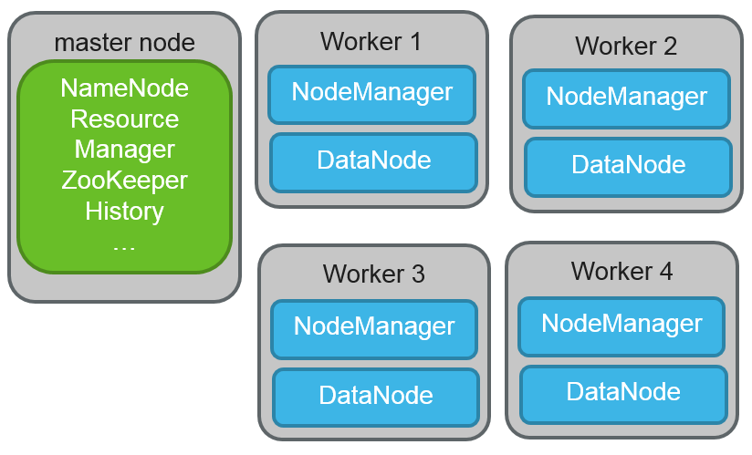
Hadoop and the Data Lifecycle
Transform?
Discard
results
data
Replicate?
Ingest and Examine
data
data
Cloud Storage
Archive
Storage Tier?
Length of Time?
Tier 1 1 year
Tier 2 3 years
Tier 3 7 years
HDFS Tier 2
HDFS Tier 1
90 Days
Until Deleted
Notes:
INSTRUCTOR NOTE: THE POINT OF THIS SLIDE IS TO ILLUSTRATE ALL THAT HDP CAN DO IN THE BACKGROUND TO SUPPORT DATA LIFECYCLE – SPARK CAN RUN ON TOP OF THIS, TAKING ADVANTAGE BOTH OF SCALE AND DATA MANAGEMENT VIA HDP… HDP is complex, but necessary, etc.
Why does HDP need so many frameworks? Let’s take a look at a simple data lifecycle example.
We start with some raw data and an HDP cluster. The first step in managing the data is to get it into the HDP cluster. We must have some mechanism to ingest that data – perhaps Sqoop, Flume, Spark Streaming, or Storm - and then another mechanism to analyze and decide what to do with it next. Does this data require some kind of transformation in order to be used? If so, ETL processes must be run, and those results generated into another file. Quite often, this is not a single step, but multiple steps configured into a data application pipeline.
The next decision comes with regards to whether to keep or discard the data. Not all data must be kept, either because it has no value (empty files, for example), or it is not necessary to keep once it has been processed and transformed. Thus some raw data can simply be deleted.
Data that must be kept requires additional decisions to be made. For example, where will the data be stored, and for how long? Your Hadoop cluster might have multiple tiers of HDFS storage available, perhaps separated via some kind of node label mechanism. In the example, we have two HDFS storage tiers. Any data that is copied to tier 2 should be stored for 90 days. We have another, higher tier of HDFS Storage, and any data stored here should be kept until it is manually deleted.
You may decide that some data should be archived rather than made immediately available via HDFS, and you can might multiple tiers of archives as well. In our example we have three tiers of archival storage, and data is kept for one, three, and seven years depending on where it is stored.
A third location where and data might end up is on some kind of cloud storage, such as AWS or Microsoft Azure.
Both raw data and transformed data might be kept anywhere in this storage infrastructure as result of having been input and processed by this HDP cluster. In addition, you may be working in a multi-cluster environment, in which case an additional decision is required. What data needs to be replicated between the clusters? If files need to be replicated to another HDP cluster, then once that cluster ingests in examines that data, this same kind of processes and decision mechanisms need to be employed. Perhaps additional transformation is required. Perhaps some files can be examined and deleted. For files that are to be kept, their location and length of time to retain must be decided, just as on the first cluster.
This is a relatively simple example of the kind of data lifecycle decisions that need to be made in an environment where the capabilities of HDP are being fully utilized. This can get significantly more complex with the addition of additional storage tiers, retention requirements, and geographically dispersed HDP clusters which must replicate data between each other, and perhaps the central global cluster designed to do all final processing.

Slide 16
Pre-Lab: Setting Up the Lab Environment
Notes:
Make sure your lab environment is accessible and functional.

Slide 17
HDFS Overview

Slide 18
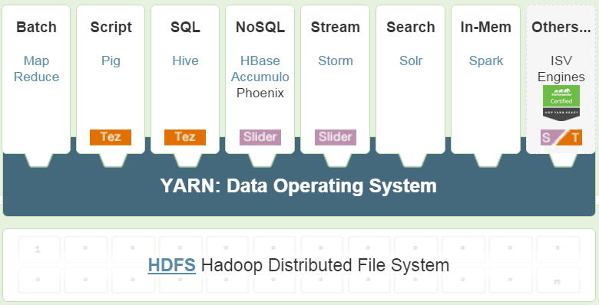
HDFS and YARN are the Core of Hadoop
Notes:
The Hadoop Distributed File System (HDFS) and YARN (Yet Another Resource Negotiator) are part of the core of Hadoop and are installed when you install the Hortonworks Data Platform. In this section we will focus on HDFS, the distributed file system for HDP.

Slide 19
HDFS – The Hadoop File System
Hadoop stores files using the Hadoop distributed file system (HDFS).
HDFS is the basis for Hadoop’s storage scalability and availability. HDFS:
Splits large data files into smaller chunks called blocks
Spreads those blocks across different slave/worker nodes
Tracks data block location
Automatically replicates data for high availability
Scaling storage is easy – simply add more nodes!
Notes:
HDFS is the basis for Hadoop’s storage scalability and availability.
HDFS achieves scalability by taking large files and splitting them, by default, into 128 megabyte chunks called blocks. This block size is configurable. The file blocks are spread across the slave nodes in the cluster. For example, if a file is split into 10 blocks and you have 10 slave servers, all 10 blocks can be read in parallel. To achieve greater scalability for larger files, just add more slave nodes to the cluster.
HDFS achieves availability by automatically replicating each block of a file. By default, HDFS maintains three copies of the data, and ensures that those copies are not on the same slave nodes, or even the same server rack if the cluster is configured correctly. As as example, if a file is split into 10 blocks then the cluster would actually maintain 30 blocks.
A Hadoop cluster scales computation capacity, storage capacity, and I/O bandwidth by adding more slave nodes. HDFS scales by adding more machines with local disks, making NAS and SAN storage unnecessary for HDP environments.

Slide 20
HDFS Command Line Interaction
hdfs dfs –command [args]
-cat: display file content (uncompressed)
-text: just like -cat but works on compressed files
-mkdir: create a directory in HDFS
-put, -get, -mv: copies files between local file system and HDFS, as well as move within HDFS.
-ls, -rm: list and remove files/directories (add -R to make commands recursive)
-chgrp, -chmod, -chown: changes file permissions
-stat: statistical info for a given file
Notes:
Developers can interact with HDFS directly via the command line using the hdfs dfs command and appropriate arguments. If a developer has previous Linux command line experience, the hdfs dfs commands will be familiar and intuitive to use. The most common use for command line usage is manual data ingestion and file manipulation. Example commands include:
-cat: display file content (uncompressed)
-text: just like cat but works on compressed files
-mkdir: create a directory in HDFS
-put,-get: copies files from the local file system to the HDFS and vice versa.
-mv: moves files
-ls, -rm: list and remove files/directories (adding -R makes listing/removal recursive)
-chgrp,-chmod,-chown: changes file permissions
-stat: statistical info for any given file (block size, number of blocks, file type, etc.)
Additional information can be obtained by hdfs dfs at the command line with no arguments or options, or by viewing online documentation.

Slide 21
HDFS Commands and Permissions
hdfs dfs -mkdir mydata
hdfs dfs -put numbers.txt mydata/
hdfs dfs -ls mydata
HDFS implements a POSIX-style permissions model
User, group, and other rwx permissions for files and directories
Files: r = read, w = write or append
Directories: r = list contents, w = create or delete files or subdirectories, x = access a child object
Notes:
The sequence of command below creates a directory, copies a file from the local file system to the new directory in HDFS, and then lists the contents of the directory:
hdfs dfs -mkdir mydata
hdfs dfs -put numbers.txt mydata/
hdfs dfs -ls mydata
HDFS implements a permissions model for files and directories that shares much of the POSIX model:
Each file and directory is associated with an owner and a group. The file or directory has separate permissions for the user that is the owner, for other users that are members of the group, and for all other users.
For files, the r permission is required to read the file and the w permission is required to write or append to the file.
For directories, the r permission is required to list the contents of the directory, the w permission is required to create or delete files or directories, and the x permission is required to access a child of the directory .

Slide 22
Lab: Using HDFS Commands
Notes:
Use HDFS to create and manipulate files and directories from the command line.

Slide 23
YARN Overview

Slide 24
Hadoop Applications Without YARN
Hive Cluster
Streaming Cluster
Spark Cluster
HDFS 1
HDFS 2
HDFS 3
Data A
Data A
Data A
Notes:
Why is YARN so important to Spark? Let's take a look at a sample enterprise Hadoop deployment. Without a central resource manager to ensure good behavior between applications, it is necessary to create specialized, separate clusters to support multiple applications. This, in turn, means that when you want to do something different with the data that application was using, it is necessary to copy that data between clusters. This introduces inefficiencies in terms of network, CPU, memory, storage, general datacenter management, and data integrity across Hadoop applications.
YARN as a resource manager mitigates this issue by allowing different types of applications to access the same underlying resources pooled into a single data lake. Since Spark runs on YARN, it can join other Hadoop applications on the same cluster, enabling data and resource sharing at enterprise scale.

Slide 25
YARN – the HDP Operating System
Apache Hadoop YARN is the data operating system for Hadoop 2.
YARN is:
Responsible for scheduling tasks and managing CPU and memory resources
Designed to enable multiple distributed applications to utilize cluster resources in a shared, secure, and multi-tenant manner
Notes:
YARN (unofficially "Yet Another Resource Negotiator") is the computing framework for Hadoop. If you think about HDFS as the cluster file system for Hadoop, YARN would be the cluster operating system. It is the architectural center of Hadoop.
A computer operating system, such as Windows or Linux, manages access to resources, such as CPU, memory, and disk, for installed applications. In similar fashion, YARN provides a managed framework that allows for multiple types of applications – batch, interactive, online, streaming, and so on – to execute on data across your entire cluster. Just like a computer operating system manages both resource allocation (which application gets access to CPU, memory, and disk now, and which one has to wait if contention exists?) and security (does the current user have permission to perform the requested action?), YARN manages resource allocation for the various types of data processing workloads, prioritizes and schedules jobs, and enables authentication and multitenancy.

Slide 26
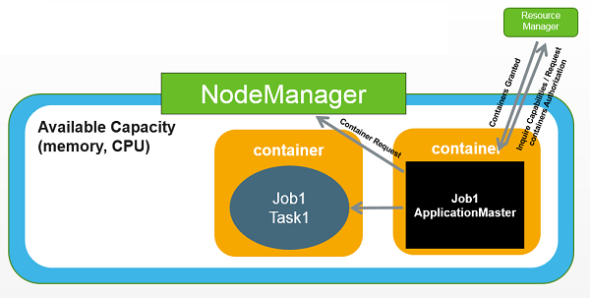
YARN Resource Containers
A resource container:
Is the abstraction used to represent a discreet amount of CPU and memory resources on a machine
Hadoop applications run inside containers.
Is managed and scheduled by YARN
Is logically isolated from other containers running on the same machine
Isolation supports application multi-tenancy.
Is allocated in different sizes based on application-defined resource requests
Notes:
To understand the YARN architecture, it helps to understand YARN resource containers.
Every slave node in a cluster is comprised of resources such as CPU and memory. The abstract notion of a resource container is used to represent a discreet amount of these resources. Cluster applications run inside one or more containers.
Containers are managed and scheduled by YARN.
A container’s resources are logically isolated from other containers running on the same machine. This isolation provides strong application multi-tenancy support.
Applications are allocated different sized containers based on application-defined resource requests, but always within the constraints configured by the Hadoop administrator.

Slide 27
Knowledge Check

Slide 28
Questions
Name the three V’s of Big Data.
Name four of the six types of data commonly found in Hadoop.
Why is HDP comprised of so many different frameworks?
What two frameworks make up the core of HDP?
What is the base command-line interface command for manipulating files and directories in HDFS?
YARN allocates resources to applications via _____________________.
Notes:
Volume, Velocity, and Variety
Sentiment, clickstream, sensor/machine, server, geographic, and text
To allow for end-to-end management of the data lifecycle
HDFS and YARN
hdfs dfs
containers

Slide 29
Summary

Slide 30
Summary
Data is made "Big" Data by ever-increasing Volume, Velocity, and Variety
Hadoop is often used to handle sentiment, clickstream, sensor/machine, server, geographic, and text data
HDP is comprised of an enterprise-ready and supported collection of open source Hadoop frameworks designed to allow for end-to-end data lifecycle management
The core frameworks in HDP are HDFS and YARN
HDFS serves as the distributed file system for HDP
The hdfs dfs command can be used to create and manipulate files and directories
YARN serves as the operating system and architectural center of HDP, allocating resources to a wide variety of applications via containers
Notes:
This summary page lists some of the main points from this lesson.

Slide 31
Overview of Zeppelin and Spark
Notes:
Start from here

Slide 32
Objectives
Use Apache Zeppelin to work with Spark
Describe the purpose and benefits of Spark
Define Spark REPLs and application architecture
Notes:
By the end of this lesson, the student should be able to:
Use Apache Zeppelin to work with Spark
Describe the purpose and benefits of Spark
Define Spark REPLs and application architecture

Slide 33
Zeppelin Overview

Slide 34
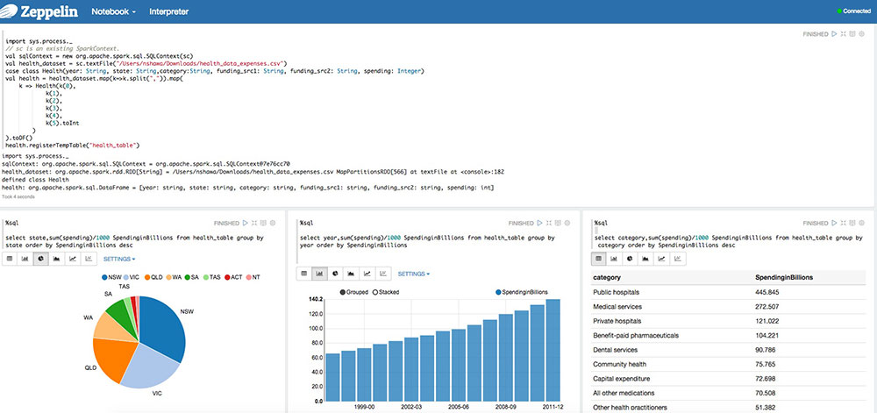
Introducing Zeppelin
Apache Zeppelin is a web-based notebook that enables interactive data analytics on top of Spark
In second Tech Preview as of HDP 2.4
Multi-language support
Python, Scala, Hive, SparkSQL, shell, markdown, etc.
Allows for data visualization, report generation, and collaboration
Notes:
Apache Zeppelin is a web-based notebook that enables interactive data analytics on top of Spark. Zeppelin is in its second Technical Preview as of HDP 2.4. It supports a growing list of programming languages, such as Python, Scala, Hive, SparkSQL, shell, and markdown. It allows for data visualization, report generation, and collaboration.

Slide 35
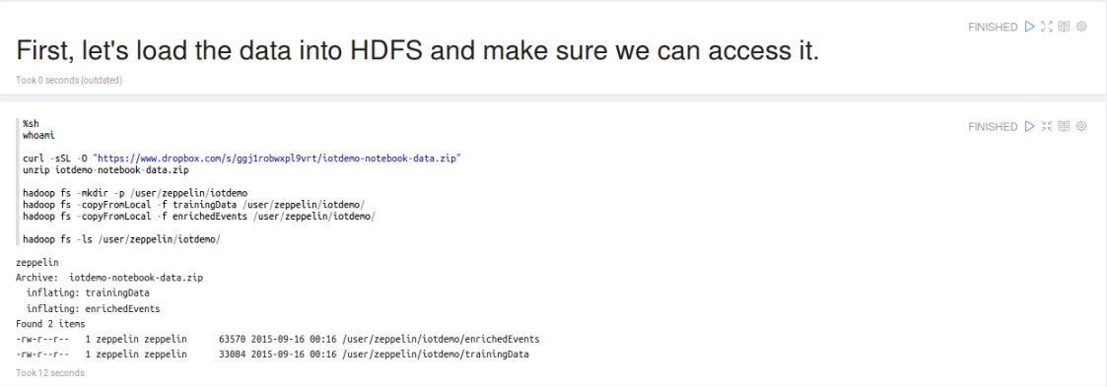
Zeppelin Major Functions
Data Ingestion
Data Discovery
Data Analytics
Data Visualization and Collaboration
Notes:
Zeppelin has four major functions: data ingestion, discovery, analytics, and visualization. It comes with built-in examples that demonstrate these capabilities. These examples can be reused and modified for real-world scenarios.

Slide 36
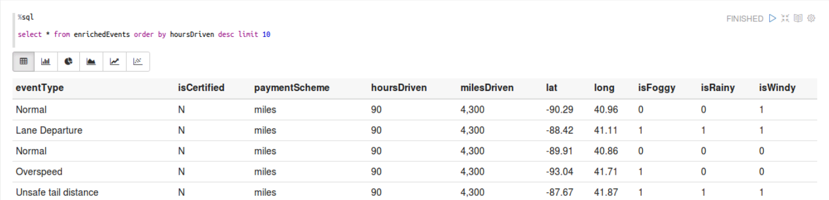
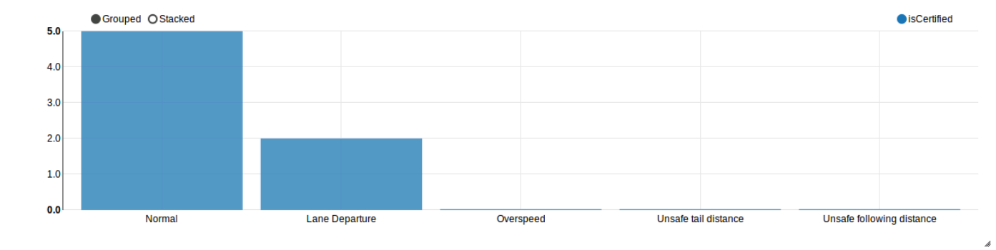
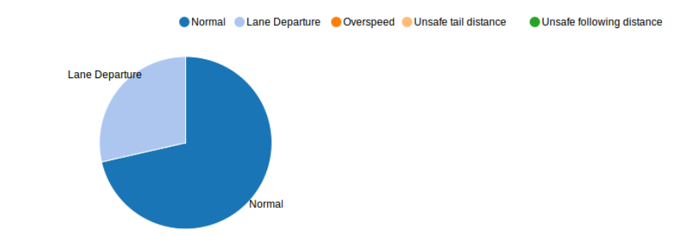
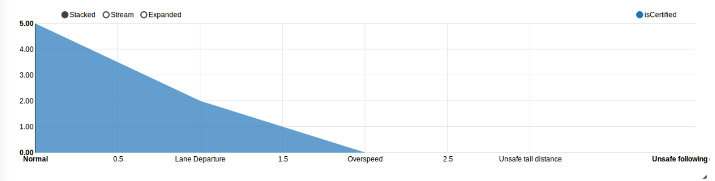
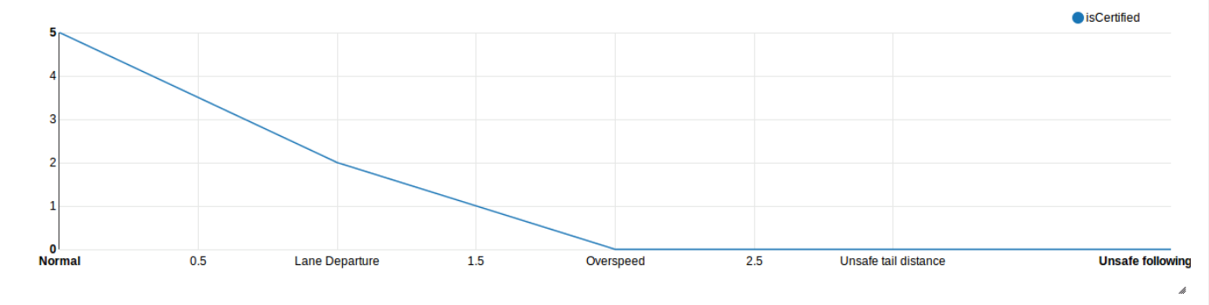
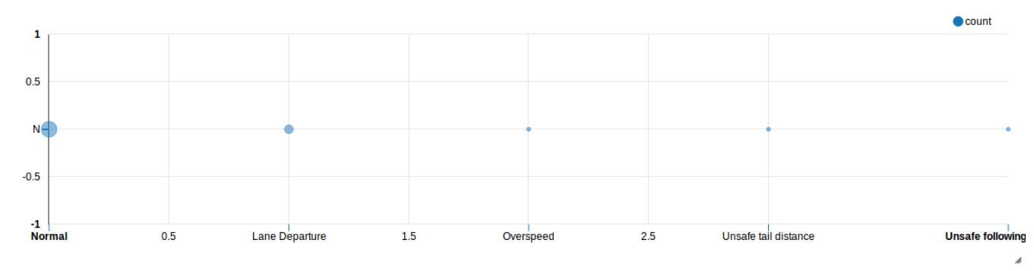
Data Visualization
Several built-in ways to interactively view / visualize data
Table
Column
Pie
Area
Line
Scatter
Notes:
Zeppelin comes with several built-in ways to interactively view and visualize data including:
Table view
Column charts
Pie charts
Area charts
Line charts, and
Scatter plot charts

Slide 37
What Does "Tech Preview" Mean?
Tech Preview status means a technology is not yet fully recommended for use in production environments
Why Zeppelin is used in this course:
The issues that keep it in tech preview do not affect learning - *nearly* all labs could be run in either command line or Zeppelin with identical steps
Zeppelin for data visualization and collaboration is currently the best solution in HDP - even in tech preview - for multi-language support (Python, Scala, etc.)
When Zeppelin comes out of tech preview (may already be true by the time you take this course), you will already have significant hands-on experience
Notes:
As mentioned earlier, Zeppelin is in "tech preview" as of HDP 2.4, but what does that mean? At the time of this writing, Zeppelin is currently not recommended in production environments.
As a general rule, Hortonworks University courses avoid the inclusion of technologies that are in tech preview, however in this case an exception was made based on the following reasons:
The issues that keep Zeppelin in tech preview do not affect learning. *Nearly* all of the labs in this class could be run either from the command line or Zeppelin with identical steps.
Despite its tech preview status, Zeppelin is the best solution available today in HDP for key functionalities such as data visualization and collaboration supporting multiple languages (for example, both Python and Scala.)
When Zeppelin comes out of tech preview - which will likely happen prior to this course being revved, and depending on when you're reading this, may have already happened - by using it now you will already have significant hands-on experience.

Slide 38
Spark Overview

Slide 39
Spark Introduction
Large-scale, cluster-based, in-memory data processing platform
Development APIs for Scala, Java, Python, and R
Supports SQL-like operations, streaming, and machine learning
Runs on YARN, providing access to shared datasets across various HDP applications
Notes:
Spark is a platform that allows for large-scale, cluster-based, in-memory data processing. It enables fast, large-scale data engineering and analytics for iterative and performance-sensitive applications. It offers development APIs for Scala, Java, Python, and R. In addition, Spark has been extended to support SQL-like operations, streaming, and machine learning as well.

Slide 40
Spark RDDs – Scalability and Performance
Leverages HDP's horizontal scalability
Fault-tolerant collection of data elements.
Enables parallel processing across the cluster
on-disk RDD
in-memory RDD
RAM
RAM
RAM
RAM
Notes:
To leverage Hadoop’s horizontal scalability, Spark processes data in a Resilient Distributed Dataset, called an RDD. An RDD is a fault-tolerant collection of data elements. An RDD is created by starting with a file on disk, or a collection of data in memory in a driver program. Each RDD is distributed across multiple nodes in a cluster. This enables parallel processing across the nodes.
Allowing RDDs to reside and be processed in memory dramatically increases performance especially when a dataset needs to be manipulated through multiple stages of processing. The data in an RDD can be transformed and analyzed very rapidly.

Slide 41
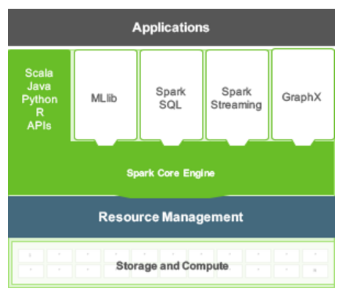
Spark High-Level Tools
The Spark Core Engine supports four high-level tools to build applications that are part of the Spark project:
Spark SQL
Spark Streaming
MLlib
GraphX
Spark also integrates with other Hadoop platforms to extend and enhance its capabilities - for example:
Hive
Zeppelin
Notes:
Coming from the Spark project, Spark Core supports a set of four high-level tools that support SQL-like queries, streaming data applications, a machine learning library (Mlib), and graph algorithms (GraphX). In addition, Spark also integrates with a number of other HDP tools, such as Hive for SQL-like operations and Zeppelin for graphing / data visualization.

Slide 42
Spark and HDP
HDP 2.4.0 – Spark 1.6.0
HDP 2.3.4 – Spark 1.5.2
HDP 2.3.2 – Spark 1.4.1
HDP 2.2.8 – Spark 1.3.1
HDP 2.2.4 – Spark 1.2.1
For this class we will use Spark 1.6 on HDP 2.4.
Notes:
The following Spark versions align with various HDP versions:
HDP 2.4.0 – Spark 1.6.0
HDP 2.3.5 – Spark 1.5.2
HDP 2.3.2 – Spark 1.4.1
HDP 2.2.8 – Spark 1.3.1
HDP 2.2.4 – Spark 1.2.1
For the labs in this class, we use Spark 1.6.0 on HDP 2.4.0.

Slide 43
Spark REPLs and Application Architecture

Slide 44
REPL Spark Shells
The Spark Shell provides an interactive way to learn Spark, explore data, and debug applications
Available for Python and Scala
$ pyspark
$ spark-shell
REPL
Read Evaluate Print Loop
Notes:
REPL stands for “Read, Evaluate, Print, Loop.” REPLs take a single user input, evaluates it, and returns the result. There are two REPLs available in Spark – one for Python and one for Scala. These are also sometimes referred to as “Spark shell” applications.
In addition to helping one learn Spark, the shells are great for debugging and exploring data. They can also be used for building applications.
In order to start the Python shell, the user needs to enter "pyspark" on the command line. In order to start the Scala shell, the user needs to enter "spark-shell" on the command line.

Slide 45
Enterprise Spark Application Components in HDP
HDP Cluster
Driver
SparkContext
YARN
HDFS
Executors
YARN Resource Manager
Executor
Executor
Executor
Client Machine or HDP Container
Executor
Driver
Executor
Executor
SparkContext
HDFS Storage
Notes:
There are 5 core components of an enterprise Spark application in HDP. They are the driver, SparkContext, the YARN resource manager, the HDFS cluster file system, and executors.
When using a REPL, the driver and SparkContext will run on a client machine. When deploying an application as a cluster application, the driver and SparkContext can also run in a YARN container. In both cases, Spark executors run in YARN containers on the cluster.

Slide 46
Spark Driver
Contains the main() function
Spark REPLs are Spark driver programs
Creates SparkContext and uses it to access Spark
Manages writing and displaying log files
Single point of failure when running YARN client (as opposed to cluster) applications
Driver
Notes:
The Spark driver contains the main() Spark program that manages the overall execution of a Spark application. It is a JVM that creates the SparkContext which then communicates directly with Spark. It is also responsible for writing/displaying the logs that the SparkContext gathers from executors.
The Spark shell REPLs are examples of Spark driver programs.
IMPORTANT: The Spark driver is a single point of failure for a YARN client application. If the driver fails, the application will fail. This is mitigated when deploying applications using YARN cluster.

Slide 47
SparkContext
Manages the connection to Spark
Contacts YARN ResourceManager to launch Spark executors
Schedules tasks for Spark executors
Automatically created as sc by a REPL at startup
Import org.apache.spark.SparkContext
Import org.apache.spark.SparkConnf
val conf = new SparkConf()
val sc = new SparkContext(conf)
Driver
SparkContext
Notes:
For any application to become a Spark application, an instance of the SparkContext class must be instantiated. The SparkContext contains all the code and objects required to process the data in the cluster, and works with the YARN ResourceManager to get the requested resources for the application. It is also responsible for scheduling tasks for Spark executors. The SparkContext checks in with the executors to report work being done and provide log updates.
A SparkContext is automatically created as sc in REPL applications. The following code is executed at start up:
from pyspark import SparkContext, SparkConf conf = SparkConf() conf = SparkConf() sc = SparkContext(conf=conf)
------------------Scala equivalent--------------------
Import org.apache.spark.SparkContext
Import org.apache.spark.SparkConnf
conf = new SparkConf()
sc = new SparkContext(conf)

Slide 48
Spark Executors
Responsible for all application workload processing
The "workers" of a Spark application, with SparkContext serving as the "master"
Exist for the life of the application
Interchangeable workspaces
Tasks assigned to a lost executor will be reassigned
Data lost will be recomputed on another executor
Behavior and performance can be controlled programmatically
HDP Cluster
Executor
Executor
Executor
Executor
Executor
Executor
Notes:
The Spark executor is the component that does performs the map and reduce tasks of a Spark application, and is sometimes referred to as a Spark “worker.” Once created, executors exist for the life of the application.
Note: In the context of Spark, the SparkContext is the "master" and executors are the "workers." However, in the context of HDP in general, you also have "master" nodes and "worker" nodes. Both uses of the term worker are correct - in terms of HDP, the worker (node) can run one or more Spark workers (executors). When in doubt, make sure to verify whether the worker being described is an HDP node or a Spark executor running on an HDP node.
Spark executors function as interchangeable work spaces for Spark application processing. If an executor is lost while an application is running, all tasks assigned to it will be reassigned to another executor. In addition, any data lost will be recomputed on another executor.
Executor behavior can be controlled programmatically. Configuring the number of executors and their resources available can greatly increase performance of an application when done correctly.

Slide 49
Lab: Introduction to Spark REPLs and Zeppelin

Slide 50
Knowledge Check

Slide 51
Questions
Name the tool in HDP that allows for interactive data analytics, data visualization, and collaboration with Spark.
What programming languages does Spark currently support?
What is the primary benefit of running Spark on YARN?
Name the five components of an enterprise Spark application running in HDP.
Which component of a Spark application is responsible for application workload processing?
Notes:
Zeppelin
Scala, Java, Python, and R
Access to datasets shared across the cluster with other HDP applications
Driver, SparkContext, YARN, HDFS, and executors.
Executor

Slide 52
Summary

Slide 53
Summary
Zeppelin is a web-based notebook that supports multiple programming languages and allows for data engineering, analytics, visualization, and collaboration using Spark
Spark is a large-scale, cluster-based, in-memory data processing platform that supports parallelized operations on enterprise-scale datasets
Spark provides REPLs for rapid, interactive application development and testing
The five components of an enterprise Spark application running on HDP are:
Driver
SparkContext
YARN
HDFS
Executors
Notes:
This summary page lists some of the main points from this lesson.

Slide 54
Working with RDDs
Notes:
Start from here

Slide 55
Objectives
Explain the purpose and function of RDDs
Explain Spark programming basics
Define and use basic Spark transformations
Define and use basic Spark actions
Invoke functions for multiple RDDs, create named functions, and use numeric operations
Notes:
By the end of this lesson, the student should be able to:
Explain the purpose and function of RDDs
Explain Spark programming basics
Define and use basic Spark transformations
Define and use basic Spark actions
Invoke functions for multiple RDDs, create named functions, and use numeric operations

Slide 56
Introduction to RDDs

Slide 57
Resilient Distributed Datasets (RDDs)
Distributed collection of immutable elements
Dataset divided into partitions, which allows for parallel operation
Node selection for RDD partitions is aligned with HDFS blocks to maximize parallelism and Hadoop infrastructure benefits
If individual partition is lost, will be recreated on another node
Notes:
The Resilient Distributed Dataset (RDD) is an immutable, distributed, and resilient collection of elements that can be operated on in parallel.
An RDD is composed of one or more partitions that can be distributed across nodes in the cluster. These partitions are immutable, meaning when changes occur, new RDDs are created rather than having those changes written to existing RDDs. They are also resilient, meaning if an RDD partition fails, it can be recreated on another node.
For HDFS files, the RDD partitions will be aligned with the file’s blocks to maximize parallelism and other HDP infrastructure benefits.

Slide 58
Create RDDs Programmatically - Simple Lists
Use sc.parallelize() to create an RDD, assigned to a local variable name, composed of lists of numbers and verify with collect()
val rddNumList = sc.parallelize(List(5, 7, 11, 14)) rddNumList.collect()
res0: Array[Int] = Array(5, 7, 11, 14) val rddTextList = sc.parallelize(List("car", "house", "garage”))
rddTextList.collect() res1: Array[String] = Array(car, house, garage)
Notes:
Users can programmatically create RDD lists of number or text values using the sc.parallelize() API. This is useful for learning Spark and distributing local collections of data to the cluster. For example: rddNumList = sc.parallelize([5, 7, 11, 14])
This creates an RDD that contains four numeric values. To confirm the RDD was created and contains the correct information, we can look at the contents using collect():
rddNumList.collect()
This returns the following output.
[5,7,11,14]
The same process works on lists of text. For example:
rddTextList = sc.parallelize(["car", "house", "garage"])
rddTextList.collect() ["car", "house", "garage"]
Python Version
------------------
rddNumList = sc.parallelize([5, 7, 11, 14]) rddNumList.collect() [5, 7, 11, 14] rddTextList = sc.parallelize(["car", "house", "garage"])
rddTextList.collect() ['car', 'house', 'garage']

Slide 59
Create RDDs Programmatically - Variables as Input
RDDs can also take variable values as input:
val maryFile = ("Mary had a little lamb") val rddMary = sc.parallelize(List(maryFile)) rddMary.collect() res2: Array[String] = Array(Mary had a little lamb)
val textList = List("car", "house", "garage“)
val rddTextList = sc.parallelize(textList)
rddTextList.collect() res3: Array[String] = Array(car, house, garage)
Notes:
RDDs can also take variable values as input. To demonstrate, we start by creating a variable named maryFile and assigning it a text string value:
maryFile = ("Mary had a little lamb")
Then we use parallelize() to turn the variable contents into an RDD, and collect() to view the results:
rddMary = sc.parallelize([maryFile])
rddMary.collect()
['Mary had a little lamb']
Note: The [ ] around the variable name prevents the variable input from being read one character at a time. If we had used ( ) instead, the collect function would have returned:
['M', 'a', 'r', 'y', ' ', 'h', 'a', 'd', . . . , 'l', 'a', 'm', 'b']
Another example, creating the list from the previous section, but this time creating the list as a variable first:
textList = (["car", "house", "garage"])
rddTextList = sc.parallelize(textList)
rddTextList.collect() ["car", "house", "garage"]
Python Version
------------------
maryFile = ("Mary had a little lamb") rddMary = sc.parallelize([maryFile]) rddMary.collect() ['Mary had a little lamb’]
textList = ["car", "house", "garage"]
rddTextList = sc.parallelize(textList)
rddTextList.collect() ['car', 'house', 'garage']

Slide 60
Create Simple RDDs From Text Files
An RDD can also be created from a text file on local, HDFS, or other locations (such as network or cloud storage) using sc.textFile()
val rddLocal = sc.textFile("file:/localPathToFile/filename.txt")
val rddHDFS = sc.textFile("hdfs://namenodename:8020/HDFSpath/filename.txt")
Multiple files can be combined as part of a single RDD using a comma-separated list or a wildcard character
val rddComma = sc.textFile("fileLocation/file1.txt,fileLocation/file2.txt")
val rddWild = sc.textFile("fileLocation/*.txt")
Notes:
Another common way to create an RDD is to load it from one or more text files using sc.textFile(). These files can be located on local storage, HDFS, or other cloud or network storage locations. For example, to create an RDD from a text file on your local drive:
rddLocal = sc.textFile("file:/localPathToFile/filename.txt")
To create an RDD from a file on HDFS:
rddHDFS = sc.textFile("hdfs://namenodename:8020/HDFSpath/filename.txt")
Multiple files can be combined as part of a single RDD using either a comma-separated list of individual files, the wildcard character, or a combination of the two. For example, to create an RDD based on three specific files:
rddComma = sc.textFile("fileLocation/file1.txt,fileLocation/file2.txt")
To create an RDD that contains all .txt files that meet wildcard requirements in a given location:
rddWild = sc.textFile("fileLocation/*.txt")
Wildcards and comma-separated lists can be combined in any configuration.

Slide 61
From Data Files to HDFS to RDD
RDD1 = DF2 + DF1
Spark Application
data file 1
Processing occurs on these three nodes
data file 2
data file 3
Example assumes blocks are replicated to other nodes in the cluster, not shown here
Node 1
Node 2
Node 3
Node 4
Node 5
RDD 1.3
RDD 1.1
RDD 1.2
HDFS
DF1.1
DF2.1
DF3.1
DF2.2
DF3.2
Notes:
In this simple example, we have a small cluster which has been loaded with three data files, and will walk through their input into HDFS, followed by having two of them used to create a single RDD, and begin to demonstrate the power of parallel datasets.
The first file in the example is small enough to fit entirely in a single 128 MB HDFS block – thus data file 1 is made up of only one HDFS block (labeled DF1.1) which is written to Node 1. This would be replicated by default to two other nodes, which we are assuming are not shown in the image.
Data files 2 and 3 take up two HDFS blocks apiece. In our example, these four data blocks are written to four different HDFS nodes. Data file 2 is represented in HDFS by DF2.1 and DF 2.2 (written to node 2 and node 4, respectively). Data file 3 is represented in HDFS by DF3.1 and DF3.2 (written to node 3 and node 5, respectively). Again, it is not shown in the image, but each of these blocks would be replicated multiple times across nodes in the cluster.
Next we write a Spark application that initially defines an RDD that is made up of a combination of the data in data files 1 and 2. In HDFS, these two files are represented by three HDFS blocks on nodes 1, 2, and 4. When the RDD partitions are created in memory, the nodes that will be used will be nodes that contain the data blocks in order to improve performance and reduce the network traffic that would result from pulling data from one node’s disk to another node’s memory.
The three data blocks that represent these two files that were combined by the Spark application are then copied into memory on their respective nodes and become the partitions of the RDD. DF2.1 is written to an RDD partition we have labeled RDD 1.1. DF2.2 is written to an RDD partition we have labeled RDD 1.2. DF1.1 is written to an RDD partition we have labeled RDD 1.3.
Thus, in our example, one RDD was created from two files (which are split across three HDFS data nodes), which exist in memory as three partitions which a Spark application can then continue to use.

Slide 62
Multiple RDDs in a Cluster
RDD1 = 4 Partitions
Node1
Node 2
Node 3
Node 4
Node 5
Node 6
Node 7
RDD 1.1
RDD 1.3
RDD 1.2
RDD 1.4
RDD 2.3
RDD 2.2
RDD 2.1
RDD2 = 3 Partitions
Notes:
This diagram shows a hypothetical cluster that has two RDD's. Each RDD is composed of multiple partitions, and the partitions are distributed across the cluster.

Slide 63
RDD Characteristics
Can contain any type of serializable element, meaning those that can be converted to and from a byte stream
Examples: int, float, bool, and sequences/iteratives like arrays, lists, tuples, and strings
Element types can be mixed - for example, an array of strings and int values.
Implicit conversion whenever possible
Non-serializable elements (for example: objects created with certain third-party JAR files or other external resource) cannot be made into RDDs
Notes:
RDDs can contain any type of serializable element, meaning those that can be converted to and from a byte stream. Examples include: xamples: int, float, bool, and sequences/iteratives like arrays, lists, tuples, and strings. Element types in an RDD can be mixed as well. For example, an array or list can contain both string and int values. Furthermore, RDD types are converted implicitly when possible, meaning there is no need to explicitly specify the type during RDD creation.
Note: Non-serializable elements (for example: objects created with certain third-party JAR files or other external resource) cannot be made into RDDs.

Slide 64
RDD Operations
Two operations can be performed on an RDD
Transformations: apply a function and create new RDD partitions based on the output
Actions: return a result of a function as output to a screen, file, etc.
Transformation
RDD1A
RDD1B
RDD
Action
Returned Result
Notes:
Once an RDD is created, there are two operations that can be performed on it: Actions and Transformations.
Transformations take an existing RDD, applies a function to the elements of the RDD, and creates a new RDD comprised of the transformed elements.
An action returns a result of a function applied to the elements of an RDD in the form of screen output, a file write, etc.

Slide 65
Spark Programming Basics

Slide 66
Introduction to Functional Programming
Spark makes heavy use of functional programming
Definition: Programming that does not rely on data outside the function being executed, nor does it modify data that exists outside the current function
Non-functional programming example:
var varValue = 0 def unfunctionalCode()= varValue += 1
Same code written functionally:
def functionalCode(varValue: Int) = varValue + 1
All Spark transformations are based on functional programming
Notes:
Spark makes heavy use of functional programming, but what does that mean? An easy way to think about functional programming is to define it as programming that does not rely on data outside of the function being executed, nor does it modify data that exists outside of the current function.
First let's take a look at an example of non-functional programming. In this function, we define a variable value outside of our function, then pull that value into our function and modify it. Note the dependence on and the writing to a variable that exists external to the function itself:
Python code
--------------
varValue = 0 def unfunctionalCode(): global varValue varValue = varValue + 1
Now let's take a look at the same basic example, but this time written using functional programming principles. In this example, the variable value is instantiated as part of calling the function itself, and only the value within the function is modified.
Python code
--------------
def functionalCode(varValue): return varValue + 1
All Spark transformations are based on functional programming.

Slide 67
Functional Programming Implications in Spark
Immutable data: RDD1A can be transformed into RDD1B, but an individual element within RDD1A cannot be independently modified
No state or side effects: No interaction with or modification of any values or properties outside of the function
Behavioral consistency: If you pass the same value into a function multiple times, you will always get the same result - changing order of evaluation does not change results
Functions as arguments: function results (including anonymous functions) can be passed as input/arguments to other functions
Lazy evaluation: function arguments are not evaluated / executed until required
Notes:
The need to operate on different partitions of the same RDD in parallel makes functional programming a requirement for Spark. Thus, Spark programming has the following characteristics:
Immutable data: RDD1A can be transformed into RDD1B, but an individual element within RDD1A cannot be independently modified.
No state or side effects: No interaction with or modification of any values or properties outside of the function.
Behavioral consistency: If you pass the same value into a function multiple times, you will always get the same result - changing order of evaluation does not change results.
Functions as arguments: function results (including anonymous functions) can be passed as input/arguments to other functions.
Lazy evaluation: function arguments are not evaluated / executed until required.

Slide 68
Anonymous (a.k.a. Lambda) Functions
Passed as an argument to another function
Element variable is defined to the left of a =>, function body defined to the right
Example using z as the anonymous function variable and z + 1 as the function body: val rddNumList = sc.parallelize(List(5, 7, 11, 14))
val rddAnon = rddNumList.map(z => z + 1) rddAnon.collect() res5: Array[Int] = Array(6, 8, 12, 15)
Spark Function
Anonymous Function Call
Anonymous Function Body / Definition
Notes:
Anonymous functions, also known as Lambda functions, are used heavily in Spark programming. They start with a declaration of the anonymous function by using the keyword lambda. Then, the programmer provides the variable name that will be used in the function body, followed by a colon. To the right of the colon will be the function body, which can be a function definition or a call to yet another function.
Here is an example using "z" as the anonymous function variable selected and applying z+1 to all elements of an RDD as an argument to the Spark map function:
rddNumList = sc.parallelize([5, 7, 11, 14]) rddAnon = rddNumList.map(lambda z: z + 1) rddAnon.collect() [6, 8, 12, 15]
Python Code
---------------
rddNumList = sc.parallelize([5, 7, 11, 14]) rddAnon = rddNumList.map(lambda z: z + 1)
rddAnon.collect()
[6, 8, 12, 15]

Slide 69
Basic Spark Transformations

Slide 70
map()
Applies a function supplied as its argument to each element of the RDD
val rddNumList = sc.parallelize([5, 7, 11, 14]) rddNumList.map(z => z + 1).collect() [6, 8, 12, 15]
Mary had a little lamb
Its fleece was white as snow
And everywhere that Mary went
The lamb was sure to go
val rddMary = sc.textFile(“fileLocation/mary.txt”)
val rddLineSplit = rddMary.map(line=> line.split(" "))
Array(Mary, had, a, little, lamb)
Array(Its, fleece, was, white, as, snow)
Array(And, everywhere, that, Mary, went)
Array(The, lamb, was, sure, to, go)
Notes:
The map transformation applies a function supplied as its argument to each element of an RDD.
In the example below, we have a list of numbers that make up our RDD. We then apply the map function and instruct Spark to run the anonymous function (using z as the variable name for each element) z+1, an immediately print the output to the screen:
rddNumList = sc.parallelize([5, 7, 11, 14]) rddNumList.map(lambda z: z + 1).collect() [6, 8, 12, 15]
Note that the second line of code in this example did not define a new RDD. If further transformations were necessary, the second line of code would need to be rewritten as follows:
rddAnon = rddNumList.map(lambda z: z + 1)
rddAnon.collect()
[6, 8, 12, 15]
Maps can apply to strings as well. Here is an example that starts by reading a file from HDFS called "mary.txt":
rddMary=sc.textFile("mary.txt")
rddLineSplit = rddMary.map(lambda line: line.split(" "))
RDDs created using the textFile method treat newline characters as characters that separate elements. Thus, since the file had four lines, the file as shown in the image would have four elements in the RDD.
A map() transformation is then called. The goal of the map transformation in this scenario is to take each element, which is a string containing multiple words, and break it up into an array that is stored in a new RDD for further processing. The split function takes a string and breaks it into arrays based on the delimiter passed into split(). The result is an RDD which still only has four elements, but now those elements are arrays rather than monolithic strings.

Slide 71
flatMap()
Similar to map(), but after a map function has been performed, takes an additional step and flattens the file
val rddLineSplit = rddMary.map(lambda line: line.split(" "))
val rddFlat = rddMary.flatmap(line => line.split(" "))
Mary
Array(Mary, had, a, little, lamb)
had
Array(Its, fleece, was, white, as, snow)
a
Array(And, everywhere, that, Mary, went)
little
Array(The, lamb, was, sure, to, go)
***
sure
to
go
Notes:
The flatMap function is similar to map, with the exception that it performs an extra step to break down (or flattens) the component parts of elements such as arrays or other sequences into individual elements after running a map function.
As we saw previously, map is a one to one transformation: one element comes in, one element comes out. Using map(), four line elements were converted into four array elements, but we still started and ended with the same number of elements. The flatMap function, on the other hand, is a one to possibly many transformation: one element may go in, but many can come out.
Let's compare using the previous map() illustration.
rddLineSplit = rddMary.map(lambda line: line.split(" "))
If we run the exact same code, only replace map() with flatMap(), the output is returned as a single list of individual elements rather than four lists of elements that were originally separated by the line break.
rddFlat = rddMary.flatmap(lambda line: line.split(" "))
This time, the results are each word being treated as its own element, resulting in 22 elements instead of 4. Again, it is easiest to think about flatMap() as simply a map operation followed by a flatten operation, in a single step.

Slide 72
filter()
Keeps elements that meet a defined criteria
If the element meets that criteria, it is passed on to the new RDD
If not, the element is discarded
val rddNumList = sc.parallelize(List(5, 7, 11, 14))
rddNumList.filter(number => number <= 10).collect()
Array(5, 7)
val months = List("January", "March", "May", "July", "September“)
val rddMonths = sc.parallelize(months)
rddMonths.filter(name => name.length > 5).collect()
Array(January, September)
Notes:
The filter function is used to remove elements from an RDD that don't pass a certain criteria, or put another way, only keeps elements in an RDD based on a predicate. If the predicate returns true (the filter criteria are met), the record is passed on to the transformed RDD.
In the example below, we have an RDD composed of four elements and want filter out any element whose value is greater than 10 (or in other words, keep any value 10 or less). Note that the initial RDD is being created by using the sc.parallelize API:
rddNumList = sc.parallelize([5, 7, 11, 14])
rddNumList.filter(lambda number: number <= 10).collect()
[5, 7]
This could have been performed using any standard mathematical operation.
Filter is not limited to working with numbers. It can work with strings as well. Let's use an example RDD consisting of the list of months below:
months = ["January", "March", "May", "July", "September"]
rddMonths = sc.parallelize(months)
We then use filter, with an anonymous function that uses the len function to count the number of characters in each element, and then filter out any that contain five or fewer characters.
rddMonths.filter(lambda name: len(name) > 5).collect()
['January', 'September']
Again, any available function that performs evaluations on text strings or arrays could be used to filter for a given result.

Slide 73
distinct()
val rddBigList = sc.parallelize(List(5, 7, 11, 14, 2, 4, 5, 14, 21))
rddBigList.collect()
Array(5, 7, 11, 14, 2, 4, 5, 14, 21)
val rddDistinct = rddBigList.distinct()
rddDistinct.collect()
Array(4, 5, 21, 2, 14, 11, 7)
Notes:
The distinct function removes duplicate elements from an RDD. Consider the following RDD:
rddBigList = sc.parallelize([5, 7, 11, 14, 2, 4, 5, 14, 21])
rddBigList.collect()
[5, 7, 11, 14, 2, 4, 5, 14, 21]
Notice that the numbers 5 and 14 are listed twice. If we just wanted to see each element only listed one time in our output, we could use distinct() as follows:
rddDistinct = rddBigList.distinct()
rddDistinct.collect()
[4, 5, 21, 2, 14, 11, 7]
Note that 5 and 14 only appear once in the results.

Slide 74
Basic Spark Actions

Slide 75
collect(), first(), and take()
collect() returns an entire RDD
first() returns only the first element in an RDD
take() returns a specified number of elements in an RDD
val rddNumList = sc.parallelize(List(5, 7, 11, 14))
rddNumList.collect() Array(5, 7, 11, 14)
rddNumList.first() 5
rddNumList.take(2) Array(5, 7)
Notes:
As we have already seen, the collect function returns the entire RDD on which it is run against. In addition, the first function returns just the first element in an RDD. The take function allows for the specification of a number of elements, and returns that number of elements when executed. Below are some examples of these functions in action:
rddNumList = sc.parallelize([5, 7, 11, 14])
rddNumList.collect() [5, 7, 11, 14]
rddNumList.first() 5
rddNumList.take(2) [5, 7]

Slide 76
count()
Returns the number of elements in an RDD
val rddNumList = sc.parallelize(List(5, 7, 11, 14))
rddNumList.count() 4
val rddMary = sc.textFile("mary.txt") rddMary.count() 4
Mary had a little lamb
Its fleece was white as snow
And everywhere that Mary went
The lamb was sure to go
Notes:
Count returns the number of elements in the RDD. Here is an example:
rddNumList = sc.parallelize([5, 7, 11, 14])
rddNumList.count() 4
In the case of a file that contains lines of text, count() would return the number of lines in the RDD, as in the following example:
rddMary=sc.textFile("mary.txt") rddMary.count() 4

Slide 77
reduce()
Aggregates the elements of an RDD using a function that takes two arguments and returns one
Iterates through specified RDD values until only a single value remains
val rddNumList = sc.parallelize(List(5, 7, 11, 14))
rddNumList.reduce((a,b) => a+b) ... 37
Function should be commutative and associative
Neither the order that the operations are performed in nor the way values are grouped should affect the result
Notes:
The reduce function aggregates the elements of an RDD using a function that takes two arguments and returns one, iterating through them until only a single value remains. For example:
rddNumList = sc.parallelize([5, 7, 11, 14])
rddNumList.reduce(lambda a,b: a+b) ... 37
Because of the parallelized nature of RDDs, the reduce function does not necessarily process RDD elements in a particular order. Therefore, the function used with reduce() should be both commutative and associative.
Commutative means "to move around" - which implies that the order things are done in should not matter. For example, 5+7 = 7+5, or 5*7 = 7*5. A function that is not commutative can return different results each time it is run. For example, 5 / 7 does not equal 7 / 5, so a function that employed division would not be commutative.
Associative refers to the way numbers are grouped using parenthesis. For example, 5 + (7 + 5) equals (5 + 7) + 5, or 5 * (7 * 5) = (5 * 7) * 5. A function that is not associative can return different results each time it is run. For example 5 * (7 + 5) does not equal (5 * 7) + 5., so a function that used values in grouping patterns like this would not be associative.

Slide 78
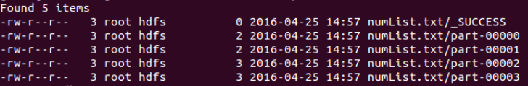
saveAsTextFile()
Writes the contents of RDD partitions as a set of text files to a specified location (hdfs://, file:/, etc.) and directory
rddBigList.saveAsTextFile("hdfs://desiredLocation/foldername")
In this example, can verify the file was successfully written from the command line
$ hdfs dfs -ls desiredLocation/foldername
Notes:
The saveAsTextFile function writes the contents of RDD partitions to a specified location (such as hdfs:// for HDFS, file:/ for local file system, and so forth) and directory as a set of text files. For example:
rddNumList.saveAsTextFile("hdfs://desiredLocation/foldername")
The contents of the RDD in the example would be written to a specific directory in HDFS.
Success can be verified using typical tools from a command line or GUI. In the case of our example, we could use the hdfs dfs -ls command to verify it had written successfully:
$ hdfs dfs -ls desiredLocation/foldername
The output would like like the screenshot shown, with each RDD partition being written to a different text file by default. The files could be copied to the local file system and then be read using a standard text editor / viewer such as nano, more, vi, etc.

Slide 79
Transformations vs. Actions: Lazy Evaluation
Transformations are lazy - they do not compute until an action is performed
val rddMary = sc.textFile("mary.txt")
val rddFlat = rddMary.flatmap(line => line.split(" "))
val rddFilter = rddFlat.filter(words => words.length > 4)
rddFilter.count()
Series of transformations is
built and tracked by the
Spark driver
Action triggers execution
of the series of transformations
Notes:
Transformations are lazy, meaning they do not actually perform any computations until an action is performed. Lazy Evaluation prevents the processing of unneeded data. When a transformation alone is applied to an RDD, initially nothing happens. The RDD just keeps track of all the transformations applied and will execute them when its necessary.
Let’s look at an example:
rddMary = sc.textFile("mary.txt")
rddFlat = rddMary.flatmap(lambda line: line.split(" "))
rddFilter = rddFlat.filter(lambda words: len(words) > 4)
rddFilter.count()
In the above code, two transformations were applied (flatMap and filter), but it was not until the count action is called that the RDD runs through the various transformations.

Slide 80
Lazy Evaluation Visualized
Mary had a little lamb
Its fleece was white as snow
And everywhere that Mary went
The lamb was sure to go
Mary had a little lamb
Its fleece was white as snow
And everywhere that Mary went
The lamb was sure to go
Execute an action and data goes through the transformations
flatMap()
Mary
had
a
little
lamb
filter()
***
little
Mary
fleece
went
white
count = 4
The
everywhere
lamb
was
sure
to
go
Notes:
Here is picture of what is happening behind the scenes when building transformations, prior to executing actions. As the visual indicates, when performing transformations on an RDD, it just saves the recipe of what it is supposed to do when needed.
Only at the end, when an action is called, will the data be pushed through the recipe to create the desired outcome.

Slide 81
RDD Special Topics - Multiple RDDs - Named Functions - Numeric Operations

Slide 82
Multiple RDDs: union() and intersection()
val rddNumList = sc.parallelize(List(5, 7, 11, 14))
val rddNumList2 = sc.parallelize(List(2, 4, 5, 14, 21))
val rddCombined = rddNumList.union(rddNumList2)
rddCombined.collect()
[5, 7, 11, 14, 2, 4, 5, 14, 21]
val rddInter = rddNumList.intersection(rddNumList2)
rddInter.collect()
Array(5, 14)
Notes:
To combine two RDDs, use the union function. This transformation is applied to an RDD and takes a second RDD as an argument, resulting in a third RDD that represents a combination of the two. For example, take the following two RDDs:
rddNumList = sc.parallelize([5, 7, 11, 14])
rddNumList2 = sc.parallelize([2, 4, 5, 14, 21])
Let's say we want to create a single RDD that is made up of the contents of the first RDD followed by the contents of the second RDD. The union function would accomplish this with the following code:
rddCombined = rddNumList.union(rddNumList2)
We can then use collect() to view our new RDD:
rddCombined.collect()
[5, 7, 11, 14, 2, 4, 5, 14, 21]
In other cases, an intersection is desired, a transformation in which only the values that exist in both RDDs make it into the output. You can create such an RDD and verify it worked using the following code:
rddInter = rddNumList.intersection(rddNumList2)
rddInter.collect()
[5, 14]
Note: If there was no need to use the union or intersected RDDs for future purposes, the results above could have been obtained in each case with the following single lines of code:
rddNumList.union(rddNumList2).collect()
…and…
rddNumList.intersection(rddNumList2).collect()

Slide 83
Named Functions
Functions used multiple times or those that require more than a single line of code should be explicitly defined and named
def gradeAorNot(percentage: Int) = {
if(percentage > 89)
"A"
else
“Not an A”
}
val rddGrades = sc.parallelize(List(87, 94, 41, 90))
rddGrades.map(gradeAorNot).collect()
Array('Not an A', 'A', 'Not an A', 'A’)
Notes:
Custom functions can be defined and named, then used as arguments to other functions. A custom function should be defined when the same code will be used multiple times throughout the program, or if a function to be used as an argument will take more than a single line of code, making it too complex for an anonymous function.
The following example evaluates a number to determine if is 90 or greater. If so, it returns the text string "A" and if not it returns "Not an A".
def gradeAorNot(percentage):
if percentage > 89:
return "A"
else:
return "Not an A"
Note: In the REPL, the number of tabs matter. For example, in line 2, you have to tab once before typing the line, and in line 3 you must tab twice. In line 4, you have to tab once, and line 5, twice.
The custom named function gradeAorNot can then be passed as an argument to another function - for example, map().
rddGrades = sc.parallelize([87, 94, 41, 90])
rddGrades.map(gradeAorNot).collect()
['Not an A', 'A', 'Not an A', 'A']
The named function could also be used as the function body in an anonymous function. The following example results in equivalent output to the code above:
rddGrades.map(lambda grade: gradeAorNot(grade)).collect()

Slide 84
Numeric Operations
Math and statistical functions can be performed on RDDs
mean, count, stDev, sum, stats, max, min, etc.
val rddNumList = sc.parallelize(List(5, 7, 11, 14))
rddNumList.stats()
(count: 4, mean: 9.25, stdev: 3.49…, max: 14, min: 5)
rddNumList.min()
5
Notes:
Numeric operations can be performed on RDDs, including mean, count, stDev, sum, max, and min, as well as a stats function that collects several of these values with a single function. For example:
rddNumList = sc.parallelize([5, 7, 11, 14])
rddNumList.stats()
(count: 4, mean: 9.25, stdev: 3.49…, max: 14, min: 5)
The individual functions can be called as well:
rddNumList.min()
5
Note: To double check the output of the Spark stdev() output in Excel, use Excel's stdevp function rather than the stdev function. Excel's stdev function assumes that the entire population is unknown, and thus makes adjustments to outputs based on assumed bias. The stdevp function assumes the entire dataset (the p stands for "population") is fully represented and does not make a bias correction. Thus, Excel's stdevp function is more similar to Spark's stdev function.

Slide 85
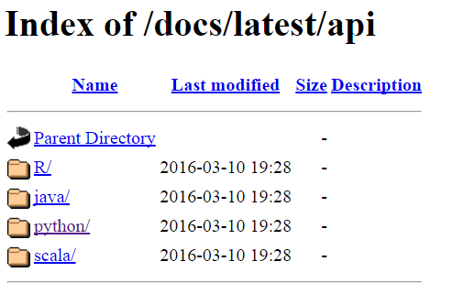
More Functions: Spark Documentation
http://spark.apache.org/docs/<version>/api/
Version options
Official version number, such as "1.4.0" or "1.6.1"
"latest" for the newest release
Notes:
There are many, many other Spark APIs available that have not yet been covered in this class. To learn more about them, you can access the Spark documentation using the links below:
http://spark.apache.org/docs/<version>/api/
Version can be and actual version number, such as "1.4.0" or "1.6.1", or alternatively you can use "latest" to view documentation on the newest release of Spark. For example:
http://spark.apache.org/docs/latest/api/
From there, simply click on the appropriate programming language to view the documentation.

Slide 86
Lab: Create and Manipulate RDDs

Slide 87
Knowledge Check

Slide 88
Questions
What does RDD stand for?
What two functions were covered in this lesson that create RDDs?
True or False: Transformations apply a function to an RDD, modifying its values
Which transformation will take take all of the words in a text object and break each of them down into a separate element in an RDD?
True or False: The count action returns the number of lines in a text document, not the number of words it contains.
What is it called when transformations are not actually executed until an action is performed?
True or False: The distinct function allows you to compare two RDDs and return only those values that exist in both of them
True or False: Lazy evaluation makes it possible to run code that "performs" hundreds of transformations without actually executing any of them
Notes:
Resilient Distributed Dataset
sc.parallelize() and sc.textfile()
False. Transformations result in new RDDs being created. In Spark, data is immutable.
flatmap()
True
Lazy evaluation
False. The intersection function performs this task. The distinct function would remove duplicates elements, so that each element is only listed once regardless of how many times it appeared in the original RDD.
True

Slide 89
Summary

Slide 90
Summary
Resilient Distributed Datasets (RDDs) are immutable collection of elements that can be operated on in parallel
Once an RDD is created, there are two things that can be done to it: transformations and actions
Spark makes heavy use of functional programming practices, including the use of anonymous functions
Common transformations include map(), flatmap(), filter(), distinct(), union(), and intersection()
Common actions include collect(), first(), take(), count(), saveAsTextFile(), and certain mathematic and statistical functions
Notes:
This summary page lists some of the main points from this lesson.

Slide 91
Pair RDDs

Slide 92
Learning Objectives
Define and create Pair RDDs
Perform common operations on Pair RDDs
Notes:
By the end of this lesson, the student should be able to:
Use Core RDD functions and create your own function
Perform common operations on Pair RDDs

Slide 93
Introduction to Pair RDDs

Slide 94
Pair RDD Introduction
A Pair RDD has elements comprised of a key-value pairs
Allows for additional key-value based functions and operations
Direct RDD interactions that can be used as an alternative to SQL-like APIs
Notes:
Key-value Pair RDDs (a.k.a. just "Pair RDDs") are made up of elements comprised of key-value pairs. By creating Pair RDDs in Spark, developers gain access to additional API functionality. This provides the developer with the capability to directly interact with RDD data in much the same way they might interact with data using Hive on Spark, Spark on Hive, or Spark SQL.

Slide 95
Create Pair RDDs: map()
Pair RDDs can be created from regular RDDs by using the map() transformation:
val rddMary = sc.textFile("filelocation/mary.txt") val rddFlat = rddMary.flatMap(line => line.split(' ')) val kvRdd = rddFlat.map(word: (word,1)) kvRdd.collect()
Mary
(Mary, 1)
had
(had, 1)
a
(a, 1)
little
map(x =>(x, 1))
(little, 1)
***
***
sure
(sure, 1)
to
(to, 1)
go
(go, 1)
Notes:
Let’s look at a simple way to create a pair RDD.
The first two lines of the example should look very familiar. We are first creating an RDD from a file called "mary.txt" and then calling a flatMap. Once each word is now its own element, key-value pairs can be created.
rdd = sc.textFile("filelocation/mary.txt")
rddFlat = rdd.flatMap(lambda line: line.split(' '))
A map transformation can be used to create the key-value pair. In this process, a function is passed to map() to create a tuple. In the example below, we create an anonymous function which returns a tuple of (word,1).
kvRdd = rddFlat.map(lambda word: (word,1))
kvRdd.collect()
The picture shows what happens when the map function is applied on the initial elements each consisting of a single word.

Slide 96
Create Pair RDDs: keyBy()
Creates key-value pairs by applying a function on each data element
Function result becomes the key, data element becomes the value in the pair
val rddTwoNumList = sc.parallelize(List((1,2,3),(7,8)))
val keyByRdd = rddTwoNumList.keyBy(t => t.productArity)
keyByRdd.collect()
[(3, (1, 2, 3)), (2, (7, 8))]
Notes:
The keyBy API creates key-value pairs by applying a function on each data element. The function result becomes the key, and the original data element becomes the value in the pair
For example:
rddTwoNumList = sc.parallelize([(1,2,3),(7,8)])
keyByRdd = rddTwoNumList.keyBy(len)
keyByRdd.collect()
[(3,(1,2,3)),(2,(7,8))]
Additional example (not shown on slide):
rddThreeWords = sc.parallelize(["cat","A","spoon"])
keyByRdd2 = rddThreeWords.keyBy(len)
keyByRdd2.collect()
[(3,'cat'),(1,'A'),(5,'spoon')]

Slide 97
Create Pair RDDs: zipWithIndex()
Creates key-value pairs by making element index (position) the value
Element becomes the key
val rddThreeWords = sc.parallelize(List(“cat”,”A”,”spoon”))
val zipWIRdd = rddThreeWords.zipWithIndex()
zipWIRdd.collect()
[('cat', 0), ('A', 1), ('spoon', 2)]
Notes:
The zipWithIndex function creates key-value pairs by assigning the index, or numerical position, of the element as the value, and the element itself as the key.
For example:
rddThreeWords = sc.parallelize(["cat","A","spoon"])
zipWIRdd = rddThreeWords.zipWithIndex()
zipWIRdd.collect()
[('cat', 0), ('A', 1), ('spoon', 2)]

Slide 98
Create Pair RDDs: zip()
Creates key-value pairs by taking elements from one RDD as the key and elements of another RDD as the value
Syntax: keyRDD.zip(valueRDD)
The two RDDs must have the same number of elements
val rddThreeWords = sc.parallelize(List("cat", "A", "spoon”))
val rddThreeNums = sc.parallelize(List(11, 241, 37))
val zipRdd = rddThreeWords.zip(rddThreeNums)
zipRdd.collect()
[('cat', 11), ('A', 241), ('spoon', 37)]
Notes:
The zip function creates key-value pairs by taking elements from one RDD as the key and elements of another RDD as the value. It has the following syntax:
keyRDD.zip(valueRDD)
The API assumes the two RDDs have the same number of elements. If not, it will return an error.
rddThreeWords = sc.parallelize(["cat", "A", "spoon"])
rddThreeNums = sc.parallelize([11, 241, 37])
zipRdd = rddThreeWords.zip(rddThreeNums)
zipRdd.collect()
[('cat', 11), ('A', 241), ('spoon', 37)]

Slide 99
Pair RDD Operations

Slide 100
mapValues()
Performs a function on Pair RDD values, leaving keys unchanged
val zipWIRdd = sc.parallelize(List(("cat", 0), ("A", 1), ("spoon", 2)))
val rddMapVals = zipWIRdd.mapValues(`val` => `val` + 1)
rddMapVals.collect()
[('cat', 1), ('A', 2), ('spoon', 3)]
Notes:
The mapValues function performs a defined operation on the values in a Pair RDD while leaving the keys unchanged. For example:
zipWIRdd = sc.parallelize([("cat", 0), ("A", 1), ("spoon", 2)])
rddMapVals = zipWIRdd.mapValues(lambda val: val + 1)
rddMapVals.collect()
[('cat', 1), ('A', 2), ('spoon', 3)]

Slide 101
keys(), values(),and sortByKey()
keys() - returns a list of just the keys
rddMapVals.keys.collect Array('cat', 'A', 'spoon’)
values() - returns a list of just the values
rddMapVals.values.collect Array(1, 2, 3)
sortByKey(ascending=True/False)
"ascending=False" sorts from largest to smallest; default is "ascending=True"
rddMapVals.sortByKey().collect() Array(('A', 2), ('cat', 1), ('spoon', 3))
Notes:
Some common functions to call when working with Pair RDDs include keys(), values(), and sortByKey(). We will explore them using the rddMapVals Pair RDD we created in the previous example: zipWIRdd = sc.parallelize([("cat", 0), ("A", 1), ("spoon", 2)])
rddMapVals = zipWIRdd.mapValues(lambda val: val + 1)
rddMapVals.collect()
[('cat', 1), ('A', 2), ('spoon', 3)]
keys() - returns a list of just the keys in the RDD without any values. rddMapVals.keys().collect() ['cat', 'A', 'spoon']
values() - returns a list of just the values in the RDD without any keys. rddMapVals.values().collect() [1, 2, 3]
sortByKey(ascending=False) - sorts the RDD alphanumerically by key. By default, will sort from smallest to largest value (ascending = True). If ascending is explicitly set to False, it orders from largest to smallest. rddMapVals.sortByKey().collect() [('A', 2), ('cat', 1), ('spoon', 3)]
Note: Without creating a PairRDD prior to using these functions, they will not work as expected.

Slide 102
Reorder Key-Value Pairs using map()
Use pattern matching to reorder placement of key-value pair elements in an RDD
val zipWIRdd = sc.parallelize(List(("cat", 0), ("A", 1), ("spoon", 2)))
val rddReorder = zipWIRdd.map{case (key, value) => (value, key)}
rddReorder.collect()
Array((0, 'cat'), (1, 'A'), (2, 'spoon’))
Notes:
To reorder the placement of elements in key-value pairs, you can use pattern matching available via the map function.
The example below demonstrates how to take a simple Pair RDD and switch the order such that the key is now the value, and the value becomes the key:
zipWIRdd = sc.parallelize([("cat", 0), ("A", 1), ("spoon", 2)])
rddReorder = zipWIRdd.map(lambda (key, value): (value, key))
rddReorder.collect()
[(0, 'cat'), (1, 'A'), (2, 'spoon')]
This can be useful when you want to use a function that is designed to work on a key (for example, the sortByKey function) but have it applied to a value instead.
For more complex key-value pairs (for example, keys that contain lists of values instead of just a single value) more complex patterns can be invoked in the anonymous function. For example:
rddKeyTwoVal = sc.parallelize([("cat", (0,1)), ("spoon", (2,3))])
rddK2VReorder = rddKeyTwoVal.map(lambda (key, (val1, val2)) : ((key, val1) , val2))
rddK2VReorder.collect()
[(('cat', 0), 1), (('spoon', 2), 3)]
Virtually no limit exists for how key-value pairs can be rearranged in an RDD.

Slide 103
lookup(), countByKey(),and collectAsMap()
lookup(key) - returns a list containing all values for a given key
keyByRdd.lookup(2) WrappedArray(7, 8)
countByKey() - counts the number times a key appears
keyByRdd.countByKey() Map(2->1, 3->1)
collectAsMap() - collects the result as a map
If multiple values exist for the same key only one will be returned
keyByRdd.collectAsMap() Map(2->(7, 8), 3->(1, 2, 3))
Notes:
There are many other functions available for Pair RDD transformations and actions. We will go back to the keyByRdd example created earlier to discuss lookup(), countByKey(), and collectAsMap(). As a reminder, here is how the RDD was created:
rddTwoNumList = sc.parallelize([(1,2,3),(7,8)])
keyByRdd = rddTwoNumList.keyBy(len)
keyByRdd.collect()
[(3, (1, 2, 3)), (2, (7, 8))]
lookup(key) - returns a list containing all values for a given key. keyByRdd.lookup(2) [(7, 8)]
countByKey() - returns a count of the number of times each key appears in the RDD (in our example, there were no duplicate keys, so each is returned as 1). keyByRdd.countByKey() defaultdict(<type 'int'>,{2: 1, 3: 1})
collectAsMap() - collects the result as a map. If multiple values exist for the same key only one will be returned. keyByRdd.collectAsMap() {2: (7, 8), 3: (1, 2, 3)}
Note that these actions did not require us to also specify collect() in order to view the results.

Slide 104
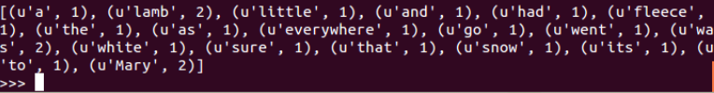
reduceByKey()
Performs a reduce operation on elements of a Pair RDD and runs a function on any elements that share a key
val kvReduced = kvRdd.reduceByKey((a,b) => a+b)
kvReduced.collect()
(Mary, 1)
(had, 1)
(a, 1)
(little, 1)
(Mary, 2)
(lamb, 1)
***
(lamb, 2)
(Mary, 1)
(went, 1)
(The, 1)
(lamb, 1)
(was, 1)
(sure, 1)
(to, 1)
(go, 1)
Notes:
The reduceByKey function performs a reduce operation on all elements of a key/value pair RDD that share a key. For our example here, we'll return to kvRdd that was created using the following code: rddMary = sc.textFile("filelocation/mary.txt") rddFlat = rddMary.flatMap(lambda line: line.split(' ')) kvRdd = rddFlat.map(lambda word: (word,1))
As an example of reduceByKey(), take a look at the following code:
kvReduced = kvRdd.reduceByKey(lambda a,b: a+b)
The reduceByKey function goes through the elements and if it sees a key that it hasn't already encountered, it adds it to the list and records the value as-is. If a duplicate key is found, reduceByKey performs a function on the key values and keeps the number of keys to one. In our example, then, the anonymous function "lambda a,b: a+b“ only kicks in if a duplicate key is found. If so, the anonymous function tells reduceByKey to take the values of the two keys (a and b) and add them together to compute a new value for the now-reduced key. The actual function being performed is up to the developer, but incrementally adding values would be a fairly common task.
Visually, then, what is happening is the elements of the RDD are being recorded and passed to the new kvReduced RDD, with the exception of two keys - 'Mary' and 'lamb' - which were both found twice. All other values remain unchanged, but now 'Mary' and 'lamb' are reduced to single key, each with a value of 2.

Slide 105
groupByKey()
Returns an RDD with a grouping of values by key
Grouped values are returned as a single iterable object
Can be viewed by mapping the elements of the iterable object into a defined list
val kvGroupByKey = kvRdd.groupByKey().map(x => (x._1, x._2))
kvGroupByKey.collect()
res30: Array[(String, Iterable[Int])] = Array((,,CompactBuffer(1)), (white,CompactBuffer(1)), (a,CompactBuffer(1, 1)), (lamb,CompactBuffer(1, 1)), (little,CompactBuffer(1)), (had,CompactBuffer(1)), (of,CompactBuffer(1)), (Mary,CompactBuffer(1)), (color,CompactBuffer(1)))
When desired output can be obtained by reduceByKey(), use that instead
Notes:
Grouping values by key allow us to aggregate values based on a key. In order to see this grouping, the results must be turned into a list before being collected.
For example, let's again use our kvRdd example created with the following code:
rddMary = sc.textFile("filelocation/mary.txt") rddFlat = rddMary.flatMap(lambda line: line.split(' ')) kvRdd = rddFlat.map(lambda word: (word,1))
Next, we will use groupByKey to group all values that have the same key into an iterable object (that is, on its own, unable to be viewed) and then use a map function to define these grouped elements into a readable list:
kvGroupByKey = kvRdd.groupByKey().map(lambda x : (x[0], list(x[1])))
kvGroupByKey.collect()
[(u'a', [1]), (u'lamb', [1, 1]),(u'little', [1]),…(u'Mary',[1, 1])]
If we had simply generated output using groupByKey alone, as below:
kvGroupByKey = kvRdd.groupByKey()
…when we ran the code to collect the results, the output would have looked something like this:
[(u'a', <pyspark.resultiterable.ResultIterable object at 0xde8450>), (u'lamb', <pyspark.resultiterable.ResultInterable object at 0xde8490>),…(u'Mary', <pyspark.resultiterable.ResultIterable object at 0xde8960>)]
This tells you that the results are an object which allows iteration, but does not display the individual elements by default. Using map to list the elements performed the necessary iteration to be able to see the desired formatted results.
Note: The groupByKey and reduceByKey functions have significant overlap and similar capabilities, depending on how the called function is defined by the developer. When either is able to get the desired output, it is better to use reduceByKey() as it is more efficient over large datasets.

Slide 106
flatMapValues()
Performs a function on Pair RDD values, leaving keys unchanged, but flattens key-value pairs that contain multiple values
Essentially the opposite of the groupByKey() example
val kvGroupByKey = kvRdd.groupByKey().map(x => (x._1, x._2))
kvGroupByKey.collect()
res30: Array[(String, Iterable[Int])] = Array((,,CompactBuffer(1)), (white,CompactBuffer(1)), (a,CompactBuffer(1, 1)), (lamb,CompactBuffer(1, 1)), (little,CompactBuffer(1)), (had,CompactBuffer(1)), (of,CompactBuffer(1)), (Mary,CompactBuffer(1)), (color,CompactBuffer(1)))
val rddFlatMapVals = kvGroupByKey.flatMapValues(`val` => `val`)
rddFlatMapVals.collect() res31: Array[(String, Int)] = Array((,,1), (white,1), (a,1), (a,1), (lamb,1), (lamb,1), (little,1), (had,1), (of,1), (Mary,1), (color,1))
Notes:
Like the mapValues function, the flatMapValues function performs a function on Pair RDD values, leaving the keys unchanged. However, in the event it encounters a key that has multiple values, it flattens those into individual key-value pairs, meaning no key will have more than one value, but you will end up with duplicate keys in the RDD. Let's start with the RDD we created in the groupByKey() example:
kvGroupByKey = kvRdd.groupByKey().map(lambda x : (x[0], list(x[1])))
kvGroupByKey.collect()
[(u'a', [1]), (u'lamb', [1, 1]),(u'little', [1]),…(u'Mary',[1, 1])]
Notice that both both the 'lamb' and 'Mary' keys contain a multiple key values in a list. Next, let's create an RDD that flattens those key-value pairs using the flatMapValues function:
rddFlatMapVals = kvGroupByKey.flatMapValues(lambda val: val)
rddFlatMapVals.collect() [(u'a', 1), (u'lamb', 1), (u'lamb', 1), (u'little', 1), … (u'Mary',1), (u'Mary',1)]
Now all key-value pairs have only a single value, and both 'lamb' and 'Mary' exist as duplicated keys in the RDD.
Note: In the example above, the anonymous function simply returns the original unedited value. However, like the mapValues function, flatMapValues() can be configured to modify the keys as it flattens out the key-value pairs. For example, if we had defined the anonymous function as: (lambda val: val + 1), then each of the values would have been returned as 2 instead of 1.

Slide 107
subtractByKey()
Returns key-value pairs containing keys in the source RDD not found in another RDD
val zipWIRdd = sc.parallelize(List(("cat", 0), ("A", 1), ("spoon", 2)))
val rddSong = sc.parallelize(List(("cat", 7), ("cradle", 9), ("spoon", 4)))
rddSong.subtractByKey(zipWIRdd).collect()
Array('cradle', 9)
('A', 1) is not returned because it does not exist in the source RDD
Notes:
The subtractByKey function will return key-value pairs containing keys not found in another RDD. This can be useful when you need to identify differences between keys in two RDDs. Here is an example:
zipWIRdd = sc.parallelize([("cat", 0), ("A", 1), ("spoon", 2)])
rddSong = sc.parallelize([("cat", 7), ("cradle", 9), ("spoon", 4)])
rddSong.subtractByKey(zipWIRdd).collect()
[('cradle', 9)]
The key-value pair that had a key of 'cradle' was the only one returned because both RDDs contained key-value pairs that had key values of 'cat' and 'spoon'.
Note that ('A', 1) was not returned as part of the result. This is because subtractByKey() is only evaluating matches in the first RDD (the one that precedes the function) as compared to the second one. It does not return all keys in either RDD that are unique to that RDD. If you wanted to get a list of all unique keys for both RDDs using subtractByKey(), you would need to run the operation twice - once as shown, and then again, swapping out the two RDD values in the last line of code. For example, this code would return the unique key values for zipWIRdd:
zipWIRdd.subtractByKey(rddSong).collect()
[('A', 1)]
If needed, you could store these outputs in two other RDDs, then use another function to combine them into a single list as desired.

Slide 108
Pair RDD Joins
All joins types are supported: inner ("join"), full outer, left outer, right outer
val zipWIRdd = sc.parallelize(Array(("cat", 0), ("A", 1), ("spoon", 2)))
val rddSong = sc.parallelize(Array(("cat", 7), ("cradle", 9), ("spoon", 4)))
rddSong.leftOuterJoin(zipWIRdd).collect()
res33: Array[(String, (Int, Option[Int]))] = Array((spoon,(4,Some(2))), (cat,(7,Some(0))), (cradle,(9,None)))
Notes:
Spark provides support for inner, full outer, left outer, and right outer joins when working with Pair RDDs. Here is an example of using leftOuterJoin(): zipWIRdd = sc.parallelize([("cat", 0), ("A", 1), ("spoon", 2)])
rddSong = sc.parallelize([("cat", 7), ("cradle", 9), ("spoon", 4)])
rddSong.leftOuterJoin(zipWIRdd).collect()
[('spoon', (4, 2)), ('cradle', (9, none)), ('cat', (7, 0))]

Slide 109
More Functions: Spark Documentation
http://spark.apache.org/docs/<version>/api/
Version options
Official version number, such as "1.4.0" or "1.6.1"
"latest" for the newest release
Notes:
There are many, many other Spark APIs available for Pair RDDs that have not yet been covered in this class. To learn more about them, you can access the Spark documentation using the links below:
http://spark.apache.org/docs/<version>/api/
Version can be and actual version number, such as "1.4.0" or "1.6.1", or alternatively you can use "latest" to view documentation on the newest release of Spark. For example:
http://spark.apache.org/docs/latest/api/
From there, simply click on the appropriate programming language to view the documentation.

Slide 110
Lab: Create and Manipulate Pair RDDs

Slide 111
Knowledge Check

Slide 112
Questions
An RDD that contains elements made up of key-value pairs is sometimes referred to as a _________________.
Name two functions that can be used to create a Pair RDD.
True or False: A key can have a value that is actually a list of many values.
Since sortByKey() only sorts by key, and there is no equivalent function to sort by values, how could you go about getting your Pair RDD sorted alphanumerically by value?
You determine either reduceByKey() or groupByKey() could be used in your program to get the same results. Which one should you choose?
How can you use subtractByKey() to determine *all* of the unique keys across two RDDs?
Notes:
Answers
Pair RDD
map(), keyBy(), zipWithIndex(), zip()
True
First use map() to reorder the key-value pair so that the key is now the value. Then use sortByKey() to sort. Finally, use map() again to swap the keys and values back to their original positions.
reduceByKey(), because it is more efficient - especially on large datasets.
Run it twice, switching the order of the RDDs each time.

Slide 113
Summary

Slide 114
Summary
Pair RDDs contain elements made up of key-value pairs
Common functions used to create Pair RDDs include map(), keyBy(), zipWithIndex(), and zip()
Common functions used with Pair RDDs include mapValues(), keys(), values(), sortByKey(), lookup(), countByKey(), collectAsMap(), reduceByKey(), groupByKey(), flatMapValues(), subtractByKey(), and various join types.
Notes:
This summary page lists some of the main points from this lesson.

Slide 115
Spark Streaming

Slide 116
Objectives
After completing this lesson, students should be able to:
Describe Spark Streaming
Create and view basic data streams
Perform basic transformations on streaming data
Utilize window transformations on streaming data
Notes:
After completing this lesson, students should be able to:
Describe Spark Streaming
Create and view basic data streams
Perform basic transformations on streaming data
Utilize window transformations on streaming data

Slide 117
Spark Streaming Overview

Slide 118
What is Spark Streaming?
Implements a receiver and specialized RDDs called DStreams on top of Spark
Enables micro-batch processing of live streaming data
Allows for additional ROI on Spark platform investment
DStream
Spark Core
Streaming Data
Output
Receiver
DStream
DStream
Spark Streaming
Notes:
As the name implies, Spark Streaming is a tool that enables a developer to utilize the Spark platform to ingest and process streaming data. Spark Streaming is composed of a receiver, which collects streaming data in small amounts called micro-batches, and then makes them available for processing via a collection of specialized RDDs called a DStream. These DStreams can then be manipulated and further processed via the Spark Streaming API, which is an extension of Spark Core, to produce various output types.

Slide 119
DStreams
Batches of input data created at regular time intervals
Micro-batching as opposed to true streaming
DStream t=5
A, B, C, D, E
Data Stream: A, B, C, D, E, F, G,
H, I, J, K, L, M, N, O
DStream t=10
F, G, H, I, J
Receiver
DStream t=15
K, L, M, N, O
Notes:
A DStream is a collection of one or more specialized RDDs divided into discrete chunks based on time interval. When a streaming source communicates with Spark Streaming, the receiver caches information for a specified time period, after which point the data is converted into a DStream and available for further processing. Each discrete time period (in the example pictured, every five seconds) is a separate DStream.

Slide 120
DStream vs. RDD
DStreams contain data and physically exist in memory from moment of creation
Normal RDDs are just sets of instructions until an action is performed
By default, DStreams are deleted after processing
Outputs vs. Actions
Notes:
DStreams have some differences compared to traditional RDDs. The first, and perhaps most consequential difference is that DStreams contain data and physically exist in memory from the moment of creation. Traditional RDDs, on the other hand, are sets of instructions that don't actually contain in-memory data until an action is performed. The second big difference is that, by default, DStreams only exist in memory until the next batch of data is ready to be processed. A third, minor difference is terminology: while you perform transformations on both RDDs and DStreams, RDDs create results via "actions" whereas DStreams use similar "outputs."

Slide 121
DStream Replication
Receiver duplicates data to two executors by default
Executor 1
DStream1
Receiver
Executor 2
DStream1
Notes:
DStreams are fault tolerant, meaning they are written to a minimum of two executors at the moment of creation. The loss of a single executor will not result in the loss of the DStream.

Slide 122
Receiver Availability
If an executor with a receiver goes down, it will be restarted in another executor
Executor 1
DStream1
Receiver
Executor 2
Receiver
DStream1
Executor 3
DStream1
Notes:
By default, receivers are highly available. If the executor running the receiver goes down, the receiver will be immediately restarted in another executor.
As mentioned earlier, Spark Streaming performs micro-batching rather than true bit-by-bit streaming. Collecting and processing data in batches can be more efficient in terms of resource utilization, but comes at a cost of latency and risk of small amounts of lost data. Spark Streaming can be configured to process batch sizes as small as one second, which takes approximately another second to process, for a two-second delay from the moment the data is received until a response can be generated. This introduces a small risk of data loss, which can be mitigated by the use of reliable receivers (available in the Scala and Java APIs only at the time of this writing) and intelligent data sources.

Slide 123
Receiver Reliability
By default, receivers are "unreliable"
No acknowledgment between receiver and source
No record of whether data has been successfully written
No ability to ask for retransmission for missed data
Possibility for data loss if receiver is lost
To implement a reliable receiver, a custom receiver must be created
Scala / Java only as of Spark 1.6.0
Not supported by Python APIs
Notes:
By default, receivers are "unreliable." This means there is:
No acknowledgment between receiver and source
No record of whether data has been successfully written
No ability to ask for retransmission for missed data
Possibility for data loss if receiver is lost
To implement a reliable receiver, a custom receiver must be created. A reliable receiver implements a handshake mechanism that acknowledges that data has been received and processed. Assuming the data source is also intelligent, it will wait to discard the data on the other side until this acknowledgement has been received, which also means it can retransmit it in the event of data loss. Custom receivers are available in the Scala and Java Spark Streaming APIs only, and are not available in Python. For more information on creating and implementing custom / reliable receivers, please refer to Spark Streaming documentation.

Slide 124
Streaming Data Source Examples
Basic Sources
Text files from an HDFS directory
Text via TCP socket connection
Queue of RDDs (for testing purposes)
Advanced Sources
Kafka
Kinesis
Flume
MQTT
*Additional basic and advanced sources are available in Scala / Java
Notes:
Spark Streaming can receive data from multiple sources, both basic and advanced types. Basic sources include monitoring HDFS directories and ingesting any new files that are created as streamed data, text streaming via a TCP socket connection, and even setting up queues of traditional RDDs that can be used to test a streaming application. Advanced sources include Apache Kafka, Amazon Kinesis, Apache Flume, and MQTT.
Note: Additional data sources are available via the Scala and Java APIs. Please refer to the Spark Streaming documentation for additional information.

Slide 125
Basic Data Streaming

Slide 126
StreamingContext
An extension of the SparkContext
Entry point for streaming applications
Sets up receiver and enables real-time transformations on Dstreams, as well as various output types
Client Machine or HDP Container
Driver
SparkContext
StreamingContext
Notes:
Spark Streaming extends the Spark Core architecture model by layering in a StreamingContext on top of the SparkContext. The StreamingContext acts as the entry point for streaming applications. It is responsible for setting up the receiver and enables real-time transformations on DStreams. It also produces various types of output.

Slide 127
Modify REPL CPU Cores
Streaming requires having two or more CPU cores available
One core for the receiver plus one core for each DStream being ingested
This can be changed by modifying the MASTER environment variable when launching the REPL
To utilize two cores: pyspark --master local[2] (for python)
To utilize two cores: spark-shell --master local[2] (for scala)
Notes:
When running streaming applications, it is required to utilize multiple CPU cores. A Spark Streaming application should have a number of cores equal to the number of DStreams being ingested plus a core for the receiver itself. Thus, if you have 20 DStreams, you should have 21 CPU cores available. This behavior can be controlled by modifying the MASTER environment variable, which in the REPL can be done at launch. For example, to utilize two cores in pyspark:
# pyspark --master local[2]
Instructors Only: https://spark.apache.org/docs/latest/programming-guide.html

Slide 128
Launch StreamingContext
Import the StreamingContext API
Example: import org.apache.spark.streaming.StreamingContext
Create an instance of the StreamingContext and supply the name of the SparkContext (when using the REPL, sc) and an interval time for micro-batching
Example setting a one-second interval: val ssc = new StreamingContext(sc, 1)
Spark StreamingContext instances can be defined with varying time intervals based on needs
Only one StreamingContext is allowed per JVM
val sscTen = new StreamingContext(sc, 10)
Notes:
To launch the StreamingContext, you first need to import the StreamingContext API. In pyspark, the code to perform this operation would be:
from pyspark.streaming import StreamingContext
Next, you create an instance of the StreamingContext. When doing so, you supply the name of the SparkContext in use, as well as the time interval (in seconds) for the receiver to collect data for micro-batch processing. When using a REPL, the SparkContext will be named sc by default. For example, when creating an instance of StreamingContext named ssc, in the pyspark REPL, with a micro-batch interval of one second, you would use the following code:
ssc = StreamingContext(sc, 1)
*Note: This operation will return an error if the StreamingContext API has not been imported.
Both the name of the SparkStreaming instance and the time interval can be modified to fit your purposes. Here's an example of creating a StreamingContext instance with a 10-second micro-batch interval:
sscTen = StreamingContext(sc, 10)
It is important to note, that while multiple instances of StreamingContext can be defined, only a single instance of SparkContext can run per JVM. Once running, another instance will fail to launch. In fact, once the current instance has been stopped, it cannot be launched again in the same JVM. Thus, while the REPL is a useful tool for learning and perhaps testing Spark Streaming applications, in production it would be problematic because every time a developer wanted to test a slightly different application, it would require stopping and restarting the REPL itself.

Slide 129
Stream from HDFS Directories and TCP Sockets
To create a stream by monitoring an HDFS directory and ingesting any new files:
hdfsInputDS = ssc.textFileStream("someHDFSdirectory")
To create a stream by monitoring TCP socket source (hostname and port):
tcpInputDS = ssc.socketTextStream("someHostname", portNumber)
Notes:
To create a stream by monitoring an HDFS directory and ingesting any new files that appear, choose a variable name for the DStream, then call the textFileStream() function from the StreamingContext API and supply the full path to the appropriate HDFS directory. For example:
hdfsInputDS = ssc.textFileStream("someHDFSdirectory")
Note: If the HDFS directory exists on the cluster the application is attached to, only the path needs to be provided. If it exists on a separate cluster, prepend the path with "hdfs:/nodename:8020/…"
To create a stream by monitoring a TCP socket source, choose a variable name for the DStream, then call the socketTextStream() function and supply the source hostname or IP address (whichever is appropriate in your situation) and the port number to monitor. For example:
tcpInputDS = ssc.socketTextStream("someHostname", portNumber)
Note that in both examples, the name of the StreamingContext instance had to be specified before calling the function. Otherwise, the application would have tried to call this from the default SparkContext, and since these functions to not exist outside of Spark Streaming, and error would have been returned.

Slide 130
Output to Console and to HDFS
Print output to the console:
Python: DSvariableName.pprint()
Scala/Java: DSvariableName.print()
Suggestion: set sc log level to "ERROR" when printing to console to reduce screen clutter
Example: sc.setLogLevel("ERROR")
Save output as a time-stamped text file on HDFS:
DSVariable.saveAsTextFiles("HDFSlocation/prefix", "optionalSuffix")
Directory permissions must be set accordingly
Can use the same DStream to output to both console and HDFS text file
Notes:
To print streaming output to the console / terminal window, in Python use the "pretty print" function, pprint(). In Scala/Java the same function is simply named print(). For example:
Python: DSvariableName.pprint()
Scala/Java: DSvariableName.print()
When printing output to the console, we suggest setting the log level for the SparkContext to "ERROR" in order to reduce screen output. Otherwise, lots of information besides what is being streamed will appear and clutter up the screen. To do this, use the SparkContext setLogLevel function as follows:
sc.setLogLevel("ERROR")
To save the output as a time-stamped text file on HDFS, use the saveAsTextFiles function. Make sure the application has write permissions to the HDFS directory selected. The syntax for this operation is:
DSVariable.saveAsTextFiles("HDFSlocation/prefix", "optionalSuffix")
The output will be generated on a per-DStream basis, with whatever you select as the prefix prepending the rest of the file name, which will be "-<timestamp>." In addition, you can choose to add a suffix to each file as well, which will appear at the end of the file. Prefixes and suffixes are useful, particularly if multiple data streams are being written to the same directory.
It is also noteworthy that these outputs are not exclusive. You can choose to output to the console *and* to HDFS without issue.

Slide 131
Start and Stop the Streaming Application
All operations must be defined before the stream is started
When ready: ssc.start()
When finished: ssc.stop()
Notes:
With streaming applications, all operations must be defined before the stream is started. Thus, the interactivity benefit of the REPL becomes lost. Once all transformations and outputs have been defined, to launch a streaming application simply call the SparkContext instance and use the start function. The application can be stopped in the same fashion using the stop function. For example:
When ready: ssc.start()
When finished: ssc.stop()
In a REPL, the streaming application will also stop if the terminal it is running in is closed.

Slide 132
Simple Streaming Program Example Using a REPL
# spark-shell --master local[2]
>>> sc.setLogLevel("ERROR")
>>> import org.apache.spark.streaming.StreamingContext
>>> val sscFive = new StreamingContext(sc, Seconds(5))
>>> val hdfsInputDS = sscFive.textFileStream("/user/root/test/")
>>> val hdfsInputDS.saveAsTextFiles("/user/root/test/stream/name")
>>> hdfsInputDS.print()
>>> sscFive.start()
Notes:
Here's an example of a simple streaming program created using the pyspark REPL:
# pyspark --master local[2]
>>> sc.setLogLevel("ERROR")
>>> from pyspark.streaming import StreamingContext
>>> sscFive = StreamingContext(sc, 5)
>>> hdfsInputDS = sscFive.textFileStream("/user/root/test/")
>>> hdfsInputDS.saveAsTextFiles("/user/root/test/stream/name")
>>> hdfsInputDS.pprint()
>>> sscFive.start()
In this application, the pyspark REPL is called with the MASTER variable configured to use two CPU cores on the local machine. The SparkContext log level is set to "ERROR", and then the StreamingContext API is imported. Then, an instance of StreamingContext named sscFive is created, with a micro-batch time interval of five seconds. A DStream is defined using the textFileStream function to monitor the local HDFS directory /user/root/test/. Those inputs are then output as text files with a prefix of "name" (no suffix is defined) to the local HDFS directory /user/root/test/stream/. Finally, the inputs are also output to the console using pprint(). Then the application is launched.

Slide 133
Lab: Basic Spark Streaming using HDFS Directories and TCP Sockets

Slide 134
Streaming Transformations

Slide 135
DStream Transformations
Allow modification of DStream data similar to RDD transformations
Familiar functions
map()
flatMap()
filter()
repartition()
union()
count()
reduceByKey()
join()
etc.
Notes:
Transformations allow modification of DStream data to create new DStreams with different output. DStream transformations are similar in nature and scope to traditional RDD transformations. In fact, many of the same functions in Spark Core also exist in Spark Streaming. The following functions should look familiar:
map()
flatMap()
filter()
repartition()
union()
count()
reduceByKey()
join()
Etc.
Instructors Only: http://spark.apache.org/docs/latest/api/python/pyspark.streaming.html#pyspark.streaming.DStream

Slide 136
Transformation using flatMap()
...
val hdfsInputDS = ssc.textFileStream("someHDFSdirectory")
val flatMapDS = hdfsInputDS.flatMap(line => line.split(" ")
flatMapDS.print()
ssc.start()
Notes:
As an example, here is a Spark Streaming application that utilizes the flatMap function and prints output to the console.
# pyspark --master local[2]
>>> sc.setLogLevel("ERROR")
>>> from pyspark.streaming import StreamingContext
>>> ssc = StreamingContext(sc, 5)
>>> hdfsInputDS = ssc.textFileStream("someHDFSdirectory")
>>> flatMapDS = hdfsInputDS.flatMap(lambda line: line.split(" ")
>>> flatMapDS.pprint()
>>> ssc.start()
Note that the first five lines of code are similar to the application example from the previous section. In this example, then, the original DStream transformed into a new DStream named flatMapDS, and the new DStream is output to the console.

Slide 137
Combine DStreams using union()
A simple example that creates two DStreams from the same source and combines them
. . .
val input1 = ssc.textFileStream("/user/root/test/")
val input2 = ssc.textFileStream("/user/root/test/")
val combined = input1.union(input2)
combined.print()
ssc.start()
Notes:
The union function also works in the same way as it does with traditional RDDs. In this example, we create two DStreams and combine them with union(). Note that we used the same HDFS location in the example, so the output would simply be the same input written twice.
# pyspark --master local[2]
>>> sc.setLogLevel("ERROR")
>>> from pyspark.streaming import StreamingContext
>>> ssc = StreamingContext(sc, 5)
>>> input1 = ssc.textFileStream("/user/root/test/")
>>> input2 = ssc.textFileStream("/user/root/test/")
>>> combined = input1.union(input2)
>>> combined.pprint()
>>> ssc.start()

Slide 138
Create Key-Value Pairs
. . .
val hdfsInputDS = ssc.textFileStream("someHDFSdirectory")
val kvPairDS = hdfsInputDS.flatMap(line => line.split(" ").map(word => (word, 1))
kvPairDS.print()
ssc.start()
Notes:
Similarly to traditional RDDs, DStreams can be transformed into key-value pairs using flatMap() followed by map(). Here's an example:
# pyspark --master local[2]
>>> sc.setLogLevel("ERROR")
>>> from pyspark.streaming import StreamingContext
>>> ssc = StreamingContext(sc, 5)
>>> hdfsInputDS = ssc.textFileStream("someHDFSdirectory")
>>> kvPairDS = hdfsInputDS.flatMap(lambda line: line.split(" ").map(lambda word: (word, 1))
>>> kvPairDS.pprint()
>>> ssc.start()

Slide 139
reduceByKey()
. . .
val hdfsInputDS = ssc.textFileStream("someHDFSdirectory")
val kvPairDS = hdfsInputDS.flatMap(line => line.split(" ").map(word => (word, 1))
kvReduced = kvPairDS.reduceByKey((a,b) => a+b)
kvReduced.print()
ssc.start()
Notes:
And again, like traditional RDDs, key-value pair DStreams can be reduced using the reduceByKey function. Here's an example:
# pyspark --master local[2]
>>> sc.setLogLevel("ERROR")
>>> from pyspark.streaming import StreamingContext
>>> ssc = StreamingContext(sc, 5)
>>> hdfsInputDS = ssc.textFileStream("someHDFSdirectory")
>>> kvPairDS = hdfsInputDS.flatMap(lambda line: line.split(" ").map(lambda word: (word, 1))
>>> kvReduced = kvPairDS.reduceByKey(lambda a,b: a+b)
>>> kvReduced.pprint()
>>> ssc.start()
This coding pattern is often used to write word count applications.

Slide 140
Lab: Basic Spark Streaming Transformations

Slide 141
Window Transformations

Slide 142
Stateful vs. Stateless Operations
By default, DStreams are discarded from memory when the next batch of data arrives
Assumes all operations performed are on single DStreams, not dependent on previous data
This is referred to as working with "stateless" operations / transformations
However, it is sometimes beneficial to perform transformations and gather output using overlapping time slices, or across an entire collected dataset
Example: Every 15 seconds perform operations over the last 45 seconds worth of data
This is referred to as working with "stateful" operations / transformations
Notes:
As previously discussed, by default DStreams are discarded from memory when the next batch of data arrives. This behavior is fine assuming all operations / transformations are performed are on single DStreams, which are not dependent on previous data. This mode of operation is is referred to as working with "stateless" operations / transformations.
However, it is sometimes beneficial or necessary to perform transformations and gather output across overlapping time slices, or even across an entire collected dataset. For example, you might want to compute a running average every 15 seconds using the last 45 seconds worth of data. This is referred to as working with "stateful" operations / transformations.

Slide 143
Checkpointing
Used in stateful streaming operations to maintain state in the event of system failure
To enable:
. . .
ssc.checkpoint("someHDFSdirectory") . . .
Notes:
Checkpointing is used in stateful streaming operations maintain state in the event of a system failure, such as loss of an executor. To enable checkpointing, you can simply specify an HDFS directory to write checkpoint data to using the checkpoint function. For example:
ssc.checkpoint("someHDFSdirectory")
Trying to write a stateful application without specifying a checkpoint directory will result in an error once the application is launched.

Slide 144
Streaming Window Functions
Window functions perform combined operations on a set of Dstreams
The window length (size, in seconds) and interval (how often it is collected) are set during creation
These values must be a multiple of the StreamingContext interval value
Dstream1
Dstream2
Dstream3
Dstream4
Dstream5
Window 1
Window 2
Window 3
Notes:
Window functions are stateful operations that run on a set of Dstreams, combining the results of a group. In the diagram, each window is composed of the last 3 DStreams. The window length, which is the size measured in seconds, and the time interval to collect the results are set during the window creation. Both of these values must be a multiple of the StreamingContext micro-batch interval value. For example, if the micro-batch interval is set to five seconds, the window size and interval must be some multiple of five. If this were the case for the example pictured, each window would have a size of 15 seconds, and could be processed at either 5 or 10-second intervals.
Note: Technically, you could also process a 15-second window in 15-second intervals, however this is functionally equivalent to setting the StreamingContext interval to 15 seconds and not using the window function at all.
Important: For basic inputs, window() does not work as expected using textFileStream(). An application will process the first file stream correctly, but then lock up when a second file is added to the HDFS directory. Because of this, all labs and examples will use the socketTextStream function.

Slide 145
Basic Window Transformations
window(windowLength, interval) - returns a new DStream which is computed based on the length and interval provided
Functionally similar to a union() transformation
Example: windowDS = streamingDS.window(30,10)
countByWindow(windowLength, interval) - returns a count of the number of elements in the stream
Example: windowCountDS = streamingDS.countByWindow(30,10)
Equivalent output to streamingDS.window(30, 10).count(), but more efficient if number of elements is large
Notes:
Two basic window transformations can be performed using the window and countByWindow functions.
The window function takes the window length and collection interval as arguments, and returns a new DStream based on the values provided. Functionally, this is similar to the union() transformation, as the data across multiple DStreams is combined into a single unit. The difference is that with streaming, the union function only operates on DStreams created simultaneously, whereas the window function combines the same DStream created across multiple micro-batches. The basic syntax is window(windowLength, interval). An example of creating a window of 30 seconds collected every 10 seconds would look like the following:
windowDS = streamingDS.window(30,10)
The countByWindow function is equivalent to the window function followed by the Spark Streaming count function, and returns a count of the number of elements in the stream. However, if the number of elements is large, this will be a more efficient way of generating a count. The arguments are the same as window(), and has the following syntax: countByWindow(windowLength, interval). An example:
windowCountDS = streamingDS.countByWindow(30,10)

Slide 146
Sample Window Application
# spark-shell --master local[2]
>>> sc.setLogLevel("ERROR")
>>> import org.apache.spark.streaming._
>>> val ssc = new StreamingContext(sc, Seconds(1))
>>> ssc.checkpoint("/user/root/test/checkpoint/")
>>> val tcpInputDS = ssc.socketTextStream("sandbox",9999)
>>> val windowDS = tcpInputDS.window(15, 5). flatMap(line => line.split(" ")).count()
>>> windowDS.print()
>>> ssc.start()
Notes:
Here's a sample application that uses window() to generate a count of all elements in a data stream, first separating them out using flatMap(). (Without flatMap(), the number of DStreams would be counted instead.) It generates this output every five seconds, using the last 15 seconds worth of DStream data. Note that the DStream interval is set to one second for the StreamingContext:
# pyspark --master local[2]
>>> sc.setLogLevel("ERROR")
>>> from pyspark.streaming import StreamingContext
>>> ssc = StreamingContext(sc, 1)
>>> ssc.checkpoint("/user/root/test/checkpoint/")
>>> tcpInputDS = ssc.socketTextStream("sandbox",9999)
>>> windowDS = tcpInputDS.window(15, 5).flatMap(lambda line: line.split(" ")).count()
>>> windowDS.pprint()
>>> ssc.start()

Slide 147
reduceByKeyAndWindow()
. . .
val tcpInDS = ssc.socketTextStream("sandbox",9999)
val redPrWinDS = tcpInDS.flatMap(line => line.split(" ")).map(word => (word, 1)). reduceByKeyAndWindow((a,b) => a+b, (a,b) => a-b, 10, 2)
redPrWinDS.print()
ssc.start()
Notes:
You can also work with key-value pair windows, and there are some specialized functions designed to do just that. One such example is reduceByKeyAndWindow(), which behaves similarly to the reduceByKey function discussed previously, but over a specified window and collection interval. For example, take a look at the following application:
# pyspark --master local[2]
>>> sc.setLogLevel("ERROR")
>>> from pyspark.streaming import StreamingContext
>>> ssc = StreamingContext(sc, 1)
>>> ssc.checkpoint("/user/root/test/checkpoint/")
>>> tcpInDS = ssc.socketTextStream("sandbox",9999)
>>> redPrWinDS = tcpInDS.flatMap(lambda line: line.split(" ")).map(lambda word: (word, 1)). reduceByKeyAndWindow(lambda a,b: a+b, lambda a,b: a-b, 10, 2)
>>> redPrWinDS.pprint()
>>> ssc.start()
To generate the reduced key-value pair, the DStream is transformed using flatMap(), then converted to a key-value pair using map(). Then, the reduceByKeyAndWindow function is called.
Note that the reduceByKeyAndWindow function actually takes two functions as arguments prior to the window size and interval arguments. The first argument is the function that should be applied to the DStream. The second argument is the *inverse* of the first function, and is applied to the data that has fallen out of the window. The value of each window is thus calculated incrementally as the window slides across DStreams without having to recompute the data across all of the DStreams in the window each time.
NEED TO VERIFY (do not include in book): THERE ARE TWO VERSIONS OF THIS FUNCTION - those which have an inverse (where two functions are supplied, as on the slide) and those that do not, in which case only a single function is supplied. NEED TO VERIFY IF THIS IS THE SAME IN SCALA. NEED TO VERIFY THAT non-invertible functions work and are recognized by taking only three arguments. In Python, if the function is invertible, the operation will not work as expected if the inverse function is not supplied. http://spark.apache.org/docs/latest/streaming-programming-guide.html#transform-operation

Slide 148
Lab: Spark Streaming Window Transformations

Slide 149
Knowledge Check

Slide 150
Questions
Name the two new components added to Spark Core to create Spark Streaming.
If an application will ingest three streams of data, how many CPU cores should it be allocated?
Name the three basic streaming input types supported by both Python and Scala APIs.
What two arguments does an instance of StreamingContext require?
What is the additional prerequisite for any stateful operation?
What two parameters are required to create a window?
Notes:
Answers
Receivers and DStreams. StreamingContext is also an acceptable answer here.
Four - one for each stream, and one for the receiver.
HDFS text via directory monitoring, text via TCP socket monitoring, and queues of RDDs.
The name of the SparkContext and the micro-batch interval.
Checkpointing.
Window duration and collection interval.

Slide 151
Summary

Slide 152
Summary
Spark Streaming is an extension of Spark Core that adds the concept of a streaming data receiver and a specialized type of RDD called a DStream.
DStreams are fault tolerant, whereas receivers are highly available.
Spark Streaming utilizes a micro-batch architecture.
Spark Streaming layers in a StreamingContext on top of the Spark Core SparkContext.
Many DStream transformations are similar to traditional RDD transformations
Window functions allow operations across multiple time slices of the same DStream, and are thus stateful and require checkpointing to be enabled.
Notes:
This summary page lists some of the main points from this lesson.

Slide 153
Spark SQL

Slide 154
Objectives
After completing this lesson, students should be able to:
Name the various components of Spark SQL and explain their purpose
Describe the relationship between DataFrames, tables, and contexts
Use various methods to create and save DataFrames and tables
Manipulate DataFrames and tables
Notes:
After completing this lesson, students should be able to:
Name the various components of Spark SQL and explain their purpose
Describe the relationship between DataFrames, tables, and contexts
Use various methods to create and save DataFrames and tables
Manipulate DataFrames and tables

Slide 155
Spark SQL Components

Slide 156
Spark SQL
A Spark module for processing structured data
Automated performance improvements compared to Spark Core API programs
Allows leveraging of investments in Hive data and knowledge-building while taking advantage of Spark's in-memory processing capabilities
Notes:
Spark SQL is a Spark module that allows for optimized processing of structured data. It provides many advantages to the Spark developer, including automated performance improvements that generally mean better performance than applications built using Spark Core RDD APIs. Spark SQL also integrates seamlessly with Hive, which allows an enterprise to leverage investments already made in that platform (including data stored as well as knowledge and processes that have built over time) while simultaneously benefitting from Spark's improved performance via in-memory processing.

Slide 157
DataFrames
Data organized into one or more columns, similar to a table
Underlying constructs = RDD
Can be created from RDDs, Hive tables, and outside data sources
Can be used to create SQL tables
Three primary methods available to interact with DataFrames and tables
DataFrames API available for Java, Scala, Python, and R
Native Spark SQL (subset of SQL92)
HiveQL (with just a few exceptions)
Notes:
A DataFrame is data that has been organized into one or more columns, similar in structure to a SQL table, but that is actually constructed from underlying RDDs. DataFrames can be created directoy from RDDs, as well as from Hive tables and many other outside data sources.
There are three primary methods available to interact with DataFrames and tables in Spark SQL:
The DataFrames API, which is available for Java, Scala, Python, and R developers,
The native Spark SQL API, which is composed of a subset of the SQL92 API commands, or
The HiveQL API. Most of the HiveQL API is supported in Spark SQL.

Slide 158
Hive
Original data warehouse platform in Hadoop
Interacts with data using a SQL-like query language, HiveQL
Represents unstructured data in HDFS as tables using a metadata overlay
Ubiquitous
Every Hadoop distribution includes it
Massive amounts of existing data managed by Hive
Notes:
Most enterprises that have deployed Hadoop are familiar with Hive. It is the original data warehouse platform developed for Hadoop. It represents unstructured data stored in HDFS as structured tables using a metadata overlay managed by Hive's HCatalog, and then can interact with those tables via HiveQL, it's SQL-like query language.
Hive is distributed with every major Hadoop distribution. Massive amounts of data are currently managed by Hive across the globe. Thus, Spark SQL's ability to integrate with Hive and utilize HiveQL capabilities and syntax provides massive value for the Spark developer.

Slide 159
Hive Data Visually
Represented logically as….
Col(1) | Col(2) | Col(3) | … | Col(n)
Hive (metadata)
data file 1
HDFS (unstructured data)
data file 2
data file 3
Notes:
Hive data starts as raw data that has been written to HDFS. Hive has a metadata component that logically organizes these unstructured data files into rows and columns like a table. The metadata layer acts as a translator, enabling SQL-like interactions to take place even though the underlying data on HDFS remains unstructured.

Slide 160
The DataFrame Visually
Converted to…
RDD 1.1x
RDD 1.2x
RDD 1.3x
data file
Spark SQL
Represented logically as….
RDD
Col(1) | Col(2) | Col(3) | … | Col(n)
Hive (metadata)
HDFS (unstructured data)
Notes:
In much the same way, a DataFrame starts out as something else - perhaps an ORC or JSON file, perhaps a list of values in an RDD, or perhaps a Hive table. Spark SQL has the ability to take these (and other) data sources and convert them into a DataFrame. As mentioned earlier, DataFrames are actually RDDs, but are represented logically as rows and columns. In this sense, Spark SQL behaves in a similar fashion as Hive, only instead of representing files on a disk as tables like Hive does, Spark SQL represents RDDs in memory as tables.

Slide 161
Spark SQL Contexts - Python
Two options: from pyspark.sql import SQLContext
sqlContext = SQLContext(sc) or from pyspark.sql import HiveContext
sqlContext = HiveContext(sc)
Zeppelin uses HiveContext named sqlContext when running %sql code
REPL also creates a HiveContext named sqlContext at launch
Notes:
Spark requires a Spark context, Spark Streaming requires a Spark Streaming context, and Spark SQL requires a SQL context. In this case, however, there are two contexts to choose from: the SQLcontext or the HiveContext. In both cases, the default name usually given to the context is sqlContext, but this is at the discretion of the developer.
The basic code difference is which context gets imported at the beginning of the program. The options are:
from pyspark.sql import SQLContext
sqlContext = SQLContext(sc) or from pyspark.sql import HiveContext
sqlContext = HiveContext(sc)
Zeppelin and the Spark REPLs both default to using a HiveContext named sqlContext. For most of the code examples in this lesson, we will follow the same pattern. For Zeppelin, this becomes active when running code prepended by %sql.

Slide 162
Spark SQL Contexts - Scala
Two options: import org.apache.spark.sql.SQLContext
val sqlContext = SQLContext(sc) or import org.apache.spark.sql.hive.HiveContext
val sqlContext = HiveContext(sc)
Zeppelin uses HiveContext named sqlContext when running %sql code
REPL also creates a HiveContext named sqlContext at launch
Notes:
Spark requires a Spark context, Spark Streaming requires a Spark Streaming context, and Spark SQL requires a SQL context. In this case, however, there are two contexts to choose from: the SQLcontext or the HiveContext. In both cases, the default name usually given to the context is sqlContext, but this is at the discretion of the developer.
The basic code difference is which context gets imported at the beginning of the program. The options are:
from pyspark.sql import SQLContext
sqlContext = SQLContext(sc) or from pyspark.sql import HiveContext
sqlContext = HiveContext(sc)
Zeppelin and the Spark REPLs both default to using a HiveContext named sqlContext. For most of the code examples in this lesson, we will follow the same pattern. For Zeppelin, this becomes active when running code prepended by %sql.

Slide 163
Spark SQL Contexts - Scala
Two options: import org.apache.spark.sql._
val sqlContext = SQLContext(sc)
or import org.apache.spark.sql.hive._
val sqlContext = HiveContext(sc)
Notes:
This is how you would create either instances of either SQLContext or HiveContext using Scala:
import org.apache.spark.sql._
val sqlContext = SQLContext(sc)
or
import org.apache.spark.sql.hive._
val sqlContext = HiveContext(sc)

Slide 164
SQLContext vs. HiveContext
SQLContext
Provides a generic SQL parser
HiveContext
Superset of (extends) SQLContext
Enables numerous additional operations using the HiveQL parser
Allows ability to read data directly from and write back to Hive tables
Provides access to Hive User Defined Functions (UDFs)
Which to use?
SQLContext has fewer dependencies and uses less resources if the limited API meets your needs
HiveContext allows greater flexibility and capabilities
When in doubt, use HiveContext
Notes:
When deciding which Spark SQL context to use, keep the following in mind:
The SQLContext is a standalone API that provides a limited, generic SQL92 parser.
The HiveContext contains all of the capabilities of SQLContext because it is a superset of SQLContext - meaning it contains all of the SQLContext capabilities, and extends them. Some of those extensions include numerous additional operations available via the HiveQL parser, the ability to read data from and write data to Hive tables, and access to Hive's User Defined Function (UDF) capabilities. Furthermore, these capabilities are available whether or not you currently utilize Hive in your HDP cluster.
Thus, if your structured data needs are simple, the SQLContext has fewer dependencies and uses nominally less resources than HiveContext does, which can be an advantage if the limited SQL92 API meets your needs. On the other hand, HiveContext allows for far greater flexibility and extended capabilities. In general, or when in doubt, it is always safer to use HiveContext.

Slide 165
Catalyst, the Spark SQL Optimizer
Accelerates query performance via:
Built-in catalog of optimizations
Intelligent, cost-based plan selection and execution
Simpler to write a SQL statement than a series of filter(), group(), etc. calls
Performance matches or outperforms equivalent core RDD programs
Spark SQL Query
Cost Modeling and Plan Selection
Analysis
Logical Optimization
Physical Plan Creation
Dataframe
Code Generation
RDD 1.3x
RDD 1.1x
RDD 1.2x
Notes:
Spark SQL utilizes an optimizer called Catalyst. Catalyst accelerates query performance via an extensive built-in, extensible catalog of optimizations that goes through a logical process and builds a series of optimized plans for executing the query. This is followed by an intelligent, cost-based modeling and plan selection engine, which then generates the code required to perform the operation.
This provides numerous advantages over core RDD programming. It is simpler to write a SQL statement to perform an operation on structured data than it is to write a series of filter(), group(), and other calls. Not only is it simpler, performance-wise executing queries using Catalyst provides performance that matches or outperforms equivalent core RDD nearly 100% of the time. Thus, not only can Spark SQL make managing and processing structured data easier, it provides performance improvements as well!

Slide 166
DataFrames, Tables & Contexts

Slide 167
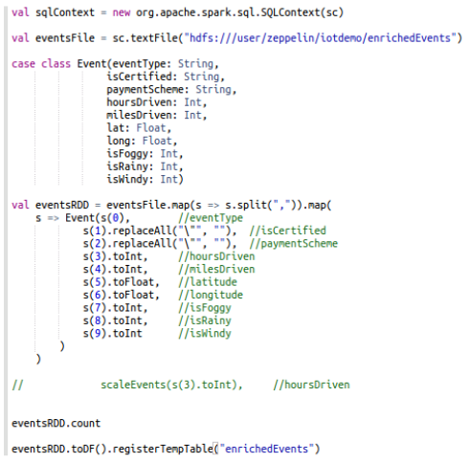
DataFrames and Tables - IoT Demo Create
IoT demo starts with a text file…
…creates a schema…
…assembles a formatted RDD using the text file and schema…
…converts the RDD to a DataFrame, and registers it as a temporary table.
Notes:
To understand the relationship between DataFrames and tables, we will start with the IoT demo which was run in an earlier lab. In the code, a CSV file is converted to an RDD named eventsFile using sc.textFile. Next, a schema named Event is created which which labels each column and sets its type. Then a new RDD named eventsRDD is generated which takes the contents of the eventFile RDD and transforms the elements according to the Event schema, casting each column and reformatting data as necessary. The code then counts the rows of eventsRDD - presumably as some kind of verification that the operation was successfully performed.
The final two steps are performed on a single line of code. First eventsRDD is converted to an unnamed DataFrame, which is then immediately registered as a temporary table named enrichedEvents.
IMPORTANT NOTE: Some of the techniques shown here to format a text file for use in a DataFrame is beyond the scope of this class, but various references exist online for how to accomplish this.

Slide 168
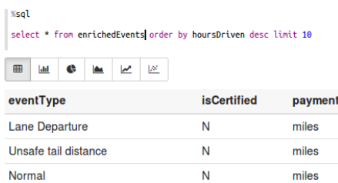
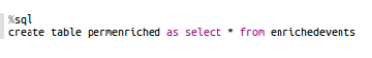
DataFrames and Tables - IoT Demo Use
In a new paragraph, this table is now available to be manipulated using SQL commands
It can also be permanently stored in Hive for future use across multiple context instances
Notes:
Once a DataFrame has been registered as a table, it is now available for direct manipulation by a Spark SQL context, using SQL commands. This temporary table can also be permanently converted to a permanent table in Hive. Making the table part of Hive's managed data has the added benefit of making the table available across multiple Spark SQL contexts.

Slide 169
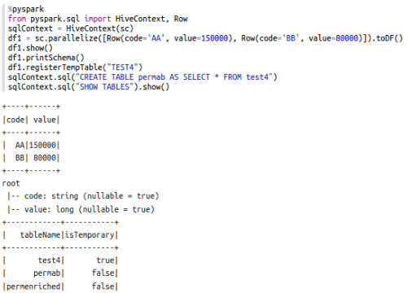
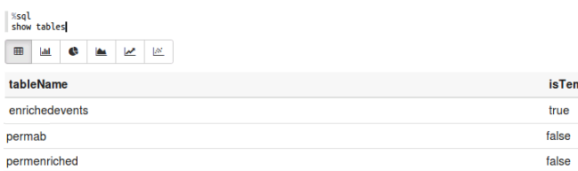
DataFrames and Tables - Row Objects (Python)
Row objects can be created programmatically, converted to DataFrames, and registered as temporary tables, and stored in Hive as well
…but %sql sees it differently!
Note that the "SHOW TABLES" api call shows test4, permab, and permenriched, but *not* enrichedevents table
Key: Storing tables in Hive enables visibility across context instances
Notes:
INSTRUCTOR NOTE: Any modifications to slide text will require reording of bullets. The line …but %sql sees it differently! should appear with the second graphic and come after Note that "SHOW TABLES"…. If you change the text even slightly, PPT reorders it based on its position.
Another way to create a DataFrame is by creating a Row object. In the Python code shown, a Row object is created using sc.parallelize(). This Row object has an implied schema of two columns - named code and value - and there are two records for code AA with a value of 150000 and code BB with a value of 80000. Because we do not need to work with the RDD directly, we immediately convert this collection of Row objects to a DataFrame using toDF(). We then visually verify that the Row objects were converted to a DataFrame using show(), and that the schema was applied correctly using printSchema().
The DataFrame is registered as a temporary table named test4, which is then converted to a permanent Hive table named permab. We then run SHOW TABLES to view the tables available for SQL to manipulate.
Note here that SHOW TABLES returned two Hive tables - permab and permenriched - and the temporary table test4. However, if we return to our other SQL context and run SHOW TABLES, we see the two Hive tables, but we do *not* see test4. In addition, this SQL context can still see the enrichedevents temporary table, which was not visible to our other SQL context.
The key takeaway here is this: if you want to make a table available to all SQL contexts across the cluster and not just the current SQL context, you must convert it to a permanent Hive table.

Slide 170
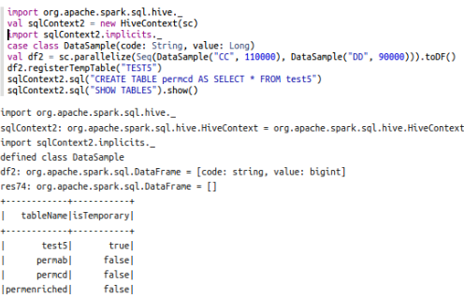
DataFrames and Tables - Row Objects (Scala)
Code looks different in Scala but the same basic flow applies - create formatted RDD, convert to DataFrame, register as a temporary table, and save to Hive
Note again: only temporary table visible for SQL operations is one created by this context, but all Hive tables are visible
Notes:
This code in this screenshot performs a similar operation to the IoT example, but on a smaller scale, and using Row objects in Scala rather than Python. Some of the key differences between this and the previous example include the definition of the DataSample schema class prior to creation of the df2 RDD, with a different syntax during creation of the RDD. As in the previous example, this RDD is immediately converted to a DataFrame, then registered as a temporary table which is converted to a Hive table.
Note again: the only temporary table visible when SHOW TABLES is executed is the temporary table created by this instance of the SQL context. All of the Hive tables are returned, as per previous examples.

Slide 171
DataFrames and Tables - Summary
Registering a temporary table makes that table available for either DataFrames API or SQL interactions while operating in that specific context, but storing tables in Hive (and using HiveContext) makes them available across contexts
sqlContext1
sqlContext2
tempTable2
sqlContext3
tempTable1
tempTable3
HiveTable
HiveTable
HiveTable
HiveTable
Hive (metadata)
HDFS (unstructured data)
Notes:
Once again, then, one of the keys when writing multiple applications and utilizing multiple Spark SQL contexts across a cluster, registering a temporary table makes it available for either DataFrame API or SQL interactions while operating in that specific context. However, those DataFrames and tables are only available within the Spark SQL context in which they were created. To make a table visible across Spark SQL contexts, you should store that table permanently in Hive, which makes it available to any HiveContext instance across the cluster.

Slide 172
Creating and Saving DataFrames and Tables

Slide 173
Convert an RDD to a DataFrame
An RDD with elements that adhere to a properly defined schema can be converted to a DataFrame using one of the following methods:
toDF():
val dataframeX = rddName.toDF()
createDataFrame(): val dataframeX = sqlContext.createDataFrame("rddName")
In Python, if an RDD is properly formatted but lacks a schema, createDataFrame() can be used to infer the schema on DataFrame creation
rddName = sc.parallelize([(‘AA’, 150000), (‘BB’, 80000)])
dataframeX = sqlContext.createDataFrame(rddName, [‘code’, ‘value’])
Notes:
An RDD with elements that adhere to a properly defined schema can be converted to a DataFrame using one of the following methods:
toDF(): dataframeX = rddName.toDF()
createDataFrame(): dataframeX = sqlContext.createDataFrame("rddName")
In Python, if an RDD is properly formatted but lacks a schema, createDataFrame() can be used to infer the schema on DataFrame creation.
rddName = sc.parallelize([(‘AA’, 150000), (‘BB’, 80000)])
dataframeX = sqlContext.createDataFrame(rdd, [‘code’, ‘value’])

Slide 174
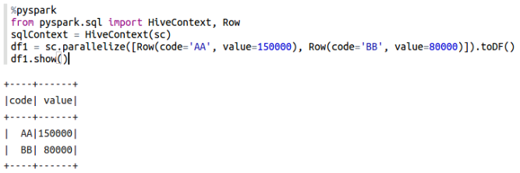
Create DataFrames Programmatically - Python
Create an RDD of Row elements, define schema element by element, and convert to a DataFrame
from pyspark.sql import HiveContext, Row
sqlContext = HiveContext(sc)
df1 = sc.parallelize([Row(code= 'AA', value= 150000), Row(code= 'BB', value= 80000)]).toDF()
Notes:
Before an RDD can be converted to a DataFrame, a properly structured one must be created. In Python this can be accomplished by creating an RDD of Row elements in which the schema is defined on an element-by-element basis. This RDD can then be converted to a DataFrame. For example:
from pyspark.sql import HiveContext, Row
sqlContext = HiveContext(sc)
df1 = sc.parallelize([Row(code= 'AA', value= 150000), Row(code= 'BB', value= 80000)]).toDF()

Slide 175
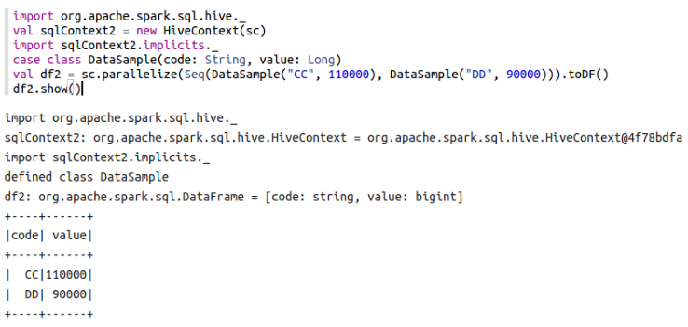
Create DataFrames Programmatically - Scala
Import sqlContext.implicits._ and define a schema class object, then define instances of that object as an RDD and convert the RDD to a DataFrame
import org.apache.spark.sql.hive._
val sqlContext2 = new HiveContext(sc)
import sqlContext2.implicits._
case class DataSample(code: String, value: Long)
val df2 = sc.parallelize(Seq(DataSample("CC", 110000), DataSample("DD", 90000))).toDF()
Notes:
To create an RDD that can be converted to a DataFrame using Scala, start by importing sqlContext.implicits._ (assuming your Spark SQL context is named sqlContext), which assists in implicit type casting. (This is handled automatically in most cases when programming with Python.) Then, create the schema you will be using with case class [schemaName](columnName: datatype, columnName: datatype, ….). Then, create the DataFrame by creating an RDD that contains a sequential list of instances of this class and provide appropriate values, followed by toDF(). For example:
import org.apache.spark.sql.hive._
val sqlContext2 = new HiveContext(sc)
import sqlContext2.implicits._
case class DataSample(code: String, value: Long)
val df2 = sc.parallelize(Seq(DataSample("CC", 110000), DataSample("DD", 90000))).toDF()

Slide 176
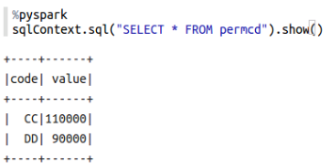
sqlContext.sql() and show()
The DataFrames API enables a user to run native SQL commands using the sql() function prepended by the name of the context (default is usually sqlContext)
When displaying DataFrame contents or the output from a SQL command run from the DataFrames API, append show() to display the contents on-screen
sqlContext.sql("SELECT * FROM permcd").show()
Notes:
Once a table is created, the DataFrames API can still be used to view and manipulate it using sqlContext.sql("SQL command goes here"). Again, this assumes your Spark SQL context is named sqlContext. If you wish to see the output from the SQL command, append show() to the line of code. For example:
sqlContext.sql("SELECT * FROM permcd").show()
As previous examples have demonstrated, the show function can also be used to display the contents of a DataFrame.

Slide 177
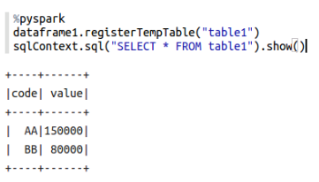
Register DataFrames as Temporary Tables
Use registerTempTable() to make the DataFrame available to SQL within the current context
dataframe1.registerTempTable("table1")
Notes:
By default, DataFrames are not available for direct SQL manipulation. Instead, a developer would need to use the DataFrames API to perform operations. To register a DataFrame to a table that can be directly manipulated by SQL, use registerTempTable(). For example: dataframe1.registerTempTable("table1")
This takes the DataFrame named dataframe1 and registers it as a temporary table named table1. As the screenshot demonstrates, this table is now available for SQL manipulations.

Slide 178
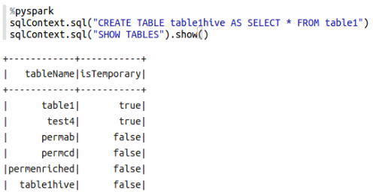
CREATE TABLE
Use the HiveQL CREATE TABLE function to make a copy of a DataFrame as a permanent Hive table
sqlContext.sql("CREATE TABLE table1hive AS SELECT * FROM table1")
Notes:
Temporary tables are only available to the Spark SQL context that created them. One way to make a table visible across all Spark SQL contexts in the cluster is to create a Hive table and copy the contents of the temporary table to it. The code to accomplish this would be:
sqlContext.sql("CREATE TABLE table1hive AS SELECT * FROM table1")
This creates a table named table1hive in Hive, copying all of the contents from temporary table table1. The screenshot demonstrates that table1hive is now registered as a permanent table.

Slide 179
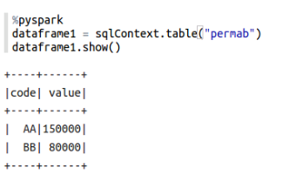
table() - Create DataFrames from Existing Hive Tables
Define a variable for the DataFrame and use table() to make the data available to DataFrames API functionality
dataframe1 = sqlContext.table("permab")
Notes:
Just as DataFrames can be converted to tables, tables can also be converted to DataFrames, which can then be directly manipulated using the DataFrames API. This is accomplished by using sqlContext.table(), as in the example below:
dataframe1 = sqlContext.table("permab")

Slide 180
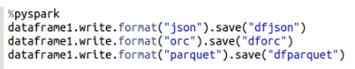
Save DataFrames as Files Using write()
DataFrames can be saved to HDFS as files of many commonly used file formats, including ORC, JSON, and parquet.
dataframe1.write.format("json").save("dfjson")
dataframe1.write.format("orc").save("dforc")
dataframe1.write.format("parquet").save("dfparquet")
Notes:
DataFrames can be permanently stored in HDFS in several non-table formats as well using write(). Some of the common ones used include ORC, JSON, and parquet. The command to save the DataFrame contents to these file types follows the following syntax:
DataFrameName.write.format("selectedFormat").save("HDFSfolder")
Specific examples for JSON, ORC, and parquet files:
dataframe1.write.format("json").save("dfjson")
dataframe1.write.format("orc").save("dforc")
dataframe1.write.format("parquet").save("dfparquet")

Slide 181
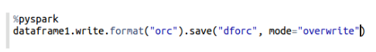
Save Modes
Save modes control behavior during save operations
ErrorIfExists: Default mode, returns an error if the data already exists
Append: Appends data to file or table if it already exists
Overwrite: Replaces existing data if it already exists
Ignore: Does nothing if the data already exists
dataframe1.write.format("orc").save("dforc", mode="overwrite")
Notes:
By default, if a write() is used and the file already exists, an error will be returned. This is because of the default behavior of save modes. However, this default can be modified. Here are the possible values for save mode when writing a file and their definitions:
ErrorIfExists: Default mode, returns an error if the data already exists
Append: Appends data to file or table if it already exists
Overwrite: Replaces existing data if it already exists
Ignore: Does nothing if the data already exists
For example, if you were using the write() command from before to save an ORC file and you wanted the data to be overwritten / replaced if a file by the same name already existed, you would use the following code:
dataframe1.write.format("orc").save("dforc", mode="overwrite")

Slide 182
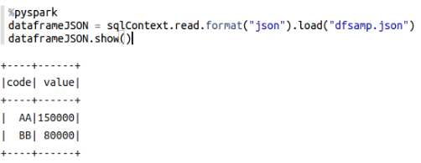
Create DataFrames from Files using read()
DataFrames can be created easily from certain structured file types, including ORC, parquet, and if properly formatted, JSON (as well as others)
val dataframeJSON = sqlContext.read.format("json").load("dfsamp.json") Or, if reading from a folder of part-* files created using write(): val dataframeJSON = sqlContext.read.format("json").load("folderName/*")
Notes:
DataFrames can be created from files of many structured file types, including ORC, parquet, and JSON files if they are properly formatted using read(). (For a complete list of supported file types for direct import into DataFrames, please refer to Spark SQL documentation.
The syntax is similar to the write() command used before, only read() is used, and an appropriate file is loaded. For example, to use the JSON file created earlier to create a DataFrame:
dataframeJSON = sqlContext.read.format("json").load("dfsamp.json")
or, if reading from a folder of part-* files created using write():
dataframeJSON = sqlContext.read.format("json").load("folderName/*")
Note: If you peruse the documentation, you will note that some file formats have read() shortcuts - for example: read.json instead of read.format("json"). We do not demonstrate them in class because they are not consistent across all supported file types, however if a developer works primarily with JSON files on a regular basis, using the read.json shortcut may be beneficial.

Slide 183
Lab: Create and Save DataFrames

Slide 184
Manipulating DataFrames and Tables

Slide 185
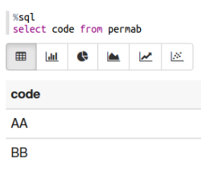
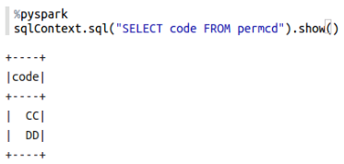
Manipulate SQL Tables using SQL Commands
As we have already seen, tables can be manipulated by using standard SQL commands via Spark SQL or within the DataFrames API using sqlContext.sql()
Notes:
As has already been discussed, tables can be manipulated using SQL and HiveQL commands via Spark SQL or within the DataFrames API using sqlContext.sql(). In both cases, queries are optimized using Catalyst, meaning highly optimized operations occur by default.
In this class, we do not explicitly teach a significant number of SQL commands, as it is assumed most Spark developers have prior exposure to this topic.

Slide 186
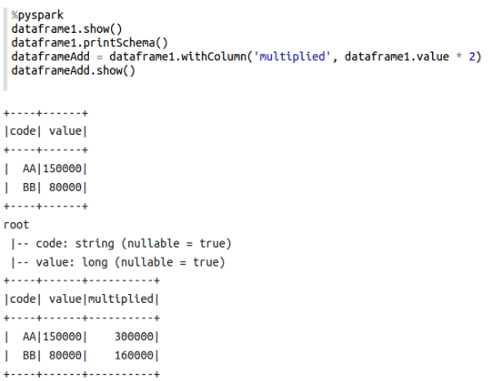
show(), printSchema(), and withColumn()
show() displays contents of a DataFrame or SQL result
printSchema() displays the schema for a DataFrame
withColumn() creates a new DataFrame with a new column based on criteria you provide
Notes:
In addition to sqlContext.sql(), however, the DataFrames API contains a number of functions that are designed to manipulate DataFrames (rather than tables) in a similar fashion to how SQL queries manipulate tables.
The show function is one we have seen several times already. It displays the contents of a DataFrame, the output of a SQL command run within sqlContext.sql(), and is also required for on-screen display of several other functions that will be discussed.
The printSchema function displays the schema for a DataFrame.
The withColumn function returns a new DataFrame with a new column based on criteria you provide. In the example, a new column named multiplied was created, and the numbers in that column are the numbers in the value column multiplied by two.

Slide 187
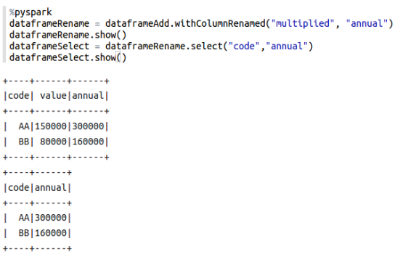
withColumnRenamed() and select()
withColumnRenamed() returns a new Dataframe with a renamed column
select() returns a new DataFrame with only the specified columns and data
Notes:
The withColumnRenamed function returns a new DataFrame with a column renamed - in the example, from multiplied to annual.
The select function returns a new DataFrame with only the explicitly named columns and their data.

Slide 188
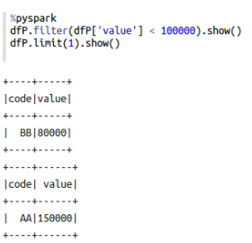
filter() and limit()
filter() returns a DataFrame with only rows that have column values that meet a defined criteria
limit() returns a DataFrame with a defined number of rows
Notes:
The filter function returns a DataFrame with only rows that have column values that meet a defined criteria - in the screenshot, only rows that had values less than 100,000 were returned.
The limit function returns a DataFrame with a defined number of rows - in the example, only the first row was returned.

Slide 189
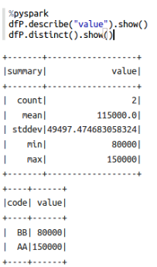
describe() and distinct()
describe() returns count, mean, standard deviation, minimum, and maximum values for named columns in a DataFrame
distinct() returns a new DataFrame of only the unique rows from the original DataFrame
Notes:
The describe function returns count, mean, standard deviation,minimum, and maximum values for named columns in a DataFrame.
The distinct function returns a new DataFrame of only the unique rows from the original DataFrame.

Slide 190
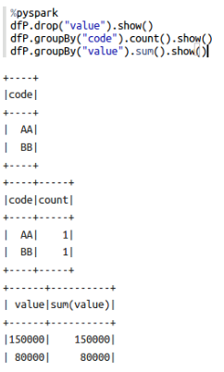
drop() and groupBy()
drop() returns a DataFrame without the named column(s)
groupBy() groups rows by matching column values, which can then have some other function performed on them and returned as the result
Two examples here, performing a count() on the code column, and then performing a sum() on the values column
Notes:
The drop function returns a DataFrame without specific volumes included. Think of it as the opposite of the select function.
The groupBy function groups rows by matching column values, and can then perform other functions on the combined rows such as count() or agg(). The screenshot shows two examples. In the first one, the code column is grouped and the number of matching values are counted and displayed in a separate column. In the second one, the values column is scanned for matching values, and then the sums of the identical values are displayed in a separate column.

Slide 191
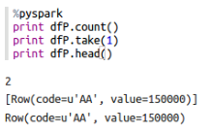
count(), take(), and head()
count() returns the number of rows in the DataFrame as a result
take() returns a number of rows in the DataFrame and returns them as Row objects
head() returns the first row in the DataFrame as a Row object
Note: In the screenshot provided, these functions are shown prepended with print. However, the print command is not required for Scala, nor is it required for Python when using the REPL. (See note in student book for more detail.)
Notes:
The count function returns the number of rows in the DataFrame as a result.
The take function returns a number of rows in the DataFrame and returns them as Row objects.
The head function returns the first row in the DataFrame as a Row object.
IMPORTANT NOTE: In the screenshot provided, these functions are shown prepended with print. However, the print command is not required for Scala, nor is it required for Python when using the REPL. Technically, these functions should probably not have required the print function in order to produce output either, but via trial and error testing we discovered that they worked when print was supplied in Zeppelin. In addition, at the time of this writing, a handful of pyspark functions did not operate correctly *at all* when run inside Zeppelin, even in conjunction with the print command. Some examples include first(), collect(), and columns. This is likely the result of a bug in the version of Zeppelin used to write this course material, however this may no longer be the case by the time you are reading this. For additional DataFrames API functions, please refer to the online Apache Spark SQL DataFrames API documentation. Testing these pyspark functions without the print command will likely result in success in a future implementation.

Slide 192
Lab: Work with Tables and DataFrames

Slide 193
Knowledge Check

Slide 194
Questions
While core RDD programming is used with [structured/unstructured/both] data Spark SQL is used with [structured/unstructured/both] data.
True or False: Spark SQL is an extra layer of translation over RDDs. Therefore while it may be easier to use, core RDD programs will generally see better performance.
True or False: A HiveContext can do everything that a SQLContext can do, but provides more functionality and flexibility.
True or False: Once a DataFrame is registered as a temporary table, it is available to any running sqlContext in the cluster.
Hive tables are stored [in memory/on disk].
Name two functions that can convert an RDD to a DataFrame.
Name two file formats that Spark SQL can use without modification to create DataFrames.
Notes:
Answers
Both / Structured
False. The Catalyst optimizer means Spark SQL programs will generally outperform core RDD programs
True.
False. Temporary tables are only visible to the context that created them.
On disk
toDF() and createDataFrame()
The ones discussed in class were ORC, JSON, and parquet files.

Slide 195
Summary

Slide 196
Summary
Spark SQL gives developers the ability to utilize Spark's in-memory processing capabilities on structured data
Spark SQL integrates with Hive via the HiveContext, which broadens SQL capabilities and allows Spark to use Hive HCatalog for table management
DataFrames are RDDs that are represented as table objects which can used to create tables for SQL interactions
DataFrames can be created from and saved as files such as ORC, JSON, and parquet
Because of Catalyst optimizations of SQL queries, SQL programming operations will generally outperform core RDD programming operations

Slide 197
Data Visualization in Zeppelin

Slide 198
Objectives
After completing this lesson, students should be able to:
Explain the purpose and benefits of data visualization
Perform interactive data exploration using visualization in Zeppelin
Collaborate with other developers and stakeholders using Zeppelin
Notes:
After completing this lesson, students should be able to:
Explain the purpose and benefits of data visualization
Perform interactive data exploration using visualization in Zeppelin
Collaborate with other developers and stakeholders using Zeppelin

Slide 199
Data Visualization Overview

Slide 200
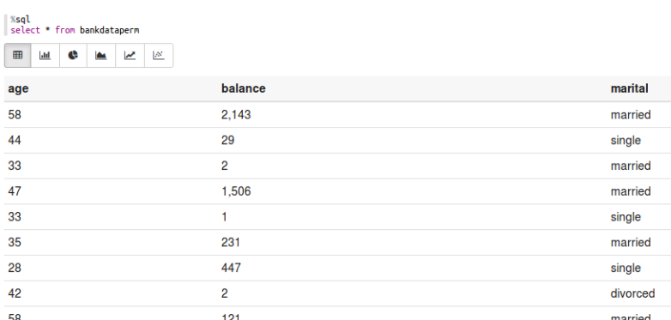
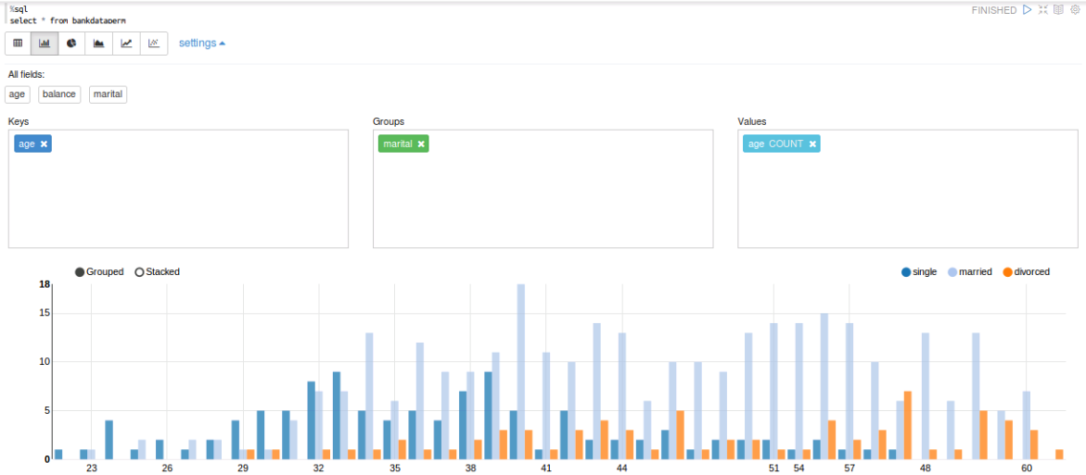
Data Visualization Introduction
Table-based data is great for calculation and organization, but hard to use for decision making when working with large sets of data
Data visualizations enable humans to make inferences and draw conclusions about large sets of data based on visual input alone
Notes:
Thus far, everything that has been discussed in-class has been looked at in terms of tabular data - that is, DataFrames and tables formatted into columns and tables. This formatting is helpful and, some would argue, necessary for computational analysis of large amounts of data, however the usefulness of the data in this format is limited from a human decision-making perspective. We simply lack the ability to look at hundreds of rows of varied data and make inferences or draw conclusions, thus tabular data on its own is limited in its ability to assist with real-world decision making.
Data visualizations allow human beings to look at large amounts of consolidated data in a graphical form, allowing us to quickly make inferences and draw conclusions based on visual input alone. While several categories of data visualizations have become standard content for things like reports and dashboards, the types of data visualizations available are limited only by the human imagination. Numerous programs and code libraries are available to produce them, and in addition, custom visualizations can easily be made using tools such as HTML and JavaScript.

Slide 201
Data Visualization and Spark
The Spark project contains a module called GraphX for visualizations
Scala only
Programmatic (difficult for non-coders to interact with)
Zeppelin can be used for data visualization as well
Lots of built-in, easy to use visualizations
Virtually any visualization library from any supported language can be used
Easy collaboration with other developers and non-technical business owners
Notes:
The Spark project actually contains a data visualization module called GraphX. It is a Scala-only set of tools that enable a developer to programmatically produce relatively complex data visualizations in Spark.
In addition, however, Zeppelin comes with a feature-rich, easy to use, and highly extensible set of data visualization capabilities. Not only can Zeppelin produce complex data visualizations, it allows a developer to collaborate with others via controlled notebook sharing, produce reports for external consumption by only sharing paragraph results, and add manipulation tools to those published paragraphs so that users without any code knowledge can be granted the ability to manipulate those results in real time for various purposes.
Because of Zeppelin's direct integration with Spark, flexibility in terms of supported languages, and collaboration and reporting capabilities, the rest of this lesson will show a developer how to use the tool for greatest effect.
Keep in mind, however, that Zeppelin also supports HTML and JavaScript, and can also work with other data visualization libraries available to Python, Java, and other developers. If Zeppelin's built-in capabilities don't quite meet your needs, you always have the ability to expand on them!

Slide 202
Data Exploration

Slide 203
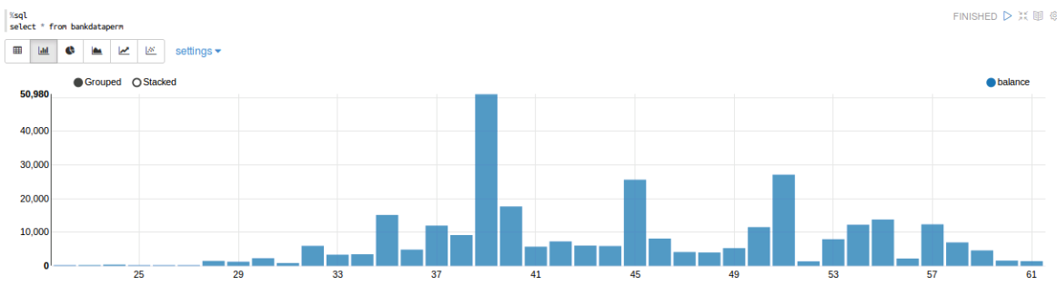
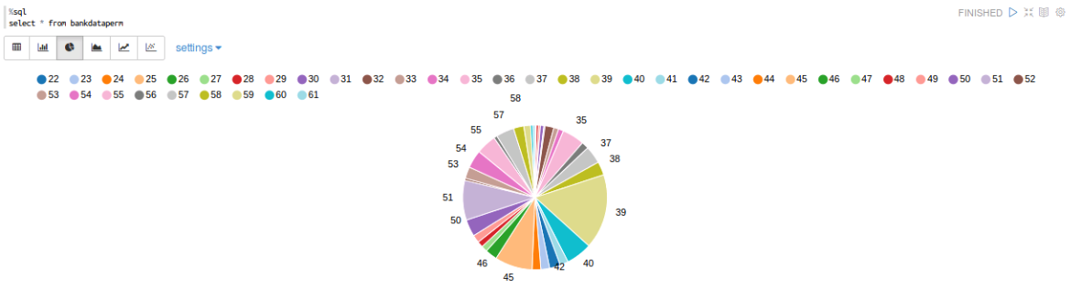
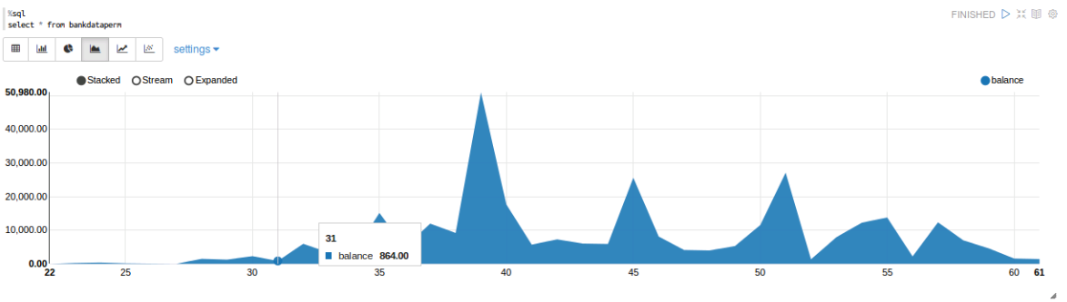
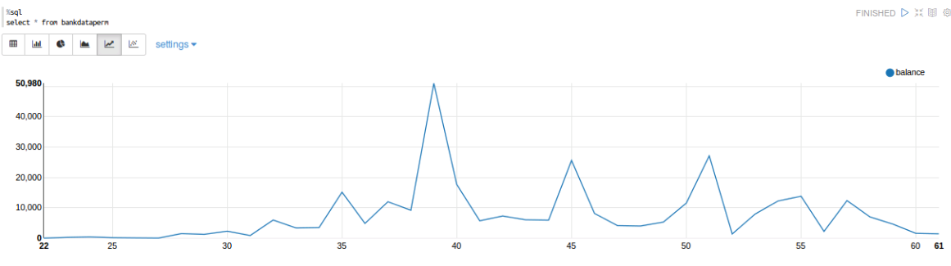
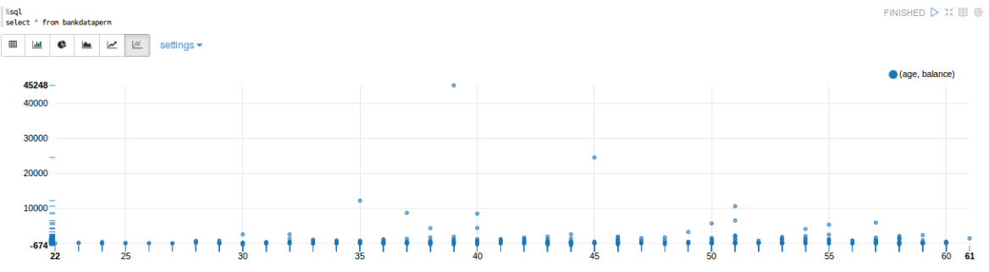
Visualizations on Tables (%sql default)
Notes:
Zeppelin provides several different ways to visualize tables, and will provide these options by default whenever working with %sql in a note. The six views provided are:
Table, which shows rows and columns much like a spreadsheet
Bar chart,
Pie chart,
Area chart,
Line chart, and
Scatter plot chart.
When a chart is displayed, you can hover the mouse pointer over an area to see the underlying data for that section of the chart.

Slide 204
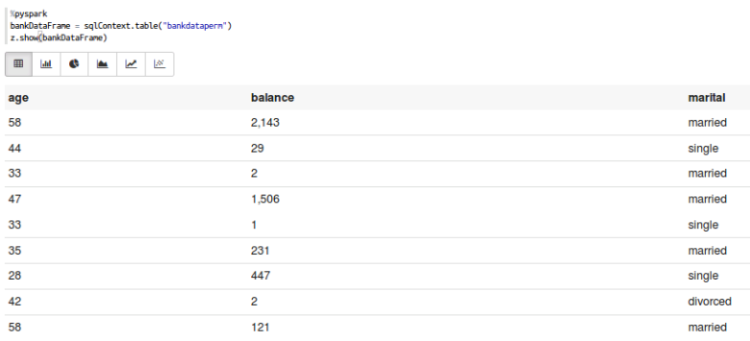
Visualizations on DataFrames
z.show(DataFrameName)
Notes:
Zeppelin can also provide visualizations on DataFrames that have not been converted to SQL tables by using the following command:
z.show(DataFrameName)
This command tells Zeppelin to treat the DataFrame like a table for visualization purposes. Since a DataFrame is already formatted like a table, the command should work without issue on every DataFrame.

Slide 205
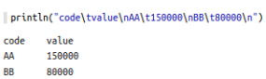
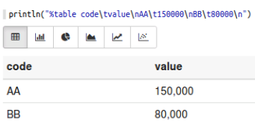
Visualizations on Other Formatted Data
Use %table as part of the print instruction and, if formatted correctly, the data will be presented with visualizations enabled
println("%table code\tvalue\nAA\t150000\nBB\t80000\n")
Notes:
Zeppelin also comes with a %table indicator, which can be used to tell Zeppelin that any properly formatted data should be treated as a table. In the example, we start by using the Scala println() command and create a simple table programmatically. The screenshot on the left shows what Zeppelin shows when %table is not part of the command. On the right, %table is used, and Zeppelin now displays the content as a table, with supporting data visualizations available.
If the data is not formatted correctly, Zeppelin would simply return the string as a table name with no data.

Slide 206


Interactive Visualization - Programmatic
Visualization displays change any time a new query (or other command) is executed
Notes:
Zeppelin will update a visualization any time a new query is run in a paragraph. For example, in the first screenshot, the SQL command displays a visualization for all columns and rows. However, in the second screenshot, the query was updated to only include rows with a value in the age column that exceeded 45.

Slide 207

Interactive Visualization - Pivot Charts
In addition, Zeppelin provides a Pivot Chart capability under Settings in which additional data manipulations can be performed without changing the original query or command
Notes:
You can write and rewrite, and then rerun, SQL statements to get exactly the data you want. However, Zeppelin also provides a pivot chart capability that becomes available when you click settings to the right of the chart options. This provides you with an ability to manipulate the chart output in a number of ways without requiring you to modify the initial query. In our example, we see that the default chart uses age as a key, and sums the balances for all persons of a given age as the value. You'll note that this was done automatically, without any grouping or sum command as part of the SQL statement itself.

Slide 208

Pivot Chart - Value Options
Click on the box under "Values" and a drop-down menu appears
Use it to change the default value action
Switch between SUM, AVG, COUNT, MIN, and MAX
Notes:
The pivot chart feature allows you to change the action performed on the Values column selected. Click on the box (in the screenshot, the one that says balance) and a drop-down menu of options appear which can be used to change the default value action. Options include SUM, AVG, COUNT, MIN, and MAX.

Slide 209





Pivot Chart - Change Values or Keys
Click on the "x" to the right of a box to remove that from the appropriate column, then drag and drop from the column options to display something new
Notes:
Any column in the table can be set as a Key or Value. To remove a column, click the "x" to the top right of the name box and it will disappear. If either the Key or Value field is blank, the output indicates that there is no data available. Then you simply drag and drop the field you want as a value into the appropriate box and the output refreshes to match. In this example, we elected to use the age column for both Keys and Values, and used the COUNT feature to count the number of individuals in each age category.

Slide 210


Pivot Chart - Add Groups
Drag and drop the appropriate grouping category from the list of options to see the data further broken down
Notes:
In addition to Keys and Values, pivot charts also allow you to specify Group columns which can provide further breakdown of the data. In the example, the marital column was defined as a grouping, and therefore every unique value in that column (married, single, or divorced) became its own bar color in the bar chart.

Slide 211



Dynamic Forms
Sometimes Pivot Charts don't provide the flexibility needed when interacting with data
In these instances, Dynamic Forms can be implemented in the query / command to provide parameters for WHERE clauses
SELECT * FROM table WHERE colName [mathOp] ${LabelName=DefValue}
Notes:
Dynamic Forms give you the ability to define a variable in the query or command and allow that value to be dynamically set via a form that appears above the output chart. These can be done in various programming languages. For SQL, you would use a WHERE clause and then specify the column name, some mathematical operator, and then a variable indicated by a dollar sign with the form name and the default value specified inside a pair of curly braces.
SELECT * FROM table WHERE colName [mathOp] ${LabelName=DefValue}
In the screenshots shown, we select the age column, where age is greater than or equal to the variable value, label the column Minimum Age and set the default value to 0 so that all values will appear by default. Then, in the resulting dynamic form, we set the minimum age to 45 and press enter, which results in the chart updating to reflect a minimum age of 45 in the output.

Slide 212

Dynamic Forms - Multiples
Multiple variables can be included as Dynamic Forms
Notes:
Multiple variables can be included as dynamic forms. In the example shown, the WHERE clause has been extended with an AND operator, so both a minimum age of 0 and a maximum age of 100 are set as defaults. The user then sets the minimum age value to 30 and the maximum age to 55 and presses enter, resulting in the underlying output changing to meet those criteria.

Slide 213



Dynamic Forms - Select
Select forms (drop-down menus) can be created as Dynamic Forms as well.
... WHERE colName = "${LabelName=defaultLabel,opt1|opt2|opt3|…}"
Notes:
Dynamic forms can also include select lists (a.k.a. drop-down menus). The syntax for a select list within a WHERE clause would be:
... WHERE colName = "${LabelName=defaultLabel,opt1|opt2|opt3|…}"
In the example shown, the marital column is specified, a variable created, and within the variable definition we specify the default value for marital = married. Then, insert a comma, and provide the complete list of options you wish to provide separated by the | (pipe) character - in our case, married, single, and divorced. This results in a new dynamic form, and the output will respond to changes in the drop-down menu.

Slide 214
Collaboration and Sharing

Slide 215


Clone and Export a Note
Before sharing a note with others, it may be a good idea to make a copy of it
Two ways to do this:
Clone: make a copy of the note in Zeppelin
Export: save a copy of the note in JSON format
Notes:
Before sharing a note with others, it may be a good idea to make a copy of it. There are two easy ways to do this: clone or export.
Cloning a note makes a copy of the note in your Zeppelin notebook. You can clone a note by clicking on the button labeled "Clone the notebook" (when you hover over it with your mouse pointer) at the top of the note.
Exporting a note downloads a copy of the note to the local file system in JSON format. You can export a note by clicking on the button labeled "Export the notebook" at the top of the note.

Slide 216

Import a Note
Exported notes can be shared with and imported by another developer
Notes:
Exporting a note also gives you the ability to share that file with another developer, which they can then import into their own notebook from the Zeppelin landing page by clicking on "Import note."

Slide 217

Note Cleanup
In-process notes can be messy and contain unnecessary duplicate code or alternatives
Individual paragraphs that are no longer needed can be deleted from the note
Paragraphs can also be reordered and new paragraphs can be inserted
For example, to add Markdown comments
Notes:
Often note development will be a series of trial and error approaches, comparing methods to pick the best alternative. This can result in a notebook that contains paragraphs that you don't want to keep, or don't want distributed to others for sake of clarity. Fortunately cleaning up a note prior to distribution is relatively easy.
Individual paragraphs that are no longer needed can be removed/deleted from the note. In the paragraph, click on the settings button (gear icon) and select remove to delete it. Paragraphs can also be moved up or down in the note and new paragraphs can be inserted (for example, to add comments in Markdown format describing the flow of the note).

Slide 218

Interactive Note Sharing
Note URLs can be shared
All connections using this URL are live, real-time connections to the same note
Notes:
Zeppelin enables collaboration between developers by sharing the URL of the note. All connections using this URL are live, real-time connections, similar to joint editing of a Microsoft Office Online or Google Drive doc.

Slide 219

Note Access Control
By default, anyone with the note link can completely control the note
To control access, click the Note Permissions (padlock) icon at the top-right corner of the note and set permissions accordingly
Notes:
By default, note permissions are open, meaning anyone with the note link can do anything with the note - including change permissions, read, and write. To control what individuals can do with a shared note, click the Note Permissions (padlock) icon at the top-right corner of the note and set permissions accordingly. The exact format will vary based on the authentication mechanisms employed in your environment.

Slide 220


Note Formatting
Note owners can control all paragraphs at the note level, including:
Hide/Show all code
Hide/Show all output
Clear all output
There are also two additional note views
Simple: Removes note-level controls
Report: Removes note-level controls and all code
Notes:
Note owners can control all paragraphs at the note level, via a set of buttons at the top of the note. These controls include:
Hide/Show all code via the button labeled "Show/hide the code,"
Hide/Show all output via the button labeled "Show/hide the output" (which changes from an open book to a closed book icon based on the current setting), and
Clear all output via the eraser icon button labeled "Clear output."
There are also two additional note views. The Simple view removes the note-level controls at the top of the note. The Report view removes all note-level controls, as well as hides all code in the note, resulting in a series of outputs. These views can be selected by clicking the button labeled "default" at the top-right corner of the note and then choosing the appropriate option from the resulting drop-down menu.

Slide 221


Automate Note Updates
Entire notes can be played, paragraph by paragraph, at regular intervals
Notes:
An entire note can be played, paragraph by paragraph, by using the Play icon button labeled "Run all paragraphs." In addition, this operation can be scheduled to run on a regular basis the scheduling feature, which is enabled by clicking the clock icon button labeled "Run scheduler." This allows you to schedule the note to run at regular intervals including every minute, every five minutes, every hour, and so on up to every 24 hours via preset links that can simply be clicked to activate. If these options are not granular enough for you, you can also schedule the note at a custom interval by supplying a Cron expression.

Slide 222

Paragraph Formatting
Paragraphs also contain formatting settings, including:
Hide/Show paragraph code
Hide/Show paragraph output
Clear paragraph output is available in the settings menu (gear icon)
Notes:
Paragraphs can also be formatted prior to distribution on an individual basis. These settings are available in the buttons menu at the top right of each paragraph, as well as underneath the settings menu (gear icon) button. Formatting options that were also available at the note level include:
Hide/Show paragraph code,
Hide/Show paragraph output, and
Clear paragraph output (under settings).

Slide 223


Paragraph Enhancement - Width
Width: Controls width of the paragraph in the note, allowing multiple paragraphs to be displayed in a row
Notes:
The visual appearance of paragraphs can also be enhanced to support various collaboration goals. For example, assume you want to create a dashboard within a Zeppelin note, showing multiple views of the same data on the same line. This can be accomplished by modifying the Width setting, found in paragraph settings. By default, the maximum width is used per paragraph, however, this can be modified so that two or more paragraphs will appear on the same line.

Slide 224




Paragraph Enhancement - Show Title
Paragraph titles can be added for clarity
Notes:
Paragraphs can be given titles for added clarity when viewing output. To set a title, under paragraph settings select Show title. The default title is "Untitled." Click on the title to change it, type the new title, and press the Enter key to set it.

Slide 225

Paragraph Enhancement - Line Numbers
Line numbers can be added to paragraph code
Notes:
Paragraphs displaying code can also be enhanced by showing the line numbers for each line of code. To turn this feature on, under paragraph settings select Show line numbers. The numbers will appear to the left of the code lines. Lines that are wrapped based on the width of the paragraph will only be given a single number, even though on the screen they will appear as multiple lines.

Slide 226


Paragraph Sharing
Individual paragraphs can be shared via links which can be sent to users or embedded in reports generated by other tools
If Dynamic Forms have been implemented in the paragraph, users will be able to interact with the data, even though they do not have access to the code
Notes:
Individual paragraphs can be shared by generating a link, which can be used as an iframe or otherwise embedded in an external-to-Zeppelin report. To generate this URL, select Link this paragraph under paragraph settings. This will automatically open the paragraph in a new browser tab, and the URL can be copied and pasted into whatever report or web page is needed.
It is important to note here that if dynamic forms have been enabled for this note, anyone who modifies the form values will change the appearance of the paragraph output for everyone looking at the link. This can be a valuable tool if, for example, a marketing department wants to generate multiple outputs based on slight tweaks to the query. You can allow them to do this without giving them access to the entire note, and without the need to modify the code on the back end.

Slide 227
Disable Paragraph Output Changes
Disable the paragraph run feature to lock the output of a paragraph
Changes to Dynamic Forms or code will not be reflected in the paragraph
Notes:
In some cases, you may want to freeze a paragraph's output in its current form. To do so, under paragraph settings select the Disable run option. Any changes to the code, as well as changes to dynamic forms input, will not change the output presented as long as the Disable run option is selected.

Slide 228
Lab: Data Visualization in Zeppelin

Slide 229
Knowledge Check

Slide 230
Questions
What is the value of data visualization?
How many chart views does Zeppelin provide by default?
How do you share a copy of your note (non-collaborative) with another developer?
How do you share your note collaboratively with another developer?
Which note view provides only paragraph outputs?
Which paragraph feature provides the ability for an outside person to see a paragraph's output without having access to the note?
What paragraph feature allows you to give outside users the ability to modify parameters and update the displayed output without using code?
Notes:
Answers
Enable humans to make inferences and draw conclusions about large sets of data that would be impossible to make by looking at the data in tabular format.
Five
Export to JSON format, then they can import it.
Give them the note URL.
The Report view.
Link the paragraph
Dynamic forms

Slide 231
Summary

Slide 232
Summary
Data visualizations are important when humans need to draw conclusions about large sets of data
Zeppelin provides support for a number of built-in data visualizations, and these can be extended via visualization libraries and other tools like HTML and JavaScript
Zeppelin visualizations can be used for interactive data exploration by modifying queries, as well as the use of pivot charts and implementation of dynamic forms
Zeppelin notes can be shared via export to a JSON file or by sharing the note URL
Zeppelin provides numerous tools for controlling the appearance of notes and paragraphs which can assist in communicating important information
Paragraphs can be shared via a URL link
Paragraphs can be modified to control their appearance and assist in communicating important information

Slide 233
Job Monitoring

Slide 234
Objectives
After completing this lesson, students should be able to:
Describe the components of a Spark job
Explain default parallel execution for stages, tasks, across CPU cores
Monitor Spark jobs via the Spark Application UI
Notes:
By the end of this lesson, the student should be able to:
Describe the components of a Spark job
Explain default parallel execution for stages, tasks, across CPU cores
Monitor Spark jobs via the Spark Application UI

Slide 235
Job Anatomy

Slide 236
Jobs and Tasks
Job
Driver
Tasks
Task = "A thing to be done"
SparkContext
flatMap(lambda x: x.split(" "))
filter(lambda x: x > 25)
Job = "A collection of things to be done with a resulting action"
map(lambda x: (x, 1))
. . .
collect()
Notes:
As previously discussed, Spark applications require a Driver, which in turn loads and monitors the SparkContext. The SparkContext is then responsible for launching and managing Spark jobs. But what do we mean when we say job?
When you type a line of code to use a Spark function, such as flatMap(), filter(), or map(), you are defining a Spark task which must be performed. A task is a unit of work, or "a thing to be done." When you put one or more tasks together with a resulting action task - such as collect() or save() - you have defined a Spark job. A job, then, is a collection of tasks (or things to be done) culminating in an action.
Note: Not explicitly called out here, but a Spark application can consist of one or more Spark jobs. Every action is considered to be part of a unique job, even if the action is the only task being performed.

Slide 237
Job Stages
Job
Driver
Task1 - No shuffle
Stage = "A logical grouping of things to be done"
Stage 1
SparkContext
Task2 - No shuffle
Task3 - SHUFFLE!
Task4 - No shuffle
Shuffle = "A task requiring that data between RDD partitions be aggregated in order to produce the desired result"
Stage 2
Task5 - No shuffle
Task6 - ACTION!
Notes:
A Spark job can be made up of several types of tasks. Some tasks don't require any data to be moved from one executor to another in order to finish processing. This is referred to as a "narrow" operation, or one that does not require a data "shuffle" in order to execute. Transformations that *do* require that data be moved between executors are called "wide" operations, and that movement of data is called a shuffle. Both narrow and wide operations will be discussed in far greater detail in the Performance Tuning section of this class. For now, it is only important to know that some tasks require shuffles, and some do not.
When executed, Spark will evaluate the tasks to be performed and break up a job at any point where a shuffle will be required. While non-shuffle operations can happen somewhat asynchronously if needed, a task that follows a shuffle *must* wait for the shuffle to complete before executing. This break point, where processing must complete before the next task or set of tasks is executed, is referred to as a stage. A stage, then, can be thought of as "a logical grouping of tasks" or things to be done. A shuffle is a task requiring that data between RDD partitions be aggregated (or combined) in order to produce a desired result.

Slide 238
Summary
A job is a collection of tasks that result in an action
Tasks are "a thing to be done"
Tasks are divided into stages based on shuffle boundaries
Stage
Stage
Stage
Job
Task
Task
Task
Task
Task
Task
Task
Task
Task
Notes:
To put it all together:
A Spark job is a collection of tasks that culminate in an action.
Tasks are a unit of work, or a thing to be done. Each transformation and action is a separate task.
Because shuffled data must be complete before a following task can begin, jobs are divided into stages based on these shuffle boundaries.

Slide 239
Parallel Execution

Slide 240
DAGs and Stages
Job
Driver
DAG (Directed Acyclic Graph) = "A logical ordering of stages based on dependencies"
Allows for parallel execution of independent stages
SparkContext
Stage 1
Stage 2
Stage 3
Stage 4
Stage 5
Stage 6
Stage 1
Stage 7
Stage 8 ACTION
Stage 7
Stage 4
Stage 2
Stage 5
Stage 3
Stage 6
Stage 8 ACTION
Notes:
A job may have several stages (in this example, the job is divided into eight stages). However, not all stages are dependent on one another. For example, in this job Stage 1 has to run first, but once it has completed there are three other stages (two, four, and seven) that can begin execution. Operating in this fashion is known as a Directed Acyclic Graph, or DAG. A DAG is essentially a logical ordering of operations (in the case of our discussion here, Spark stages) based on dependencies. Since there is no reason for Stage 7 to wait for all of the previous six stages to complete, Spark will go ahead and execute it immediately after Stage 1 completes, along with Stage 2 and Stage 4. This parallel operation based on logical dependencies allows, in some cases, for significantly faster job completion across a cluster compared to platforms that require stages to complete, one at a time, in order.
The tracking and managing of these stages and their dependencies is managed by a Spark component known as a DAG Scheduler. It is the DAG scheduler that tells Spark which stages (sets of tasks) to execute and in what order. The DAG Scheduler ensures that dependencies are met, and any dependent stages have completed prior to the next stage completing.

Slide 241
Task Steps
A task consists of three steps
Fetch input data
Execute the operation
Produce output
Parallel execution minimizes task completion times
Stage
Fetch Input
All three steps can be working at the same time
Task
Execute Task
Task
Write Output
Task
Start
Task
End
Task
Notes:
A task is actually a collection of three separate steps. When a task is first scheduled, it must first fetch the data it will need - either from an outside source, or perhaps from the results of a previous task. Once the data has been collected, the operation that the task is to do on that data can execute. Finally, the task produces some kind of output, either as an action, or perhaps as an intermediate step for a task to follow.
Tasks can begin execution once data has started to be collected. There is no need for the entire set of data to be loaded prior to performing the task operation. Therefore, execution begins as soon as the first bits of data are available, and can continue in parallel while the rest of the data is being fetched. Furthermore, the output production step can begin as soon as the first bits of data have been transformed, and can theoretically be happening while the operation is being executed *and* while the rest of the data is being fetched. In this manner, all three steps of a task can be running at the same time, with the execute phase starting shortly after the fetch begins, and the output phase starting shortly after the execute phase begins. In terms of completion, the fetch will always complete first, but the execute can finish shortly thereafter, with the output phase shortly after that.

Slide 242
Tasks and CPU Cores
Worker 1
Worker 2
CPU1
CPU2
CPU1
CPU2
Worker 1
Core 1
Fetch Input
Fetch Input
Fetch Input
Fetch Input
Execute Task
Execute Task
Execute Task
Execute Task
Write Output
Write Output
Write Output
Write Output
Each CPU core on each node can process tasks independently
Worker 1
Core 2
Fetch Input
Fetch Input
Execute Task
Execute Task
Write Output
Write Output
Worker 2
Core 1
Fetch Input
Fetch Input
Fetch Input
Execute Task
Execute Task
Execute Task
Write Output
Write Output
Write Output
Notes:
Tasks are independent units of work. Therefore, CPU cores can be operating on different tasks at different times without issue. If an executor has more than one CPU core available, it can work on multiple tasks at the same time, further increasing the parallelization of job tasks and decreasing the amount of time it takes to complete a Spark job.

Slide 243
Spark Application UI

Slide 244
Spark Application UI
Generated by and available for the life of a SparkContext
When the SparkContext is exited, no longer available
Accessed via <drivernode>:4040
In our environment: sandbox:4040
If multiple SparkContext instances are launched, multiple Spark Application UIs will exist
Each new one incremented port number by one - for example: sandbox:4041, sandbox:4042
For example: running Zeppelin, open a PySpark REPL
Notes:
The Spark Application UI is a web interface generated by a SparkContext. It is therefore available for the life of the SparkContext, but once it has been shut down, the Spark Application UI will no longer be available.
You access the Spark Application UI by default via your Driver node at port 4040. In our lab environment, then, you would use the address: "http://sandbox:4040".
Every SparkContext instance manages a separate Spark Application UI instance. Therefore, if multiple SparkContext instances are running on the same system, multiple Spark Appliction Uis will be available. Since they cannot share a port, when a SparkContext launches and detects an existing Spark Application UI, it will generate its own version of the monitoring tool at the next available port number, incremented by 1. Therefore, if you are running Zeppelin and it has created a Spark Application UI instance at port 4040, and then you launch an instance of the PySpark REPL in a terminal on the same machine, the REPL version of the monitoring site will exist at port 4041 instead of 4040. A third SparkContext would create the UI at port 4042, and so on.
Once a SparkContext is exited, that port number becomes available. Therefore, if you exited Zeppelin (using port 4040) and opened another REPL, it would create its Spark Application UI at port 4040. The two older SparkContext instances would keep the port numbers they had when they started.

Slide 245

Spark Application UI Landing Page
Notes:
The Spark UI landing page opens up to a list of all of the Spark jobs that have been run by this SparkContext instance. You can see information about the number of jobs completed, as well as overview information for each job in terms of ID, description, when it was submitted, how long it took to execute, how many stages it had and how many of those were successful, and the number of tasks for all of those stages (and how many were successful.)
Clicking on a job description link will result in a screen providing more detailed information about that particular job.
Note: You'll note that the URL - which was typed as "sandbox:4040" - was redirected to port 8088. Port 8088 is the YARN ResourceManager UI, which tracks and manages all YARN jobs. This means that in this instance, Zeppelin has been configured to run on (and be managed resource-wise by) YARN.

Slide 246

Landing Page Events Timeline
Notes:
On the Spark Application UI landing page, you will notice a link called Event Timeline. Clicking on this link results in a visualization that shows executors being added and removed from the cluster, as well as jobs being tracked and their current status. Enabling zoom allows you to see more granular detail, which can be particularly helpful if a large number of jobs have been executed over a long period of time for this SparkContext instance.

Slide 247

Job View
Notes:
Clicking on a job description on the Jobs landing page takes you to the "Details for Job XX" page. Here you can see more specific information about the job stages, including description, when they were submitted, how long they took to run, how many tasks succeeded out of how many attempted, the size of the input and output of each stage, how much data shuffling occurred between stages.

Slide 248

Job Events Timeline
Notes:
Clicking on the Event timeline once again results in a visualization very similar to the one on the landing page, but this time for the stages of that particular job instead of for all jobs.

Slide 249

Job DAG
Notes:
In addition, a new link is available on this screen: DAG Visualization. Clicking this link results in a visual display of the stages (red outline boxes) and the flow of tasks each contains, as well as the dependencies between the stages.

Slide 250

Stage View
Notes:
At the top of the window, to the right of the Jobs tab you will see a tab called Stages. Clicking on this tab will result in a screen similar to the Jobs landing page, but instead of tracking activity at the job level it tracks it at the stage level, providing pertinent high-level information about each stage.

Slide 251

Stage Detail
Notes:
Clicking on a stage detail link, either from the Stages landing page or from within a Job Details page, will take you to the Stage Details page for that stage. Here you will see a list of summary metrics for the stage, including statistical comparison of all of the tasks in that stage, as well as aggregated metrics based on which executor tasks were being performed in.

Slide 252

Stage DAG
Notes:
Clicking on the DAG Visualization link results in a visual display of the operations within the stage in a DAG formatted view.

Slide 253

Stage Additional Metrics
Notes:
Clicking on the Show Additional Metrics link allows you to customize the display of information collected in the table below. Hovering over the metric will result in a brief description of the information that metric can provide. This can be particularly useful when troubleshooting and determining the root cause of performance problems for an application.

Slide 254

Stage Event Timeline
Notes:
The Stage Detail page also provides an Event Timeline visualization, which breaks down tasks and types of tasks performed across the executors it utilized.

Slide 255

Stage Task List
Notes:
At the bottom of the Stage Detail page is a textual list of the tasks performed, as well as various information on them including the ID, status, executor and host, and duration.

Slide 256

Executor View
Notes:
The last standard tab (visible regardless of what kind of jobs have been performed) is the Executor tab. This shows information about the executors that have been used across all Spark jobs run by this SparkContext instance, as well as providing links to logs and thread dumps, which can be used for troubleshooting purposes as well.

Slide 257

SQL View
Notes:
When you run a Spark job that uses one of the Spark modules, another tab appears at the top of the window that provides module-specific types of information for those jobs. In this screenshot, we see that a Spark SQL job has been executed, and that a tab labeled SQL has appeared at the top-right. The information provided is in terms of queries rather than jobs (although the corresponding Spark job number is part of the information provided.)

Slide 258

SQL Query Details - Visual
Notes:
Clicking on a query description will take you to a Details for Query X page, which will show a DAG of the operations performed as part of that query.

Slide 259

SQL Query Details - Text
Notes:
Below the query DAG, there is a Details link which - when clicked - provides a text-based view of the details of the query.

Slide 260

Streaming Tab
Notes:
If running Spark Streaming jobs, a Streaming tab will appear in the Spark Application UI. In this view we can see details about each job Spark runs, equating to a Dstream collection and processing.

Slide 261

Streaming View
Notes:
Clicking on a streaming job description link results in a page that shows streaming statistics charts for a number of different metrics. Shown on screen here are input rate and scheduling delay. Input Rate is a link that can be clicked to expand the metrics window and show the rate per receiver, if multiple receivers are in use. In our example, only one receiver was in use and active.

Slide 262

Streaming Additional Charts
Notes:
Additional Spark Streaming charts include scheduling delay, processing time, and total delay. The charts on this page can be particularly useful when troubleshooting performance issues with a Spark Streaming job when you need to understand what the cause of slowness might be.

Slide 263

Streaming Batches
Notes:
Beneath the charts are a list of batches, with statistics available about each individual batch and whether the output operation was successful.

Slide 264

Batch Detail
Notes:
Clicking on the batch time link results in a batch details page, where additional information may be found.

Slide 265
Lab: Job Monitoring

Slide 266
Knowledge Check

Slide 267
Questions
Spark jobs are divided into _____________, which are logical collections of _______________.
A job is defined as a set of tasks that culminates in a ________________.
What Spark component organizes stages into logical groupings that allow for parallel execution?
What is the default port used for the Spark Application UI?
If two SparkContext instances are running, what is the port used for the Spark Application UI of the second one?
As discussed in this lesson, what tabs in the Spark Application UI only appear if certain types of jobs are run?
Notes:
Answers
Stages, tasks
Action
DAG Scheduler
4040
4041
SQL and Streaming

Slide 268
Summary

Slide 269
Summary
Spark applications consist of Spark jobs, which are collections of tasks that culminate in an action.
Spark jobs are divided into stages, which separate lists of tasks based on shuffle boundaries and are organized for optimized parallel execution via the DAG Scheduler.
The Spark Application UI provides a view into all jobs run or running for a given SparkContext instance, including detailed information and statistics appropriate for the application and tasks being performed.
Notes:
This summary page lists some of the main points from this lesson.

Slide 270
Performance Tuning

Slide 271
Objectives
After completing this lesson, students should be able to:
Control behavior and performance of Spark applications via:
mapPartitions() vs. map()
Modifying RDD parallelism / partitioning
Caching and persisting
Checkpointing
Using broadcast variables
Implementing joining strategies
Optimizing executors
Notes:
By the end of this lesson, the student should be able to:
Explain why mapPartitions usually performs better than map
Describe how to repartition RDDs and how this can improve performance
Explain the different caching options available
Describe how checkpointing can reduce recovery time in the event of loosing an executor
Describe situations where broadcasting increases runtime efficiencies
Detail the options available for configuring executors
Explain the purpose and function of YARN

Slide 272
mapPartitions() vs. map()

Slide 273
Improve Performance: mapPartitions() vs. map()
mapPartitions() is a special kind of map transformation
Requires both input and output to be iterable
Operates at the RDD partition level, as opposed to the element level like map()
Ex: Initialize a database with 2,000,000 elements spread across four RDD partitions
map() initializes each element individually, thus 2,000,000 initializations
mapPartitions() initializes each partition (four initializations total) and then can iterate through the elements in each partition
Can result in significant performance improvements
Notes:
As a reminder, the mapper transformations are narrow operations which benefit from partitions being operated on independently from each other.
The mapPartitions API is a special kind of map transformation that can be used when both the inputs and outputs are iterable. It operates at the RDD partition level. The map API, in contrast, operates at the element level. To see why that can matter, let's look at an example:
You want to initialize a database connection when mapping an RDD that contains 2,000,000 elements and is spread across four RDD partitions. If we use the map API to accomplish this, each element will require a database connection to be made which results in 2,000,000 initializations. However, if we use the mapPartitions API, each whole partition gets sent to the mapper’s function at once, resulting in only four database connection initializations. Once initialized, the elements in the partition can then be iterated through and transformed. This reduction in the number of initializations that must take place can result in significantly improved performance.
As a simple (but not perfect, since this would be better done with a reducer) example of how this works, take a look at the following code:
rdd1 = sc.parallelize((1,2,3,4,5,6,7,8),2)
rdd1.mapPartitions(lambda x: [sum(x)]).collect()
[(10, 26)]
The first line creates rdd1 as an iterable list of numbers, and tells Spark to split this into two partitions. The next line uses mapPartitions() to sum the values in each partition and return the individual results. If these results needed to be further combined, the output could have been saved as a new RDD by changing the second line as follows:
rdd2 = rdd1.mapPartitions(lambda x: [sum(x)])
Note: The brackets around sum(x) are required in this example because the input *and* output of mapPartitions() must be iterable. Without the brackets to keep the individual partition values separate, the function would attempt to return a number rather than a list of results, and as such would fail. If the total sum was needed, you would need to perform an additional operation on rdd2 (from the modification to line 2 above) in order to compute it such as the operation below.
rdd1.mapPartitions(lambda x: [sum(x)]).reduce(lambda a,b: a+b) # or just rdd1.reduce(lambda a,b: a+b) in the first place if not trying to explain mapPartitions

Slide 274
Improve Performance: mapPartitions() vs. map()
val rdd1 = sc.parallelize(Array(1,2,3,4,5,6,7,8),2)
val sumfuncpartition = (numbers : Iterator[Int]) =>
{
var sum = 0
while(numbers.hasNext)
{
sum = sum + numbers.next()
}
Iterator(sum)
}
rdd1.mapPartitions(sumfuncpartition).collect
Array(10, 26)
Notes:
As a reminder, the mapper transformations are narrow operations which benefit from partitions being operated on independently from each other.
The mapPartitions API is a special kind of map transformation that can be used when both the inputs and outputs are iterable. It operates at the RDD partition level. The map API, in contrast, operates at the element level. To see why that can matter, let's look at an example:
You want to initialize a database connection when mapping an RDD that contains 2,000,000 elements and is spread across four RDD partitions. If we use the map API to accomplish this, each element will require a database connection to be made which results in 2,000,000 initializations. However, if we use the mapPartitions API, each whole partition gets sent to the mapper’s function at once, resulting in only four database connection initializations. Once initialized, the elements in the partition can then be iterated through and transformed. This reduction in the number of initializations that must take place can result in significantly improved performance.
As a simple (but not perfect, since this would be better done with a reducer) example of how this works, take a look at the following code:
rdd1 = sc.parallelize((1,2,3,4,5,6,7,8),2)
rdd1.mapPartitions(lambda x: [sum(x)]).collect()
[(10, 26)]
The first line creates rdd1 as an iterable list of numbers, and tells Spark to split this into two partitions. The next line uses mapPartitions() to sum the values in each partition and return the individual results. If these results needed to be further combined, the output could have been saved as a new RDD by changing the second line as follows:
rdd2 = rdd1.mapPartitions(lambda x: [sum(x)])
Note: The brackets around sum(x) are required in this example because the input *and* output of mapPartitions() must be iterable. Without the brackets to keep the individual partition values separate, the function would attempt to return a number rather than a list of results, and as such would fail. If the total sum was needed, you would need to perform an additional operation on rdd2 (from the modification to line 2 above) in order to compute it such as the operation below.
rdd1.mapPartitions(lambda x: [sum(x)]).reduce(lambda a,b: a+b) # or just rdd1.reduce(lambda a,b: a+b) in the first place if not trying to explain mapPartitions

Slide 275
RDD Parallelism

Slide 276
Inherent Parallelism – parallelize()
parallelize() bases default partitioning on the number of cores across all executors it is assigned
Minimum of two partitions
Default behavior can be overridden
Intent is to maximize parallel operations
Can be overridden at RDD creation time:
val rdd1 = sc.parallelize((1,2,3,4,5,6),numSlices=8) or simply
val rdd1 = sc.parallelize((1,2,3,4,5,6),8)
Notes:
%If dataset has no parent, such as from a sc.parallelize() operation, then the total number of CPU cores across all the executor YARN containers for the full Spark application is used unless the value is less than two (the minimum number of partitions). The spark.default.parallelism property could be set (as described in http://spark.apache.org/docs/latest/configuration.html) for each application to override this.
Spark’s goal of aligning the RDD’s number of partitions to that of the cores available is based on the intention of making sure no resources are idle when an operation on the RDD is being performed.
For small datasets running in very resource-intensive Spark applications this could mean partitions that very shallow - or in other words, partitions that have a small number of elements, or in extreme cases, no elements. Depending on circumstances, this can either improve or hurt performance. This will be discussed in more detail shortly.
The parallelize operation can take an optional parameter to make the number of partitions larger or smaller than the default value for the application.
sc.defaultParallelism
4
rdd1 = sc.parallelize((1,2,3,4,5,6))
rdd1.getNumPartitions()
4
rdd1 = sc.parallelize((1,2,3,4,5,6),numSlices=8)
rdd1.getNumPartitions()
8
rdd1 = sc.parallelize((1,2,3,4,5,6),2)
rdd1.getNumPartitions()
2

Slide 277
Inherent Parallelism – textFile()
textFile() partitions based on the number of HDFS blocks the file uses
A single-block file (default 128 MB or less) will get the minimum of two partitions
RDD partition number can be larger, but not smaller, than number of HDFS blocks
Goal is to avoid moving data between nodes
Can be overridden at RDD creation time:
val rdd2 = sc.textFile(”statePopulations.csv",minPartitions=8)
or simply val rdd2 = sc.textFile(”statePopulations.csv",8)
Notes:
As mentioned earlier, the default parallelism aligns with the number of blocks the file(s) takes up on the HDFS when using textFile. If the file is only one block in size, the RDD will be created with the minimum size of two partitions. This can be increased by providing a second optional argument declaring the number of partitions preferred. This number can not be less than the number of HDFS blocks, but this will not surface and error. Instead, it will just be created with the number of partitions equal to the number of blocks.
This is primarily due to the fact that the HDFS default block size of 128MB being easily accounted for as an RDD partition size. Furthermore, Spark can more quickly create the RDD by reading a single HDFS block and creating two, or more, RDD partitions from it than it can read from multiple HDFS partitions (usually on separate worker nodes) to create a single RDD partition.
Here is an example of creating an RDD from a one-block HDFS file.
rdd1 = sc.textFile("statePopulations.csv")
rdd1.getNumPartitions()
2
rdd1 = sc.textFile("statePopulations.csv", minPartitions=4)
rdd1.getNumPartitions()
4
rdd1 = sc.textFile("statePopulations.csv", 1)
rdd1.getNumPartitions()
1
Notice that it defaults to two partitions, but can be create with only one since the number of blocks used is also one.
Here is an example of creating an RDD from a five-block HDFS file.
rdd2 = sc.textFile("/proto/2000.csv")
rdd2.getNumPartitions()
5
rdd2 = sc.textFile("/proto/2000.csv",10)
rdd2.getNumPartitions()
10
rdd2 = sc.textFile("/proto/2000.csv",minPartitions=2)
rdd2.getNumPartitions()
5
Notice that trying to reduce the number of partitions to a value smaller than the number of blocks does not error and simply sets it to the minimum size based on the number of blocks.
As with parallelize, the goal is still to have enough RDD partitions to allow for all executors to be working during operations; especially narrow ones. The reverse can happen with a small HDFS file than compared with parallelize. A small file will take up few partitions. Generally speaking, you should increase this number on smaller files to be more inline with the number of cores available. Reasons for when that might increase or decrease performance will be discussed later in this section, along with recommendations when you might want to change this level of partitioning.

Slide 278
Inherent Parallelism – Narrow Dependencies / Operations
Ex: map(), flatMap(), or filter()
Ex: union()
Worker 1
Worker 2
Worker 3
Worker 4
Worker 5
Worker 6
Worker 7
RDD 1.1a
RDD 1.3a
RDD 1.2a
RDD 1.4a
RDD 1.1b
RDD 1.3b
RDD 1.2b
RDD 1.4b
Each child RDD partition created from a single parent RDD partition
Worker 1
Worker 2
Worker 3
Worker 4
Worker 5
Worker 6
Worker 7
RDD 1.1
RDD 2.1
RDD 1.2
RDD 2.2
RDD 3.1
RDD 3.1
RDD 3.2
RDD 3.4
Notes:
Narrow operations can be executed locally and do not depend on any outside the current element. Examples of narrow operations are map(), flatMap(), union(), and filter().
The picture above depicts examples of how narrow operations work. As visible in the picture above, there are no interdependencies between partitions.
Transformations maintain the partitioning of the largest parent RDD for the operation. For single parent RDD transformations, including filter(), flatMap(), and map(), the resulting RDD has the same number of partitions as the parent RDD. For combining transformations such as union(), the number of resulting partitions will be equal to the total number of partitions from the parent RDDs.

Slide 279
Inherent Parallelism – Wide Dependencies / Operations
Ex: join(), reduceByKey(), or groupByKey() – support partitioning overrides
Worker 1
Worker 2
Worker 3
Worker 4
Worker 5
Worker 6
Worker 7
RDD 1.1
RDD 1.3
RDD 2
RDD 1.2
RDD 1.4
Stage 1 Output
Stage 1 Output
Stage 1 Output
Stage 1 Output
Stage 2 Shuffle/Aggregate
Example shows only one RDD2 partition generated, but this is logical rather than physical output. In reality, multiple RDD2 partitions would have resulted from this operation.
Child RDD partition(s) created with input from multiple parent RDD partitions
Notes:
As discussed earlier, wide operations occur when shuffling of data is required. Examples of wide operations are reduceByKey(), groupByKey(), repartition(), and join().
Above is an example of a wide operation. As visible above, note that the child partitions are dependent on more than one parent partition. This should help explain why wide operations separate stages. The child RDD cannot exist completely unless all the data from the parent partitions have finished processing.
The example in the image shows the four RDD1 partitions reducing to a single RDD2 partition, but in reality multiple RDD2 partitions would have been generated, each one pulling a different subset of data from each of the RDD1 partitions. The diagram shows the logical combination rather than a physical result.
All shuffle-based operations’ outputs use the number of partitions that are present in the parent with the largest number of partitions. In the diagram above this would have resulted in RDD2 being spread across four partitions. Again, it was shown as a single partition to help visualize what is happening and to prevent an overly complicated diagram. The developer can specify the number of partitions the transformation will use, instead of defaulting to the larger parent. This is shown by passing a numPartitions as an optional parameter, as shown in the following two versions of the same operation.
reduceByKey(lambda c1,c2: c1+c2, numPartitions=4)
or simply
reduceByKey(lambda c1,c2: c1+c2, 4)

Slide 280
Controlling Parallelism
Several transformations allow partition numbers to be redefined
Ex: pairRdd1.sortByKey(3)
Check the number of partitions by executing rdd.getNumPartitions()
Dedicated, and distinct, functions are available to explicitly control parallelism
Use coalesce() when reducing partitions, repartition() to increase them
Notes:
The following RDD transformations allow for partition-number changes: distinct(), groupByKey(), reduceByKey(), aggregateByKey(), sortByKey(), join(), cogroup(), coalesce(), and repartition().
Generally speaking, the larger the number of partitions, the more parallelization the application can achieve. There are two operations for manually changing the partitions without using a shuffle-based transformation: repartition() and coalesce(). A repartition() operation will shuffle the entire dataset across the network. A coalesce() just shuffles the paritions that need to be moved. Coalesce should only be used when reducing the number of partitions. Examples:
Use reparition() to change the number of partitions to 500:
rdd.repartition(500)
Use coalesce() to reduce the number of partitions to 20:
rdd.coalesce(20)

Slide 281
Changing Parallelism During a Transformation
sc.textFile("statePopulations.csv")
.map(line => line.split(",")) \
.map(rec => (rec(4), rec(5).toInt()) \
.reduceByKey((c1,c2) => c1+c2, numPartitions=2)
.collect()
Aggregated result returned to Spark Driver
data file 1
Worker 1
Worker 2
Worker 3
Worker 4
Worker 5
RDD 1.3
RDD 1.1
RDD 2.1
RDD 1.2
RDD 2.2
RDD 1.3b
RDD 1.1b
RDD 1.2b
RDD 1.3c
RDD 1.1c
RDD 1.2c
HDFS
DF1.3
DF1.1
DF1.2
Notes:
The code below represents a simple application that is summing up population counts by state.
sc.textFile("statePopulations.csv").map(lambda line: line.split(",")).map(lambda rec: (rec[4],int(rec[5]))).reduceByKey(lambda c1,c2: c1+c2, numPartitions=2).collect()
The diagram is an example of what would be going on with the RDD partitions of data. In the first line of code, a file is read in. The number of partitions defaults to the number of blocks the file takes up on the HDFS. Here, if the file takes up three blocks on the HDFS it is represented by a three-partition RDD spread across three worker nodes.
In the first map operation that is splitting the CSV record into attributes, no data needed to be referenced from another partition to perform the map transformation. The same is true for the next map that is creating a PairRDD for each row’s particular state and population count.
In the reduceByKey transformation that calculates final population totals for each state, there is an explicit reduction in the number of partitions. The reduction of partitions is controlled by an optional numPartitions argument that reduceByKey() takes. Note also, when doing a reduceByKey(), the same key may be present in multiple partitions that are output from the map operation. When this happens, the data is required to shuffle. Finally, at the end, the collect() returns all the results from the two partitions in the reduceByKey operation to the driver.
Note: When the number of partitions of the new RDD is less than, or equal to, the number of partitions in the RDD being processed, Spark will place these new partitions on the same, or a subset of the, original workers to attempt to limit the amount of data that needs to be transmitted to other workers. The figure above is showing the new two-partition RDD on separate nodes as a logical, rather than physical representation of what happens in the process. In reality, the new resulting RDDs would exist on either Worker 1, 2, or 4.
To see the example above in action, create a file called statePopulations.csv with the following 16 lines.
1,Jones,1980,M,MA,100
2,Jones,1980,F,MA,100
3,Martin,1980,M,MA,100
4,Martin,1980,F,MA,100
5,Martin,1980,M,TX,100
6,Martin,1980,F,TX,100
7,Smith,1980,M,TX,100
8,Smith,1980,F,TX,100
9,Jones,1981,M,MA,100
10,Jones,1981,F,MA,100
11,Martin,1981,M,MA,100
12,Martin,1981,F,MA,100
13,Martin,1981,M,TX,100
14,Martin,1981,F,TX,100
15,Smith,1981,M,TX,100
16,Smith,1981,F,TX,100
After putting this new file in your HDFS home directory, the example below shows running the code using Python and seeing the results.
sc.textFile("statePopulations.csv").map(lambda line: line.split(",")).map(lambda rec: (rec[4],int(rec[5]))).reduceByKey(lambda pop1,pop2: pop1+pop2, numPartitions=2).collect()
[(u'MA', 800), (u'TX', 800)]

Slide 282
Changing Parallelism Without a Transformation
Coalesce – Ex: From four partitions to two
Repartition – Ex: From two partitions to four
Worker 1
Worker 2
Worker 3
Worker 4
Worker 5
Worker 6
Worker 7
RDD 1.1a
RDD 1.2a
RDD 1.3a
RDD 1.4a
RDD 1.1b
RDD 1.2b
RDD size remains the same – only number of partitions changes
Worker 1
Worker 2
Worker 3
Worker 4
Worker 5
Worker 6
Worker 7
RDD 1.1a
RDD 1.2a
RDD 1.1b
RDD 1.2b
RDD 1.3b
RDD 1.4b
Notes:
Changing the level of parallelism is a very common performance optimization task. These diagrams illustrates the difference between repartition() and coalesce(). Whenever reducing the number of partitions, always use coalesce, as it minimizes the amount of network shuffle. Repartition is required if the developer is going to increase the number of partitions.

Slide 283
PairRDD Parallelism – Hashed Partitions
By default, files read into Spark are not necessarily organized so that matching keys are written to the same partition
Also, when map() is used to create a PairRDD, partitions are not reorganized
PairRDDs can be partitioned so that matching keys are in the same partition
Can result in performance improvements, particularly when implementing joins
Some operations create hashed partitions by design
partitionBy(), cogroup(), join(), groupByKey(), reduceByKey(), sort()
The default HashPartitioner guarantees identical keys go to same partition
Notes:
PairRDDs can be partitioned in such a way that their keys are leveraged when determining how to partition data. This means that a PairRDD could be created so that all pairs for a given key wind up in the same partition. When this is done, the resulting partitions are referred to as a "hashed" partitions. Simply reading an HDFS file or calling parallelize() on a non-RDD dataset does not guarantee that partitions will be hashed partitions. The same is true for map() operation that creates a PairRDD.
On the other hand, operations such as partitionBy(), cogroup(), join(), reduceByKey() and sortByKey() create hashed partitions by default. The HashPartitioner component guarantees identical keys go to the same partition.
The following demo code explores this concept
rdd1 = sc.parallelize(range(3),1).map(lambda x:(x,'X'))
rdd1.getNumPartitions()
1
rdd1.collect()
[(0, 'X'), (1, 'X'), (2, 'X')]
rdd2 = sc.parallelize((1,2,3),1).map(lambda y:(y,'Y'))
rdd2.getNumPartitions()
1
rdd2.collect()
[(1, 'Y'), (2, 'Y'), (3, 'Y')]
rdd3 = rdd1.union(rdd2)
rdd3.getNumPartitions()
2
rdd3.collect()
[(0, 'X'), (1, 'X'), (2, 'X'), (1, 'Y'), (2, 'Y'), (3, 'Y')]
rdd3.glom().collect()
[[(0, 'X'), (1, 'X'), (2, 'X')], [(1, 'Y'), (2, 'Y'), (3, 'Y')]]
rdd3.glom().collect() # make an array for each partition
[[(0, 'X'), (1, 'X'), (2, 'X')], [(1, 'Y'), (2, 'Y'), (3, 'Y')]]
rdd4 = rdd3.partitionBy(2)
rdd4.glom().collect() # this one shows all of same key in same part
[[(0, 'X'), (2, 'X'), (2, 'Y')], [(1, 'X'), (1, 'Y'), (3, 'Y')]]
This concept allows many operations to skip shuffle steps knowing all the keys are in a single location, thus increasing the performance. When partitioning data manually, by specifying number of partitions, make sure to be aware of how many executors are being used, and try to have at least one partition per executor.
This can result in performance improvements, particularly when implementing joins.

Slide 284
Preserving Hashed Partitions
Some Spark transformations maintain partitioning after hashing
No need to recreate hashed partitions after the first run
No new keys are created and partition placement is maintained
Examples of operations that preserve hashed partitioning:
mapValues(), flatMapValues(), filter(), reduceByKey(), groupByKey(), and join()
Notes:
Once data is using hashed partitioning, keeping this partitioning is important to help downstream operations run faster. Examples of operations that preserve partitioning are mapValues(), flatMapValues(), filter(), reduceByKey(), groupByKey(), and join().
These operations don't modify keys in hashed partitions. Spark assumes the data is properly partitioned and uses this assumption to speed up downstream operations. For example, when using reduceByKey(), all the values for each key are aggregated. If the data is properly partitioned beforehand, Spark can assume that all the instances of a single key are in the same partition, on the same machine. With this knowledge, Spark can avoid doing a dataset wide shuffle, and instead all the aggregations can be performed locally.
Continuing the same hash partitioning demo from the previous section, the following example shows that the two partitions from rdd4 are still observed after performing a filter operation.
rdd4.glom().collect()
[[(0, 'X'), (2, 'X'), (2, 'Y')], [(1, 'X'), (1, 'Y'), (3, 'Y')]]
rdd4.filter(lambda kvp: kvp[0]>=2).glom().collect()
[[(2, 'X'), (2, 'Y')], [(3, 'Y')]]

Slide 285
Partitioning Optimization
Generally speaking, too many partitions is better than too few
Increase partitions by numbers by 50% until performance stops improving
Tasks will usually take at least 200ms
Scheduling tasks takes ~10ms-20ms regardless of the amount of data being processed
Number of partitions should be a slightly less than a multiple of the number of executor cores
Ten executors with two cores each = RDDs with 39, 58, or 78 partitions
Reasons for a little less is to leave a couple cores open for speculative execution
Spark SQL's Catalyst optimizer eliminates the need for developers to focus on this level of optimization in the code
Notes:
There is no perfect formula, but the general rule of thumb is that too many partitions is better than too few. Since each dataset and each use case can be very different from all the others, experimentation is required to find the optimum number of partitions for each situation.
The more partitions you have, the less time it will take to process each. There is a point at when the law of diminishing returns kicks in. Spark schedules its own tasks within the executors it has available. This scheduling of tasks takes approximately 10-20ms in most situation. Spark can efficiently run tasks as fast as 200ms without any troubles. With experimentation, you could have tasks run for even less time than this, but tasks should take at least 100ms to execute to prevent the system from spending too much time scheduling tasks instead of executing tasks.
A simple and novel approach to identifying the best number of partitions is to keep increasing the number by 50% until performance stops improving. Once that occurs, find the mid-point between the two partition sizes and execute the application in production there. If anything changes regarding the executors (number available or sizing characteristics) then the tuning exercise should be executed again.
It is optimal to have the number of partitions be a just slightly smaller than a multiple of the number of overall executor cores available. This is to ensure that if multiple waves of tasks must be run that all waves are fully utilizing the available resources. The slight reduction from an actual multiple is to account for Spark internal activities such as speculative execution (a process that looks for performance outliers and reruns potentially slow or hung tasks). For example, if there are 10 executors with two cores (20 cores total), make RDDs with 39, 58, or 78 partitions.
Generally speaking, this level of optimization is for programmers working directly with RDDs. Spark SQL and it’s DataFrame API were created to be a higher level of abstraction that lets the developer focus on what needs to get done as apposed to exactly how those steps should be executed. Spark SQL's Catalyst optimizer eliminates the need for developers to focus on this level of optimization in the code.
Note: Spark SQL (as of 1.6.1) still has some outstanding unsupported Hive functionality that developers should be aware of. These are identified at http://spark.apache.org/docs/latest/sql-programming-guide.html#unsupported-hive-functionality. These shortcomings will likely be addressed in a future release.

Slide 286
Caching and Persisting

Slide 287
Caching and Persisting Data
Spark data is not maintained in memory by default
Spark allows the developer to persist data in memory
Beneficial when an RDD is going to be used more than once - for example: an application where a "clean" file, reject file, and summary file are each created by processing the same original file
Very useful (and incredibly fast) for iterative applications
Notes:
The first thing people think of when they hear Apache Spark is in-memory data. While this is technically accurate, data is only in-memory once you tell it to go to memory. This is why caching and persisting can improve performance. When the developer uses these operations, they are putting the data into memory. This make applications that reuse this data much faster. Caching data should be used when an application is going to reuse the same dataset, like when doing an iterative application, or when creating multiple output files from the same input.
The concepts of "in-memory processing" and actual caching of datasets is often mixed into one and can be confusing. "In-memory processing" applies to just about all programming models. Most languages/frameworks read data from a non-memory location and then bring the data into computer memory to perform processing. Conceptually, Spark is no different than any other similar platform.
The key difference for Spark is how it can perform a series of narrow tasks within a single stage. Since each partition can be acted upon independently from all other partitions in a RDD or DataFrame, Spark can perform each task on the data element(s) in such a way that it does not have to write the data back to persistent storage (such as HDFS). This does not mean that Spark can always fit into memory completely during these transformations, and in these situations it can fall back to local disk used by the executors as needed. This is still far faster than having to write this information to HDFS at the completion of each task.
This concept actually works very well when applications are written so that no previous RDD is programmatically referenced again. For example, rddA > rddB > rddC > rddD. If a previously created RDD is referenced later -- for example, rddB is used to create a new rddE, a consequence arises. In this case, the Spark consults the underlying lineage/recipe, then recreates rddA and rddB so that it can create rddE. Caching rddB prior to creating rddE could increase overall performance.
A typical example might be an application where a "clean" file, reject file, and summary file are each created by processing the same original file. Caching the original file prior to performing the transformations would result in performance improvements.

Slide 288
Memory Representations & Limitations
Caching occurs at the partition level
Cached datasets can be stored two ways
Serialized: objects are turned into compact byte streams - reduces memory usage, but require more processing resources to deserialize when needed
Raw: fastest to process, but can easily take up 2-10x more memory than serialized datasets
Executor memory is a finite resource
Least Recently Used (LRU) algorithm determines which dataset(s) to evict when needed
If an operation tries to use cache that no longer exists, data will be recomputed and recached
Notes:
The cache of an RDD is either stored in serialized or "raw" format. The raw format is the data just as it exist in memory and is the fastest to process. This comes at the cost of memory used - usually between two and ten times the amount of memory is needed compared to a more compact, serialized version of the cache. Serialization is where the memory object is converted into a series of bytes, typically for the benefit of storing to a persistent store and/or to stream to another process.
Serialization takes up potentially significantly less space than raw caching, but it has to go through the complimentary deserialization process to re-inflate objects back to their raw state for processing. This requires additional processing resources when the cached file is needed.
Serialization happens at the partition level rather than at the entire RDD level.
DataFrame objects act differently in regards to caching and are actually more efficient. DataFrames have a schema assigned to them and therefore can leverage an "in-memory columnar format" when caching the overall dataset. This approach ends up storing each column separately, which can aid performance by only looking at the columns needed for a given operation. Spark SQL will also make intelligent decisions on its own regarding compression and garbage collection. Because of this, it is recommended that cache() be leveraged to persist a DataFrame in memory.
There is a finite amount of memory allocated within an executor for caching of datasets. When more data is attempted to be stored in cache than physical memory allows, some type of control must be in place to help the system determine what to do. Spark fundamentally leverages a Least Recently Uses (LRU) strategy to determine what to do. This system keeps track of when cached data was last accessed and evicts datasets from memory in such a way that more recently used will stay persisted in cache.
If an operation tries to use cached data that some reason was lost, the operation will attempt to use what ever is still in cache, but will recompute the lost data. As the data is recomputed, the data will be recached assuming space is available.

Slide 289
Caching Syntax
persist() - developer can control caching storage level
persist(StorageLevel.Selection)
cache() - simple operation
cache() == persist(StorageLevel.MEMORY_ONLY)
unpersist()- remove data from cache
Must import library to use it:
scala -> import org.apache.spark.storageLevel._
python -> from pyspark import StorageLevel
Spark SQL:
sqlContext.cacheTable() sqlContext.uncacheTable()
Notes:
The functions for caching and persisting have the same names for RDDs and DataFrames.
persist() - Developer can control caching storage level. Syntax: persist(StorageLevel). Example: persist(MEMORY_AND_DISK).
cache() - simple operation. Equivalent to persist(MEMORY_ONLY).
unpersist() –remove data from cache.
To use caching, we must do a couple things. The first is to import the library. Here is how to import the library for Scala and Python:
Scala: import org.apache.spark.storageLevel._
Python: from pyspark import StorageLevel
Once the libraries are imported, we can then call the persist/cache operations. Here is an example of persisting our RDD "rdd"
rdd.persist(StorageLevel)
The Spark SQL SQLContext object also features a cacheTable(tableName) method for any table that it knows by name and the complimentary uncacheTable(tableName) method. Additional helper methods isCached(tableName) and clearCache() are also provided.
NOTE: In Python, cached objects will always be serialized, so it does not matter whether you choose serialization or not. When we talk about storage levels next, when using pyspark, MEMORY_ONLY is the same as MEMORY_ONLY_SER.

Slide 290
Physical Options for Caching
Storage Level | Memory | Disk | Serialized | Replicas
MEMORY_ONLY (default) | Yes | Never | No | No
MEMORY_AND_DISK | Yes | Spills | No | No
MEMORY_ONLY_SER | Yes | No | Yes | No
MEMORY_AND_DISK_SER | Yes | Spills | Yes | No
MEMORY_ONLY_2 | Yes | No | No | Yes
MEMORY_AND_DISK_2 | Yes | Spills | No | Yes
DISK_ONLY | No | Yes | No | No
Notes:
For RDDs, it is recommended that the persist API be utilized as it requires the developer to be completely aware of which "storage level" is best for a given dataset and its use case. The ultimate decision on which storage level to use is based on a few questions centered around serialization and disk usage.
The first question is if the cached data should live in-memory or on disk. It may not sound like disk is a great choice, but remember that the RDD could be the result of multiple transformations that would be costly to reproduce if not cached. Additionally, the executor can very quickly get to data on its local disk when needed. This storage level is identified as DISK_ONLY.
If in-memory is a better choice, then the next question is around raw vs serialized caching (for Scala - as previously mentioned, Python automatically serializes cached objects). Regardless of that answer, the next question to answer is should the cached data be rolled onto local disk if it gets evicted from memory or should it just be dropped? There still is significant value from this data on local disk compared to having to recompute an RDD from the beginning.
Raw in-memory caching has an additional option to store the cached data for each partition in two different cluster nodes. This storage level allows for some additional levels of resiliency should an executor fail.
The following list identifies the in-memory storage levels beyond DISK_ONLY.
Spill over to disk if cache runs out of RAM?
Yes
Serialize the data?
Yes – then use MEMORY_AND_DISK_SER
No
Keep two copies?
Yes – then use MEMORY_AND_DISK_2
No – then use MEMORY_AND_DISK
No
Serialize the data?
Yes – then use MEMORY_ONLY_SER
No
Keep two copies?
Yes – then use MEMORY_ONLY_2
No – then use MEMORY_ONLY
NOTE: There is also an experimental storage level identified as OFF_HEAP which is most similar to MEMORY_ONLY_SER except that, as the name suggests, the cache is stored off of the JVM heap.
Again, while there are many choices above which indicates some level of testing will be required to find the optimal storage level, it is recommended to use persist() with RDD caching and specifically identifying the best storage level possible. For Spark SQL, continue to use cache(DataFrame) or cacheTable(table) and let the Catalyst optimizer determine the best options.

Slide 291
Caching Example
from pyspark import StorageLevel
ordersRdd = sc.textFiles("/orders/received/*")
ordersRdd.persist(StorageLevel.MEMORY_ONLY_SER)
ordersRdd.map(…).saveAsTextFile(”/orders/reports/valid.txt")
ordersRdd.filter(…).saveAsTextFile("/orders/reports/filtered.txt")
ordersRdd.unpersist()
Notes:
Here is an example where an RDD is reused more than once:
from pyspark import StorageLevel
ordersRrdd = sc.textFiles("/orders/received/*")
ordersRdd.persist(StorageLevel.MEMORY_ONLY_SER)
ordersRdd.map(…).saveAsTextFile("/orders/reports/valid.txt")
ordersRdd.filter(…).saveAsTextFile(”/orders/reports/filtered.txt")
ordersRdd.unpersist()

Slide 292
Caching Example
import org.apache.spark.storageLevel._
val ordersRdd = sc.textFiles("/orders/received/*")
ordersRdd.persist(StorageLevel.MEMORY_ONLY_SER)
ordersRdd.map(…).saveAsTextFile(”/orders/reports/valid.txt")
ordersRdd.filter(…).saveAsTextFile("/orders/reports/filtered.txt")
ordersRdd.unpersist()
Notes:
Here is an example where an RDD is reused more than once:
from pyspark import StorageLevel
ordersRrdd = sc.textFiles("/orders/received/*")
ordersRdd.persist(StorageLevel.MEMORY_ONLY_SER)
ordersRdd.map(…).saveAsTextFile("/orders/reports/valid.txt")
ordersRdd.filter(…).saveAsTextFile(”/orders/reports/filtered.txt")
ordersRdd.unpersist()

Slide 293
Which Storage Level to Choose?
If the RDD fits in memory, use the default MEMORY_ONLY
If RDDs are too big, try MEMORY_ONLY_SER with a fast serialization library (Scala only)
If the RDDs are still too big:
Consider the time to compute this RDD from parent RDD vs the time to load it from disk
Re-computing an RDD may sometimes be faster than reading it from disk
Replicated storage is good for fast fault recovery, but…
Usually this is overkill, and not a good idea if you’re using a lot of data relative to total memory
For DataFrames, use cache() instead of persist(StorageLevel)
Notes:
While there is no perfect, black and white, rule of thumb to follow, these are generally best practices for persisting data:
If the RDD fits in memory, use the default MEMORY_ONLY, as it will be the fasted option for processing.
If RDDs don’t fit in memory, try MEMORY_ONLY_SER with a fast serialization library. Doing this uses more CPU, so use efficient serialization like Kryo (described later).
If the RDDs don’t fit into memory even in serialized form, consider the time to compute this RDD from parent RDDs vs the time to load it from disk. In some cases, re-computing an RDD may sometimes be faster than reading it from disk. The best way to decide which one is better is to try them both and see what happens.
Another option is replicated storage. The data is replicated on two nodes, instead of just one. Replicated storage is good for fast fault recovery, but usually this is overkill, and not a good idea if you’re using a lot of data relative to total memory of the system.
DataFrame objects are actually more efficient when left to their defaults due to Catalyst optimizations. Use cache() rather than persist when working with DataFrames.

Slide 294
Serialization Options
For Scala, Spark provides two serialization libraries:
Java serialization (default)
Kryo serialization
Kryo is much faster & more compact (often as much as 10x)
Used to require registration of custom classes, but this has since been addressed
Python uses Pickle for RDD serialization
DataFrames generate Java byte code, so DataFrames should leverage Kryo
Notes:
For JVM-based languages (Java and Scala), Spark aims to strike a balance between convenience (allowing you to work with any Java type in your operations) and performance. It provides two serialization libraries: Java serialization (by default), and Kryo serialization.
Kryo serializing is significantly faster and more compact than the default Java serialization, often as much as 10x. The reason Kryo wasn’t set to default is because, initially, Kryo didn’t support all serializable types and the user would have register the custom classes they use with the Kryo registrar.
These issues have been addressed in recent versions of Spark. Therefore, Kryo serialization should always be used.
In Python, applications use the Pickle library for serializing, unless you are working with DataFrames or tables, in which case the Catalyst optimizer manages serialization. The optimizer converts the code into Java byte code, which - if left unspecified - will use the Java default serialization. Thus, Python DataFrame applications will need to specify the use of Kryo serialization.

Slide 295
Kryo Serialization
Using Kryo Serialization (always use it)
val conf = new SparkConf()
conf.set('spark.serializer',
'org.apache.spark.serializer.KryoSerializer’)
val sc=new SparkContext(conf=conf)
Notes:
To implement Kryo Serialization in your application, include the following in your configuration:
conf = SparkConf()
conf.set('spark.serializer’, 'org.apache.spark.serializer.KryoSerializer')
sc=SparkContext(conf=conf)
This works for DataFrames as well as RDDs since the SQLContext (or HiveContext) are passed the SparkContext in their constructor method.
If using the pyspark or spark-shell REPLs, add “ –conf spark.serializer=org.apache.spark.serializer.KryoSerializer” as a command-line argument to these executables.

Slide 296
Checkpointing

Slide 297
Recomputation Problem
As Spark transformations are processed they create a lineage
This lineage provides resilience, but can also cause problems as number of transformations grows
If data is lost on an executor, re-computing that data can take a very long time
The data can potentially have to be reprocessed through hundreds/thousands of operations
Notes:
Spark was initially built for long-running, iterative applications. Spark keeps track of an RDD's recipe or lineage. This provides reliability and resilience, but as the number of transformations performed increases and the lineage grows, the application can run into problems. The lineage can become too big for the object allocated to hold everything. When the lineage gets too long, there is a possibility of a stack overflow.
Also, when a worker node dies, any intermediate data stored on the executor has to be re-computed. If 500 iterations were already performed, and part of the 500th iteration was lost, the application has to re-do all 500 iterations. That can take an incredibly long time, and can become inevitable given a long enough running application processing a large amount of data.

Slide 298
Checkpointing
Helps mitigate the recomputation problem
Enabling checkpointing does the following
Data checkpointing that saves intermediate data to reliable storage (HDFS)
Metadata checkpointing, which stores file names and other configuration data
Lineage is “reset” to the point of the last checkpoint
Considerations:
Performed at the RDD, not the application, level
No current DataFrame support
There is an expense to persist to HDFS, but this is usually overshadowed by the benefits
No automatic cleanup of HDFS files
Notes:
Spark provides a mechanism to mitigate these issues: checkpointing.
When checkpointing is enabled, it does two things: data checkpointing and metadata checkpointing. (This feature not yet available for Spark SQL).
Data checkpointing: Saves the generated RDDs to reliable storage. As we saw with Spark Streaming window transformations, this was a requirement for transformations that combined data across multiple batches. To avoid unbounded increases in recovery time (proportional to the dependency chain), intermediate RDDs of extended transformation chains can be periodically checkpointed to reliable storage (typically HDFS) to shorten the number of dependencies in the event of failure.
Metadata checkpointing – Saves the information defining the streaming computation to fault-tolerant storage like HDFS. This is used to recover from failure of the node running the driver of the streaming application.
Metadata includes:
Configuration - The configuration that was used to create the streaming application.
DStream operations - The set of DStream operations that define the streaming application.
Incomplete batches - Batches whose jobs are queued but have not completed yet.
When a checkpoint is initialized, the lineage tracker is "reset" to the point of the last checkpoint.
When enabling checkpointing, consider the following:
Checkpointing is performed at the RDD level, not the application level
Checkpointing is not supported in DataFrames or Spark SQL
There is a performance expense incurred when pausing to write the checkpoint data, but this is usually overshadowed by the benefits in the event of failure
Checkpointed data is not automatically deleted from the HDFS. The user needs to manually clean up the directory when they’re positive that data won’t be required anymore.

Slide 299
Node Loss Without Checkpointing
All processing must be repeated, potentially hundreds or thousands of transformations
Worker 1
Worker 2
Worker 3
Worker 4
Worker 5
RDD 1.3x
RDD 1.1x
RDD 1.2x
HDFS
Notes:
The figure illustrates what can happen without checkpointing.
This is a typical application that iterates and has a lineage of X amount of RDDs. There is no checkpointing enabled. If an in-use node fails during processing, all processing steps up to that point must be repeated from the beginning. This might be hundreds, or even thousands of transformations, which can result in significant time lost to reprocessing.

Slide 300
Node Loss With Checkpointing
Trade performance while processing in exchange for faster recovery in case of node loss
Only processing since last checkpoint must be repeated
Worker 1
Worker 2
Worker 3
Worker 4
Worker 5
RDD 1.3x
RDD 1.1x
RDD 1.2x
RDD 1.2x
HDFS
CP1.3x
CP1.1x
CP1.2x
Notes:
In this example, we have the same application with checkpointing enabled. We can see that every nth iteration, data is being permanently stored to the HDFS. This may not seem intuitive at first as one might ask why we should save data to the HDFS when it is not needed. In the case that a worker node goes down, instead of trying to redo all previous transformations (which again, can number in the thousands), the data can be retrieved from HDFS and then processing can continue from the point of the last checkpoint.
This example shows that checkpointing can be viewed as a sort of insurance for events such as this. Instead of simply hoping a long-running application will finish without any worker failures, the developer makes a bit a performance trade off up front in choosing to pause and write data to HDFS from time to time.

Slide 301
Checkpointing vs Caching
Checkpoint
Saves a permanent copy of the intermediate data
Lineage is then rebuilt from the intermediate data
If data is lost, recomputes the data from intermediate data
Caching
Data is stored somewhere temporarily
Lineage is preserved
If data is lost, recomputes from base data
Notes:
Its very common for developers to become confused with checkpointing and caching when first learning about the two concepts. While they initially sound like they do similar things, that is not the case.
Checkpointing saves a permanent copy of intermediate data to HDFS. Lineage is updated, so the current RDD only has to go as far back as the checkpointed data in case of worker failure.
Caching saves a temporary copy of the data to local disk or RAM. Lineage is preserved from the base data, and thus caching has no affect on recomputation. When an application uses data from a cached RDD, it is aware the data is cached and attempts to use the data cached first. If the data cached is lost for some reason, the data will then be recomputed from base data.

Slide 302
When to Use Checkpointing
Window and other stateful streaming application transformations require it
Iterative applications that may loop through data hundreds, or thousands of times
Machine learning algorithms typically do this
Notes:
Checkpointing is typically used in applications doing more then a few iterations and almost all real-world Spark Streaming applications. It is also frequently used machine learning (Mllib) applications.

Slide 303
Implementing Checkpointing
Set a checkpoint directory and checkpoint the RDD: sc.setCheckpointDir("hdfs://somedir/") val rdd = sc.textFile("/path/to/file.txt")
var x = 0
val range = 1 to 10
val rangeIter = range.iterator while (rangeIter.hasNext) {
x = rageIter.next rdd.map(…) if (x % 5) == 0 rdd.checkpoint()
}
rdd.saveAsTextFile("/path/to/output.txt")
Notes:
To implement checkpointing, the developer must specify a location for the checkpoint directory before using the checkpoint function. Here is an example:
sc.setCheckpointDir("hdfs://somedir/")
rdd = sc.textFile("/path/to/file.txt")
while x in range(<large number>)
rdd.map(…)
if x % 5 == 0
rdd.checkpoint()
rdd.saveAsTextFile("/path/to/output.txt")
This code generates a checkpoint every time the RDD operations occur every fifth iteration.

Slide 304
Broadcast Variables

Slide 305
Broadcast Variables
Spark feature for sharing a variable throughout the application cluster
The broadcast variable must fit within an executor’s memory
Not intended for RDDs or DataFrames
Immutable
Give every node a copy of an input dataset in an efficient manner
Uses P2P torrenting concepts to efficiently distribute
Lazy - the first read of a broadcast variable will retrieve and store the data
Sent to each executor once
Notes:
A broadcast variable is a read-only variable cached once in each executor that can be shared among tasks. It cannot be modified by the executor. The ideal use case is something more substantial that a very small list or map, but also not something that could be considered “Big Data”.
Broadcast variables are implemented as wrappers around collections of simple data types. They are not intended to wrap around other distributed data structures such as RDDs and DataFrames.
The goal of broadcast variables is to increase performance by not copying a local dataset to each task that needs it and leveraging a broadcast version of it. This is not a transparent operation in the codebase - the developer has to specifically leverage the broadcast variable name.
Spark uses concepts from P2P torrenting to efficiently distribute broadcast variables to the nodes and minimize communication cost. Once a broadcast variable is written to a single executor, that executor can send the broadcast variable to other executors. This concept reduces the load on the machine running the driver and allows the executors (aka the peers in the P2P model) to share the burden of broadcasting the data.
Broadcast variables are lazy and will not receive the broadcast data until needed. The first time a broadcast variable is read, the node will retrieve and store the data in case it is needed again. Thus, broadcast variables get to sent to each node only once.

Slide 306
How do Broadcast Variables Work?
Executor
Without broadcast variables, reference data gets sent to every task on the executor, even though multiple tasks reuse the same variables.
Using broadcast variables, Spark sends a copy to the node once, then the data is stored in memory. Each task will reference the local copy of the data.
Driver
Task
RefD
Reference Data
Task
RefD
Task
RefD
Executor
Driver
Task
Reference Data
RefD
Task
Task
Notes:
This figure shows the difference between using and not using broadcast variables. On the top, this is what an application does normally. Reference data (such as lookup tables, lists, or other variables) gets sent to every task on the executor, even though multiple tasks reuse the same variables.
The bottom diagram shows using broadcast variables where Spark sends a copy of the variable, list or lookup table to each executor only once, then the data is stored in memory. Each task will reference the local copy of the data. These broadcast variables get stored in the executor memory overhead portion of the executor.

Slide 307
Why Use Broadcast Variables?
Minimize network traffic by passing referenced variables to an executor only one time
Especially beneficial when local variables are 20K or larger
Complements Spark's task launching behavior for RDD programming, which is optimized for small tasks
Not used with Spark SQL
Notes:
There are several reasons to use broadcast variables. The most obvious reason is to minimizing network traffic by moving the dataset only once between executor worker processes instead of each time a task is run. As a general rule, always share utilized local variables if they are 20K in size. Sizes smaller than this can be useful, but might require additional testing to determine how much performance increase can be expected.
An example of minimizing network traffic would be assume each task requires a small lookup table that is some number of megabytes in size. Spark can have thousands of tasks operating over tens or hundreds of executors. Instead of sending a couple of megabytes over the network thousands of times, by broadcasting the small lookup table, the application will only have to send it 10-100 times, depending on the number of executors. Additionally, the sending of this data to the executors will be done in a P2P model as described earlier instead of all from the driver to each executor.
Spark’s task scheduling system is optimized for running small tasks. The movement of data at the beginning of each tasks does not align well with the desired runtime behavior. It puts additional overhead on the task, which then takes more time to complete. Reducing this task launching overhead can speed up an application greatly.
It should be note that broadcast variables are primarily used in RDD operations. Spark SQL has its own optimizations that provide some of the benefits being obtained in the more granular concept of broadcast variables.

Slide 308
Implementing Broadcast Variables
val noise = Array("the","an","a","in")
val story = sc.parallelize(Array("I like a house", "I live in the house“))
val words = story.flatMap(line => line.split(" "))
# WITHOUT Broacast Variables
words.filter(w: !noise.contains(w)).collect()
['I', 'like', 'house', 'I', 'live', 'house']
# WITH Broadcast Variables
val bcastNoise = sc.broadcast(noise)
words.filter(w => !bcastNoise.value.contains(w)).collect()
['I', 'like', 'house', 'I', 'live', 'house’]
Notes:
It is useful to see a code example of using broadcast variables, as well as how a particular problem could be solved with, and without, using them. We can then compare to verify that the same final results can be obtained.
For this example, the use case would be to break all of the words from a story into an RDD as shown by these two lines of code.
story = sc.parallelize(["I like a house", "I live in the house"])
words = story.flatMap(lambda line: line.split(" "))
This example is just creating a small two-line story and in practice the “story” RDD would be more likely created by using sc.textFile() to read a large HDFS dataset. The rest of the use case would be to strip out any words that were considered irrelevant (aka “noise”) to further processing steps. In the code statements below, we simply are simply building a new RDD of elements that are not in the irrelevant word list.
noise = (["the","an","a","in"])
words.filter(lambda w: w not in noise).collect()
['I', 'like', 'house', 'I', 'live', 'house']
Next, we can elevate the irrelevant word list to a broadcast variable to distribute it to all workers and then simply reference it with the new variable name to obtain the same results.
bcastNoise = sc.broadcast(noise)
words.filter(lambda w: w not in bcastNoise.value).collect()
['I', 'like', 'house', 'I', 'live', 'house’]
Notice that the results are the same. While in this small illustrative example we would not show any performance gain, we would see improvements if the input “story” was of significant size and the irrelevant filter data itself was much bigger. Additionally, more savings would surface if the broadcast variable was used again and again in subsequent stages.

Slide 309
Joining Strategies

Slide 310
Spark Joins at the Partition Level
To improve performance, joins technically occur at the partition, not the complete dataset, level
Framework ensures that join key placement in partitions aligns with all datasets
The collective results represent the comprehensive join request
Leverages hash partitions and requires equal number of partitions for datasets to be joined
Partition 1
Partition 2
Orders
ID=1 ID=3 ID=5 …
Order Items
O_ID=1 O_ID=1 O_ID=3 O_ID=5 …
Orders
ID=2 ID=4 ID=6 …
Order Items
O_ID=2 O_ID=4 O_ID=4 O_ID=6 …
Notes:
Spark performs joins at the partition level. It ensures that each partition from the datasets being joined are guaranteed to align with each other.
That means that the join key will always be in the same numbered partition from each dataset being joined.
For that to happen, both joining datasets need to have the same number of partitions and have used the same hashing algorithm (described as "Hashed Partitions" earlier in this module) against the same join key before it can start the actual join processing.

Slide 311
No Common Hash Partitioning (Worst Case)
JOIN
ID=1 O_ID=1 O_ID=1 O_ID=1 ID=5 O_ID=5
ID=2 O_ID=2 O_ID=2 ID=6 O_ID=6
ID=3 O_ID=3 O_ID=3 ID=7 O_ID=7
ID=4 O_ID=4 ID=8 O_ID=8 O_ID=8 O_ID=8
Order Items
O_ID=1 O_ID=1 O_ID=1 O_ID=2
O_ID=2 O_ID=3 O_ID=3 O_ID=4
O_ID=5 O_ID=6 O_ID=7
O_ID=8 O_ID=8 O_ID=8
Neither dataset is partitioned by the join key
Both have to perform a partitionBy() transformation
Incurs a shuffle for each
NOTE: The newly created hashed partitioned datasets use the number of partitions from the largest original
Orders
ID=1 ID=2 ID=3 ID=4
ID=5 ID=6 ID=7 ID=8
Notes:
To help explain the intersection of joins and hash partitions, let's look at the worse case situation. We have two datasets that have different numbers of partitions (two on the left, four on the right) and which were not partitioned with the same key. Both of the datasets will require a shuffle to occur so that the equal number of hashed partitions will be created on the join key prior to the a join operation being executed.
Note that the number of hashed partitions created for the JOIN RDD was equal to the number of partitions from the dataset with the largest number of partitions.

Slide 312
One Dataset Hashed Partitioned (Better)
JOIN
ID=1 O_ID=1 O_ID=1 O_ID=1 ID=5 O_ID=5
ID=2 O_ID=2 O_ID=2 ID=6 O_ID=6
ID=3 O_ID=3 O_ID=3 ID=7 O_ID=7
ID=4 O_ID=4 ID=8 O_ID=8 O_ID=8 O_ID=8
Order Items
O_ID=1 O_ID=1 O_ID=1 O_ID=5
O_ID=2 O_ID=2 O_ID=6
O_ID=3 O_ID=3 O_ID=7
O_ID=8 O_ID=8 O_ID=8 O_ID=8
The larger dataset is hashed partitioned by the join key
The smaller one performs a partitionBy() transformation
Only one shuffle is required
Orders
ID=1 ID=2 ID=3 ID=4
ID=5 ID=6 ID=7 ID=8
Notes:
A better scenario would occur if the larger dataset was already hashed partitioned on the join key. In this situation, only the second dataset would need to be shuffled. As before, more partitions would be created in the newly created dataset.

Slide 313
Co-Partitioned (Best Case)
JOIN
ID=1 O_ID=1 O_ID=1 O_ID=1 ID=5 O_ID=5
ID=2 O_ID=2 O_ID=2 ID=6 O_ID=6
ID=3 O_ID=3 O_ID=3 ID=7 O_ID=7
ID=4 O_ID=4 ID=8 O_ID=8 O_ID=8 O_ID=8
Order Items
O_ID=1 O_ID=1 O_ID=1 O_ID=5
O_ID=2 O_ID=2 O_ID=6
O_ID=3 O_ID=3 O_ID=7
O_ID=8 O_ID=8 O_ID=8 O_ID=8
Both datasets are hashed partitioned by the join key with the same number of partitions
Referred to as co-partitioned join
No shuffles are required
This is a narrow operation!
Significant performance gains
Orders
ID=1 ID=5
ID=2 ID=6
ID=3 ID=7
ID=4 ID=8
Notes:
The best situation would occur when the joining datasets already have the same number of hashed partitions using the same join key. In this situation, no additional shuffling would need to happen. This is called a co-partition join and is classified as an narrow operation.
Most likely, the aligned partitions will not be always on the same executor and thus one of them will need to be moved to the executor where its counterpart is located. While there is some expense to this, it is far less costly than requiring either of the joined datasets to perform a full shuffle operation.

Slide 314
Consideration and Guidelines
RDD developers needs to consider order of operations
DataFrames benefit from Catalyst interventions, so not as critical here
If possible, filter out irrelevant data from large datasets before joining to a smaller one
Will require less shuffling to occur during the join
Cache any hash partitioned datasets that will be used in a subsequent join
Prevents the need to rebuild the intermediary dataset for each join
Notes:
While the scenarios just described are representative of both RDD and DataFrame processing, core RDD programming needs to consider the order of operations more than with DataFrame programming since the Catalyst SQL optimizer, unlike the DAG optimizer, can reorder operation to improve performance.
When joining a dataset that will end up with a significant portion of its data removed from the final results, consider filtering the dataset first to as close as a candidate set as possible for the targeted join. An example would be if you join all flight data for many years to a dataset that comprises a single year from a single carrier. It would be beneficial to create a new dataset from the complete flight history that only contains the given year and carrier information you intend to end up with as a result.
If an explicitly built and referenced hash partitioned dataset will be used in subsequent joins, it is advisable to cache it. Otherwise, the transformation dataset will need to be recreated for each additional join, thus consuming additional processing time and resources.

Slide 315
Executor Optimization

Slide 316
Executor Optimization
Executors are made up of three regions:
Overhead (384MB by default)
Space reserved for caching (60%)
Space reserved for java objects (40%)
Data that will be cached is stored in the area for caching
The remaining will be used for creating objects
Three main configurations to make up executor
--executor-memory
--executor-cores
--num-executors
Executor Overhead (384 MB)
Caching 60%
Java Objects 40%
Notes:
Executor are highly configurable and are the first place to start when doing optimizations. Executors are broken into memory regions. The first is the overhead of the executor, which is almost always 384MB. The second region is reserved for creating Java objects, which makes up 40% of the executor. The third and final region is reserved for caching data, which makes up the other 60%.
While these percentages are configurable, it is recommended that initial tuning occur in the overall configuration of an executor as well as the multiple of how many executors are needed.
When submitting an application, we tell the context how many and what size of resources to request. To set these at runtime, we use the three following flags:
--executor-memory
This is the property that defines how much memory will be allocated to a particular YARN container that will run a Spark executor.
--executor-cores
This is the property that defines how many CPU cores will be allocated to a particular YARN container that will run a Spark executor.
--num-executors
This is the property that defines how many YARN containers are being requested to run Spark executors within.

Slide 317
Configuring Executors
executor-memory
Should be between 8GB and 32GB
executor-cores
At least 2, max 4
num-executors
This is the most flexible
If caching data, desirable to have datasize * 2 as the total application memory
EXAMPLE: YARN nodes with 128GB and 16 cores available would support a relatively common 16GB-memory / 2-core executor size
If caching a 100GB dataset, 13 executors could be ideal
Notes:
Deciding how many and how much resources for the executors can be difficult. Heres a good starting point. executor-memory
Should be between 8GB and 32GB.
64GB would be a strong upper limit as executors with too much memory often are troubled with long JVM garbage collection processing times.
executor-cores
At least two, but a max of four should be configured without performing tests to validate the additional cores are an overall advantage considering all other properties.
num-executors
This is the most flexible as it is the multiple of the combination of memory and cores that make up an individual executor.
If caching data, it is desirable to have, at least, twice the dataset size as the total executor memory.
Many variables come into play including the size of the YARN cluster nodes that will be hosting the executors. A good starting point would be 16GB and two cores as almost all modern Hadoop cluster configurations would support YARN containers of this size.
If data set is 100GB, ideal to have 100GB*2/(16GB) executors, which is 12.5. For this application, choosing 12 or 13 could be ideal.
This section presents the primary configuration switches that are available to the DevOps team. Any fine-tuning final answers will be best derived from direct testing results.

Slide 318
Lab: Performance Tuning

Slide 319
Knowledge Check

Slide 320
Questions
By default, parallelize() creates a number of RDD partitions based on the number of ___________________.
By default, textFile() creates a number of RDD partitions based on the number of ______________________.
Operations that require shuffles are also known as ___________ operations.
Which function should I use to reduce the number of partitions in an RDD without any data changes?
When all identical keys are shuffled to the same partition, this is called a _______________ partition.
True or False: DataFrames are structured objects, therefore a developer must work harder to optimize them than when working directly with RDDs.
Notes:
NEED SOME JOINING QUESTIONS
Answers
Executor CPU cores available
HDFS blocks
Wide
coalesce()
Hash (or hashed)
False. The Catalyst optimizer does this work for you when working with DataFrames.

Slide 321
Summary

Slide 322
Summary
mapPartitions() is similar to map() but operates at the partition instead of element level
Controlling RDD parallelism before performing complex operations can result in significant performance improvements
Caching uses memory to store data that is frequently used
Checkpointing writes data to disk every so often, resulting in faster recovery should a system failure occur
Broadcast variables allow tasks running in an executor to share a single, centralized copy of a data variable to reduce network traffic and improve performance
Join operations can be significantly enhanced by pre-shuffling and pre-filtering data
Executors are highly customizable, including number, memory, and CPU resources
Spark SQL makes a lot of manual optimization unnecessary due to Catalyst
Notes:
This summary page lists some of the main points from this lesson.

Slide 323
Build and Submit Spark Applications

Slide 324
Objectives
After completing this lesson, students should be able to:
Create an application to submit to the cluster
Describe client vs. cluster submission with YARN
Submit an application to the cluster
List and set important configuration items
Notes:
After completing this lesson, students should be able to:
Create an application to submit to the cluster
Describe client vs cluster submission with YARN
Submit an application to the cluster
List and set important configuration items

Slide 325
Creating an Application to Submit to a Cluster

Slide 326
Zeppelin / REPLs vs. Spark Applications
Zeppelin and REPLs allow for interactive manipulation, exploration, and testing
Spark applications run as independent programs for production applications
Can be integrated into workflows managed by Falcon/Oozie
The differences between them are minimal, making code reuse easy
Notes:
Previous to this module, all of the coding that’s has been done has been done in Zeppelin or using a REPL. These tools are great for interactive analysis, as well as prototyping and testing programming logic before committing to production.
Spark Applications are the next stepping stone. Spark applications run as standalone applications that can be integrated into workflows and scheduled with tools such as Falcon and Oozie. Fortunately, the differences between a Spark Application and running a job in the Spark are minimal, which makes it easy to take code developed in Zeppelin and port it into an independent application with few to no modifications.

Slide 327
Writing an Application to Submit to YARN
Zeppelin and the REPLs take care of a few things automatically
Import the SparkContext and SparkConf libraries
Set up the main program
Create a Spark configuration object
Create and initialize a SparkContext instance
For production applications, this must be coded by the developer
Can be accomplished in about five lines of code
Notes:
When Zeppelin or a REPL is started, they do several things for the developer behind the scenes, including:
Import the SparkContext and SparkConf libraries,
set up a main program,
create an appropriate configuration object, and then
create and start a SparkContext instance.
The developer has to do these things in a standalone application.
The difference between what a developer does in the REPL and what a developer must do in a standalone application can be as simple as adding about five lines of code.

Slide 328
Importing Libraries
The user must code the import all the libraries used by the application
All applications will need the SparkContext and SparkConf libraries in addition to basic libraries such as sys and os import os
import sys
from pyspark import SparkContext, SparkConf
To import other Spark libraries, its the same as any other application
from pyspark.sql import SQLContext
from pyspark.sql.types import Row, IntegerType
Notes:
The first part a developer must do is import the SparkContext and SparkConf libraries. In addition, they will need to import all the other libraries they want to use in the application - for example, the SQLContext libraries. To do so, it looks like any other application. Here is an example of importing some important libraries in Python. import os
import sys
from pyspark import SparkContext, SparkConf
To import other Spark libraries, it’s the same as with any other application. Here is an example of importing more Spark libraries that are related to Dataframe processing:
from pyspark.sql import SQLContext
from pyspark.sql.types import Row, IntegerType
Developers should be familiar with this concept. Applications are built with dependencies all the time, and Spark is no exception.

Slide 329
Creating a "main" Program
The developer must set up the main program for the application
import os
import sys
from pyspark import SparkContext, SparkConf, SQLContext
if __name__ == "__main__":
#Spark Programming
Notes:
Zeppelin and the REPLs automatically sets up the main program. Here is an example of how to set it up for a standalone application:
import os
import sys
from pyspark import SparkContext, SparkConf, SQLContext
if __name__ == "__main__":
#Spark Program
Again, this should look exactly the same as any other application. There is some main part of the application that gets executed, and the same goes with Spark.

Slide 330
Creating a Spark Configuration
The SparkConf configuration object is used by the context
It identifies the app name, resource manager, resources to request, etc.
The developer must add the creation of the configuration to the application
SparkConf supports pipelining as well as “setting” configuration properties
conf = SparkConf().setAppName("appName").setMaster("yarnMode")
conf.set('spark.executor.instances', '5')
conf.set('configuration', 'value’)
Notes:
The next thing the developer must do is create the SparkConf configuration object. This configuration will tell the context some very important information about the application, like the resource manager, app name, amount of resources to request, etc. The developer can set configurations a couple ways as described further in a later section of this module. Here is an example of creating the configuration. conf = SparkConf().setAppName("AppName").setMaster("yarnMode")
conf.set('spark.executor.instances', '5')
conf.set('configuration', 'value')
The conf.set(‘configuration’,’value’) lets the developer set any configuration they choose. It is very common to have several of these in the application.

Slide 331
Creating the SparkContext
The SparkContext is used for the application to communicate to the cluster, request resources, and schedule tasks to be run
The developer creates the context using the configuration object
sc = SparkContext(conf=conf)
SparkContext has configurations that can be set after its been created
sc.setLogLevel("ERROR")
Always stop the context at the end of the application
Ensures resources are properly released
sc.stop()
Notes:
After creating the Spark Configuration, the developer must create the SparkContext. The SparkContext will communicate to the cluster, schedule tasks, and requests resources, amongst other things. Once the SparkContext is created, the application will begin interacting with other Hadoop resources such as YARN’s Resource Manager. After creating the SparkContext, we now have an application that is ready to process distributed data in a parallel manner.
The SparkContext has some configurations that can be set as well. One that we used in the Spark Streaming labs a lot was setLogLevel("level"), where we set the log level to ERROR:
sc.setLogLevel("ERROR")
Check the API documentation for information about all the setters that can be used on the SparkContext after it has been created.
At the end of the application, the developer should stop the context. Failing to do so can leave some ghost processes running which will hold on to resources and may be very difficult to find and kill. Spark will not throw an error if the stop() method is not utilized, but the best practice is to use it.
Below is an example, of creating the SparkContext, setting a configuration and stopping the SparkContext. While not including the sc.stop() may have no impact to the developer, the overall cluster experience will diminish as resources will still be allocated and administrators will start having to manually kill these processes. This process is not trivial as identifying which processes are related to this problem amongst all YARN processing running is difficult. Developers should be cognizant of this multi-tenant nature of most Hadoop clusters and the fact that resources should be freed when no longer needed. This is easy to do by simply including the necessary call to sc.stop() in all applications.
sc = SparkContext(conf=conf)
sc.setLogLevel("ERROR")
sc.stop()

Slide 332
A Complete Application (Python)
import os
import sys
from pyspark import SparkContext, SparkConf
if __name__ == "__main__":
conf = SparkConf() .setAppName("appName").setMaster("yarnMode")
sc = SparkContext(conf=conf)
sc.textFile("dataFile.txt”) ## Spark Programming
sc.stop()
Notes:
Here is an example of a complete application: import os
import sys
from pyspark import SparkContext, SparkConf
if __name__ == "__main__":
conf = SparkConf() \
.setAppName("App Name") \
.setMaster("yarn-client")
sc = SparkContext(conf=conf)
sc.textFile("myfile.txt”) ## Do Stuff with this RDD
## Do more processing
sc.stop()
Once this scaffolding is in place, the programmer supplied code that can be added can be the repackaging of the code from the interactive learning and testing done in the REPL.

Slide 333
YARN Client vs. YARN Cluster

Slide 334

Spark Deployment Modes
YARN
Client Machine
Container
yarn-client
AppMaster
Driver
YARN
yarn-cluster
Client Machine
Container
AppMaster
Driver
Notes:
There are two modes to choose from when deploying Spark applications to YARN.
The first, and probably the one that developers have the most experience with, is "yarn-client." In yarn-client mode, the driver program is a JVM started on the machine the application is submitted from. The SparkContext then lives in that JVM. This is the way the REPLs and Zeppelin start a Spark application. They provide an interactive way to use Spark, so the context must exist where the developer has access.
The other option, and the one that should be used for production applications, is "yarn-cluster." The biggest difference between the two is the location of the Spark Driver. In cluster mode, the application puts the Spark driver on the YARN ApplicationMaster process which is running on a worker node somewhere in the cluster. One big advantage of this is that even if the client machine that submitted the application to YARN fails, the Spark application will continue to run.

Slide 335
YARN Application Submission
Spark YARN mode options:
yarn-client
yarn-cluster
yarn-client
Developing applications
Testing of applications
REPLs and Zeppelin
yarn-cluster
Running production applications
Notes:
To reiterate regarding YARN modes - there are two options: yarn-client and yarn-cluster.
Use yarn-client when:
Initial development of an application, especially if items are being printed to the screen
Testing applications
Used by default for REPLs and can be set for Zeppelin
Use yarn-cluster when:
Scheduling a running production application

Slide 336
YARN Client Submission Process
YARN ResourceManager
2) Submit YARN App
3) Allocate container and…
Client Machine
Worker 1
Worker 2
4) Negotiate Resources
1) Driver Kickoff
Container
Container
Initiate Spark Program
AppMaster
ExecutorLauncher
Executor and
ExecutorBackend
Create Context
Spark Context
Run Job
DAGScheduler
…launch
ExecutorLauncher
ApplicationMaster
5) Allocate containers
and launch program
Run Job
TASKScheduler
Launch Task
SchedulerBackend
Notes:
In yarn-client mode, the driver and context are running on the client, as seen in the example.
When the application is submitted, the SparkContext reaches out to the resource manager to create an Application Master. The Application Master is then created, and asks the Resource Manager for the rest of the resources that were requested in the SparkConf, or from the runtime configurations. After the the Application Master gets confirmation, it contacts the Node Managers to launch the executors. The SparkContext will then start scheduling tasks for the executors to execute.

Slide 337
YARN Cluster Submission Process
YARN ResourceManager
2) Submit YARN App
3) Allocate container and…
Client Machine
Worker 1
Worker 2
4) Negotiate Resources
1) Create Spark Client
Container
Container
Spark Submit
AppMaster
Executor and
ExecutorBackend
Create
Spark Driver
Spark Client
Spark Context
…launch
Spark Driver
ApplicationMaster
(which initiates
Spark context,
schedulers, etc.)
5) Allocate containers
and launch program
Notes:
In a yarn-cluster submission, the application starts similarly to yarn-client, except that a Spark client is created. The Spark client is a proxy that communicates with the Resource Manager to create the Application Master.
The Application Master then hosts the Spark driver and SparkContext. Once this handoff has occurred, the client machine can go away with no repercussions to the application. The only job the client had was to start the job and pass the binaries. Once the Application Master is started, it is the same internal process as during a yarn-client submission. The Application Master talks to the Node Managers to start the executors. Then the SparkContext, which resides in the Application Master can start assigning tasks to the executors.
This removes the single point of failure that exists with yarn-client job submissions. The Application Master needs to be functional, but in yarn-cluster, there is no need for the client after the application has launched.
In addition, many applications are often submitted from the same machine. The driver program, which holds the application, requires resources and a JVM. If there are too many applications running on the client, then the next will have to wait until resources free up, which can create a bottleneck. A yarn-cluster submission moves that resource usage to the cluster.

Slide 338
Submitting an Application to YARN

Slide 339
Submitting an Application to YARN
Spark uses the spark-submit command from the command line
spark-submit /path/to/sparkDemo.py
Between spark-submit and the application file, the developer can add runtime configurations
--num-executors 2
--executor-memory 1g
--master yarn-cluster
--conf spark.executor.cores=2
Arguments can be added after the file name
Notes:
After creating an application, the developer may submit it to the cluster. Spark uses the command "spark-submit" to submit a spark application from the command line. Here is an example of submitting an application named sparkDemo.py to the cluster: spark-submit /path/to/sparkDemo.py Between the spark-submit and the application file, the developer can add runtime configurations.
Here are some of the runtime configurations that can be set, with the format to submit them:
--num-executors 2
--executor-memory 1g
--master yarn-cluster
--conf spark.executor.cores=2
NOTE: As you will see later in this section, the last configuration property could have also been added as --executor-cores=2.
Arguments can be added after the file name.
Be careful when requesting resources. Spark will hold on to all resources it is allocated, even if they are not being used. While YARN can pre-empt containers, it is the developers duty to make sure they are using a reasonable amount of resources. Once allocated, Spark does not easily give up resources.

Slide 340
Using Different Versions of Python
There are sometimes issue with the version of python you are using and what is configured on the cluster.
Specifying the PYSPARK_PYTHON variable while submitting your application can fix this issue
PYSPARK_PYTHON=/usr/bin/python spark-submit \
--master yarn-cluster sparkDemo.py
Notes:
A very common issue enterprises face when starting to use Spark with Python is the version of Python that is configured, and the location of their Python code. When submitting to YARN, there can be issues with the version of Python in the config file and what is available on the cluster. A safe way to circumvent the issue is to set the variable PYSPARK_PYTHON with the path to the version of Python the developer is using. This is a Python-specific issue, with different versions of Python such as Anaconda or Python 3.
A safe way to submit a pyspark application (called sparkDemo.py) using YARN is to use the following syntax:
PYSPARK_PYTHON=/usr/bin/python spark-submit --master yarn-cluster sparkDemo.py

Slide 341
Application Submission Example
Example of a spark-submit command:
spark-submit --master yarn-cluster --num-executors 4 \
--executor-memory 8g /user/username/sparkDemo.py \
/home/username/input.json /home/username/output.orc
Notes:
Here is a sample of a full-fledged spark-submit example.
**Note the PYSPARK_PYTHON is not specified here for brevity, but it would be a good idea to include this in all submissions where there might be a conflict on Python versioning.
spark-submit --master yarn-cluster --num-executors 4 \
--executor-memory 8g /user/root/sparkDemo.py \
/home/username/input.json /home/username/output.orc
In the example above, the application is being submitted to YARN in the yarn-cluster mode. We're requesting four executors, each with 8GB of memory. The application being submitted is /user/username/sparkDemo.py which is being passed two arguments -- an input file and an output file.

Slide 342
Setting Important Configuration Items

Slide 343
Spark Configuration Hierarchy
Can set the same configuration in multiple places
Where they are set will define which takes priority
Highest to least priority
Set inside the application
Set at runtime
Set in a configuration file passed to the application
Spark installation defaults located at /etc/spark/conf/spark-defaults.conf
Documented at spark.apache.org
Notes:
Spark applications present an opportunity to set several configurations more than once. Here is the priority in which they are taken:
From highest to least priority
Set inside the application
Set at runtime
Set in a configuration file passed to the application
Spark installation defaults located at /etc/spark/conf/spark-defaults.conf
These can be seen in the documentation at spark.apache.org
Because of this, setting as little in the application is best practice, with the exception of a few configurations. Pass the rest in at runtime or in a configuration file.

Slide 344
Setting Important Configuration Items at Runtime
Configuration set using --conf key=value
Configurations with keywords
--num-executors 20
--executor-mem 8g
--executor-cores 2
--master yarn-client
--driver-memory 1g
spark.shuffle.memoryFraction
spark.storage.memoryFraction
spark.default.parallelism
spark.speculation
Notes:
There are several very common, important runtime configurations that the developer will typically need to set, contained in the examples below:
Configurations with keywords
--num-executors 20
--executor-mem 8g
--executor-cores 2
--master yarn-client
--driver-memory 1g
Configurations set using --conf key=val
spark.shuffle.memoryFraction
spark.storage.memoryFraction
spark.default.parallelism
spark.speculation

Slide 345
Setting Important Configuration Items in Application
These settings should always be set in the application
Don’t forget to register any custom classes with Kryo for non-Python applications
conf = SparkConf()
conf.set('spark.serializer',
'org.apache.spark.serializer.KryoSerializer')
conf.set('spark.speculation','true')
Notes:
As mentioned in the Performance Tuning lesson, an important configuration to set in the application is to specify the use of the Kryo serializer. Also, register any custom classes that are used if the application is not using Python. Python uses its own Pickle serializer for Python objects, but can use Kryo for JVM objects that will be created when using Spark SQL.
Setting speculative execution to true is also usually a good idea. This monitors tasks and compares them across their narrow operation counterparts. If one or more tasks are running slowly compared to other partitions in a stage, they will be re-launched.
Here is an example of setting both the Kryo serializer and speculative execution:
conf = SparkConf()
conf.set('spark.serializer',
'org.apache.spark.serializer.KryoSerializer’)
conf.set('spark.speculation','true')
To register a class with Kryo in Scala use the following.
val kryo = Kryo()
kryo.register( classOf[ Array[ MyClass[_] ] ] )

Slide 346
Lab: Build and Submit YARN Applications

Slide 347
Knowledge Check

Slide 348
Questions
What components does the developer need to recreate when creating a Spark Application as opposed to using Zeppelin or a REPL?
What are the two YARN submission options the developer has?
What is the difference between the two YARN submission options?
When making a configuration setting, which location has the highest priority if the event of a conflict?
True or False: You should set your Python Spark SQL application to use Kryo serialization
Notes:
Answers
The developer must import the SparkContext, SparkConf libraries, create the main program, create a SparkConf and a SparkContext, and stop the SparkContext at the end of the application.
yarn-client and yarn-cluster are the two yarn submission options
The difference between yarn-client and yarn-cluster is where the driver and SparkContext reside. The driver and context reside on the client in yarn-client, and in the application master in yarn-cluster.
Settings configured inside the application
True. It is used for JVM objects that will be created when using Spark SQL

Slide 349
Summary

Slide 350
Summary
A developer must reproduce some of the back-end environment creation that Zeppelin and the REPLs handle automatically.
The main differences between a yarn-client and yarn-cluster application submission is the location the Spark driver and SparkContext.
Use spark-submit, with appropriate configurations, the application file, and necessary arguments, to submit an application to YARN.
Notes:
This summary page lists some of the main points from this lesson.

Slide 351
Introduction to Machine Learning with Spark

Slide 352
Objectives
After completing this lesson, students should be able to:
Describe the purpose of machine learning and some common algorithms used in it
Describe the machine learning packages available in Spark
Examine and run sample machine learning applications
Notes:
After completing this lesson, students should be able to:
Describe the purpose of machine learning and some common algorithms used in it
Describe the machine learning packages available in Spark
Examine and run sample machine learning applications

Slide 353
Disclaimer
This is not a Data Science class
Fully utilizing the packages this lesson will discuss requires fundamental understandings of topics that go well beyond what will be covered
Labs and suggested exercises will consist of pre-built scripts / applications that will demonstrate some of these topics in practice
Notes:
As a disclaimer: Machine learning is an expansive topic that could easily span multiple days of training without covering everything. Since this is a class for application developers and not specifically data scientists, an in-depth discussion on machine learning is out of scope. However, Spark does come with a number of powerful machine learning tools and capabilities. Fully utilizing the packages and practices this lesson will discuss requires fundamental understandings that go well beyond what will be covered. Even so, it is well worth a developer's time to be aware of their existence and generally the kinds of things they can do.
Furthermore, the lab and suggested exercises that accompany this less lesson will consist of pre-built scripts and sample applications that will demonstrate some of these topics in practice. A student interested in learning more is encouraged to take a look at additional and future Hortonworks University offerings which specifically focus on more advanced programming, data science, or both.

Slide 354
Machine Learning Basics

Slide 355
Machine Learning Basics
Machine learning attempts to find actionable patterns within data
Creates a model, which is used to make predictions
Two basic types of Machine Learning
Supervised
Unsupervised
Notes:
Machine learning attempts to take data and find any actionable patterns within. Machine learning algorithms create a model from previous data, and apply that model to new data in order to predict something.
There are two basic types of machine learning: supervised and unsupervised. Technically, there are others - such as semi-supervised and reinforcement learning - but discussions on those goes beyond the scope of this class.
INSTRUCTOR NOTE: http://www.datasciencecentral.com/profiles/blogs/a-tour-of-machine-learning-algorithms

Slide 356
Supervised Learning
Most common type of machine learning
A model is created that uses one or more variables to make a prediction, and then that prediction can be immediately tested to determine accuracy
Two common types of predictions:
Classification: Yes or no, approve or reject, spam or safe, etc. - Will the flight depart on time?
Regression: What will the value be? - What time is the flight likely to depart?
Breaks a dataset into two parts:
Training data: used to create the model
Testing data: used to determine model accuracy
Notes:
Supervised learning is the most common type of machine learning. It occurs when a model is created using one or more variables to make a prediction, and then the accuracy of that prediction can be immediately tested.
There are two common types of predictions: Classification and Regression.
Classification attempts to answer a discrete question - is the answer yes or no? Will the application be approved or rejected? Is this email spam or safe to send to the user? "Will the flight depart on time?" It's either a yes or no answer - if we predict the flight departs early or on time, the answer is yes. If we predict it will be one minute late or more, the answer is no.
Regression attempts to determine what a value will be given specific information. What will the home sell for? What should their life insurance rate be? What time is the flight likely to depart? It's an answer where a specific value is being placed, rather than a simple yes or no is being applied. Therefore, we might say the flight will depart at 11:35 as our prediction.
Supervised learning starts by randomly breaking a dataset into two parts: training data and testing data.
Training data is what a machine learning algorithm uses to create a model. It starts with this dataset, then performs statistical analysis of the effect one or more variables has on the final result. Since the answers (yes or no for classification, or the exact value - ex: flight departure time) are known, the training dataset can know with a high degree of certainty that the weight it applies to a variable is accurate within the training data.
Once a model that is accurate for the training dataset is built, that model is then applied to the testing dataset to see how accurate it is when the correct answers are not known ahead of time. The model will almost never be 100% accurate for testing data, but the better the model is, the better it will be at accurately predicting results where the answers are not known ahead of time.

Slide 357
Supervised Learning Example Dataset
Carrier | Airplane | Age | Airport | Time | Weather | StaffPerc | Sched | Actual
A | B | 11 | SFO | EarlyMorn | Clear | 90 | 05:31 | 05:31
C | D | 2 | ORD | Morn | Windy | 84 | 08:14 | 09:35
A | D | 7 | ATL | EarlyAft | Cloudy | 100 | 12:05 | 12:05
D | D | 14 | ORD | Aft | Rain | 100 | 15:21 | 15:45
B | A | 4 | JFK | EarlyEve | Stormy | 94 | 17:00 | 19:20
C | B | 6 | BWI | Eve | Warnings | 80 | 20:42 | CANCEL
A | D | 2 | HDP | LateEve | Clear | 100 | 22:00 | 22:00
E | D | 10 | STL | RedEye | Stormy | 93 | 23:45 | CANCEL
C | B | 8 | DAL | Aft | Rain | 99 | 14:10 | 14:10
C | E | 8 | SJC | Morn | Clear | 98 | 09:34 | 10:15
Thousands upon thousands of data points collected and available every day - massive historical data to work from
Notes:
This is a simple example of what a supervised learning dataset might look like. We have many columns to choose from when selecting the variables we want to test. There would likely be thousands upon thousands of data points collected and available, with new information streaming in on a continuous basis, giving us massive historical data to work from.
Note that this dataset could be used either for regression or classification. Classification would compare the Sched vs. Actual column and if the Actual value was less than or equal to Sched interpret it as a yes. If not, it would be a no. For regression, the actual departure time is known.

Slide 358
Terminology
Each row in the dataset is called an "observation"
Each column in the dataset is called a "feature"
Columns selected for inclusion in the model are called "target variables"
Notes:
Each row in a dataset is called an "observation." Each column in the dataset is called a "feature." Columns selected for inclusion in your machine learning model are called "target variables."

Slide 359
Supervised Learning Example Workflow
Randomly break data into two parts for training vs. test data
In Spark, extremely large datasets can be used due to availability of cluster resources
Pick one or more variables to use to build model
For example: airplane age, weather, and airport
Pick too few and the model may not be accurate enough
Pick too many and the model is only accurate for the training data
Run machine learning algorithm to build model based on those variables
Run the model against the test data and see how accurately it predicts results
Then go back and alter variables, build new model, and test again until satisfied
Notes:
When creating a supervised learning application, there is a well-defined end-to-end flow. The developer starts with a training dataset, labels and a target variable. The features must be extracted and then turned into a feature matrix. Given the labels and the feature matrix, a model can be trained. Once the model is created, as new data comes in, a feature vector must be extracted from the new data. Then the target variable can be predicted, using the model created.

Slide 360
Supervised Learning - Examining Results
For classification results, prediction is either correct or incorrect
Will the flight depart on time?
Percentage accuracy against testing data determines strength of the model
For regression results, prediction will often be inexact, but better models produce closer predictions when compared to actual results on test data
What time will the flight leave? How far off is the prediction?
Minimal "sum of means squared error" determines strength of the model
Notes:
Once a model has been run against the testing dataset, its level of accuracy can be determined.
For classification results, the model either correctly or incorrectly predicts the result. For example: Will the flight depart on time? The model will accurately predict the answer to this question a certain percentage of the time, and will be inaccurate for all other observations in the testing dataset. Making that percentage incorrect as small as possible for the testing data is the overall goal of the model-building process.
For regression results, real-world predictions will often be inexact, but the better the model is, the closer it will come to predicting actual values for the test data.
The accuracy of a regression model is based on minimizing a value called "sum of means squared error." The basic notion is that two different regression models may produce results that have the same average error, but a model with greater volatility will be penalized.

Slide 361
Sum of Mean Squared Error
Simple example: four observations, two models with an average (mean) variance of 2
Model A variance by observation: 0, 4, 0, 4
Model B variance by observation: 1, 3, 2, 2
Intuitively, even though Model A gets it exactly right more often, it also gets it more wrong consistently as well
Sum of mean squared takes each value and squares it, then adds them together
Larger variance values get an exponential penalty
Model A sum of mean squared = 0 + 16 + 0 + 16 = 32
Model B sum of mean squared = 1 + 9 + 4 + 4 = 18
Thus, Model B is determined to be a better fit
Notes:
To help understand the sum of mean squared error, take the following simple example:
Your training dataset contains four observations. Both Model A and Model B have an average value error of two. If we evaluated just the mean error, we would consider these two models to have equal predictive power. Let's take a closer look though and see why this isn't the best approach.
In the case of Model A, the variance of the four observations = 0, 4, 0, and 4. In two observations, the model is exactly accurate, and in two it is off by 4. In the case of Model B, the variance of the four observations = 1, 3, 2, and 2. The model never predicts the value with 100% accuracy, but it tends to be closer, more often. Intuitively, this should make sense, but how do we quantify this?
The sum of mean squared error simply squares each of the variances of every observation and adds those values together. This adds an exponential penalty for observations as they get further away from the predicted value. Thus, the sum of mean squared error for Model A = 0 + 16 + 0 + 16, for a final value of 32. The sum of mean squared error for Model B = 1 + 9 + 4 + 4, for a final value of 18. Thus, we can both intuitively and mathematically determine that Model B is a better predictor than Model A.

Slide 362
Decision Tree Algorithm
Popular, multi-stage classification algorithm that classifies based on one variable, then drills deeper by adding another variable, and repeats process for additional variables
Airport: ORD On time: 65% Delayed: 35%
Carrier A: On time: 80% Delayed 20%
Carrier B: On time: 50% Delayed 50%
Weather: Clear On time: 95% Delayed: 5%
Weather: Rainy On time: 70% Delayed: 30%
Weather: Clear On time: 70% Delayed 30%
Weather: Rainy On time: 10% Delayed: 90%
Notes:
One commonly used classification algorithm is called the Decision Tree algorithm. In essence, a decision tree uses a selected variable to determine the probability of an outcome, and then - assuming that variable and probability are known - selects another variable and does the same thing. This continues through the dataset, with variables and their order of selection/evaluation determined by the data scientist. In the graphic, we see a small part of what would be a much larger decision tree, where an airport value of ORD has been evaluated, followed by carriers at ORD, followed by weather conditions.
There are often numerous ways in which decision trees might be constructed, and some paths will produce better predictions than others. The same target variables can be arranged into multiple decision tree paths, which can be combined into what is known as a Forest. In the end, the classification (prediction) that has the most "votes" is selected as the prediction.
INSTRUCTOR NOTE: http://www.analyticsvidhya.com/blog/2015/08/common-machine-learning-algorithms/

Slide 363

Classification Algorithms
Draw a line attempting to define the boundary between the two possible options
Notes:
When creating a classification visualization, the model draws a line where it predicts the answers will be. This line can the be compared to the actual results in the test data. For example, in this simple visualization, the white-filled circles represent observations of target variables where actual departure time was less than or equal to the scheduled departure time. The red-filled circles represent observations where actual departure time was greater than scheduled departure time. The red line represents the predictions that the model made. Above the red line would be where the model predicted on-time departures, and below the red line would be were the model predicted delayed departures.

Slide 364


Linear Regression Algorithm
Draw a line that has the best fit to the data
Notes:
In the case of regression, the line drawn is predicting an actual value rather than a binary result. In the first diagram, we see a regression where only a single variable was selected and weighted - thus the result will be a straight line. As more variables are added, the regression curves, and in some cases, can curve wildly based on the variables and the weights determined by the model. The second diagram is what a model with two variables might look like. To determine which model was a better predictor, we would find out how far away each of the dots were from the prediction line and perform a sum of mean squared error calculation.

Slide 365
Unsupervised Learning
Supervised learning is great as long as data is labeled, but what about data where the label is unknown?
Example: Product reviews on social media and web sites
No explicit positive or negative label
How can we group them to determine whether general consensus is positive or negative?
Goal is to find patterns in data that allow it to be labeled
Example: Group 1 = when review contains phrase X, it will also usually contain phrase Y
Upon evaluation, group that contains phrase Y are positive reviews
Most common type is clustering
Notes:
Supervised learning is a powerful tool as long as you have clean, formatted data where every column has an accurate label. However, in some cases, what we start with is simply data, and appropriate labels may be unknown. For example, take product reviews that people leave on social media, blogs, and other web sites. Unlike reviews on retailers pages, where the user explicitly gives a negative, neutral, or positive rating as part of creating their review, the social media and other reviews have no such rating (for example, a star rating) or label applied. How then can we group them to determine whether any given review is positive, neutral, or negative, and determine whether the general consensus is positive or negative?
For a human evaluator, simply reading the review would be enough. However, if we are collecting thousands of reviews every day from various sources, employing a human to read and categorize each one would be highly inefficient. This is where unsupervised learning comes in. The goal of unsupervised learning is to define criteria by which a dataset will be evaluated, and then find patterns in the data that are made up of groupings with similar characteristics. The algorithm does not determine what those groupings mean - that is up to the data scientist to fill in. All it determines is what should be grouped, based on the supplied criteria.
For example, we might look at examples where certain phrases are compared, and the algorithm might determine that when a review contains phrase X, it quite usually also contains phrase Y. Therefore, a review that contains phrase X but not phrase Y would still be combined with the phrase Y group. After this processing is complete, the data scientist looks at a few of the phrase Y grouped reviews and determines that they are generally positive, and thus assigns them to the positive review category.
The most common type of unsupervised learning, and the one described in this example, is called clustering.

Slide 366
Unsupervised Learning Example Dataset
Phrase1 | Phrase2 | Phrase3
did not like | had a nice | it was ok
i loved this | awesome place to | will be back
would not recommend | will not return | did not like
would definitely recommend | i loved this | service was good
could not stand | would not recommend | had a nice
service was excellent | food was cold | not sure if
service was good | will be back | hard to find
was a dump | food was outstanding | might try again
food was cold | did not like | will not return
server was friendly | was not able | hard to find
Data is cleaned of extraneous phrases - search for patterns so that reviews can be grouped without knowing outcome
Notes:
In this example, we have observations from which we have picked out phrases from a defined list we are looking for. The data has been cleaned of extraneous words and phrases, and then the remaining groups of phrases are evaluated to determine how frequently they are used within the same review. The algorithm searches for patterns so that reviews can be grouped, but has no idea whether any particular grouping represents positive, neutral, or negative reviews.

Slide 367

K-Means Algorithm
Identify groupings that likely share the same label
Notes:
Once the algorithm has grouped the results, the data scientist must determine the meaning. In diagram, negative reviews are coded red, positive are coded green, and neutral are coded yellow. A clustering algorithm known as the K-Means algorithm was applied and groupings were created. Note, just as in supervised learning, not all reviews could be grouped closely with some others, and in some cases, reviews were grouped with the wrong category. The better the model is, the more accurate these groupings will be.

Slide 368
Other Popular Algorithms
Classification
Support Vector Machine (SVM)
Logistic Regression
Naïve Bayes
Clustering
K-Nearest Neighbors
Dimensionality Reduction / Decomposition
Help determine target variables when dataset contains large number of features
Principal Component Analysis (PCA)
Singular Value Decomposition (SVD)
Collaborative Filtering / Recommendation
Used to predict results based on collaborative data
Alternating Least Squares
Notes:
In addition to the algorithms discussed in this section, there are several other popular algorithms and tools commonly employed by data scientists and available in Spark. These include:
Classification
Support Vector Machine (SVM)
Logistic Regression
Naïve Bayes
Clustering
K-Nearest Neighbors
Dimensionality Reduction / Decomposition (Help determine target variables when dataset contains large number of features)
Principal Component Analysis (PCA)
Singular Value Decomposition (SVD)
Collaborative Filtering / Recommendation (Used to predict results based on collaborative data)
Alternating Least Squares
In addition, Spark also offers a range of Basic Statistics tools, such as summary stats, correlations, and random data generation.
INSTRUCTOR NOTES: This is an awareness slide, not a slide you are expected to lecture on for any specific algorithm. For more information: https://www.packtpub.com/books/content/machine-learning-using-spark-mllib, http://web.cs.ucla.edu/~mtgarip/statistics.html

Slide 369
Spark Machine Learning Libraries

Slide 370
Spark Machine Learning Overview
Spark implementations of common learning algorithms and utilities
Allows traditional data science work to be performed on cluster-scale data
Two packages available
spark.mllib: operates on RDDs
spark.ml: operates on DataFrames
Both contain modules with various functions and sub-functions which provide powerful machine learning capabilities
Notes:
Spark's machine learning capabilities include implementations of common learning algorithms and utilities. Because Spark is natively a highly parallelized, cluster-level application, machine learning algorithms can be run at cluster scale utilizing resources across dozens, hundreds, or thousands of machines at one time.
There are two packages available for Spark machine learning: spark.mllib, which operates on RDDs; and spark.ml, which operates on DataFrames.
Both packages contain modules with various functions and sub-functions, which provide powerful machine learning capabilities.

Slide 371
mllib Modules
classification
clustering
evaluation
feature
fpm
linalg*
optimization
pmml
random
recommendation
regression
stat*
tree*
util
Notes:
INSTRUCTOR NOTE: Not going to discuss these in-depth. Just to show breadth of library. For more information: http://spark.apache.org/docs/latest/api/scala/#package, http://spark.apache.org/docs/latest/api/python/pyspark.mllib.html
This is a list of the modules available in Spark's mllib package:
classification
clustering
evaluation
feature
fpm
linalg*
optimization
pmml
random
recommendation
regression
stat*
tree*
util

Slide 372
ml Modules
attribute
classification
clustering
evaluation
feature
param
recommendation
regression
source.libsvm
tree*
tuning
util
Notes:
INSTRUCTOR NOTE: Not going to discuss these in-depth. Just to show breadth of library. For more information: http://spark.apache.org/docs/latest/api/scala/#package, http://spark.apache.org/docs/latest/api/python/pyspark.ml.html
This is a list of the modules available in Spark's ml package:
attribute
classification
clustering
evaluation
feature
param
recommendation
regression
source.libsvm
tree*
tuning
util

Slide 373
Spark Machine Learning Advantages
Cluster-level data processing capabilities
Datasets not limited to what can fit into local memory
Built-in parallel processing over many machines at one time
In-memory processing
Improved performance vs. older Hadoop machine learning libraries
ml advantages over mllib
ml operates on DataFrames
Greater flexibility
Automatic performance enhancements via Catalyst
Create reusable machine learning pipelines
Notes:
INSTRUCTOR NOTES: http://stanford.edu/~rezab/sparkworkshop/slides/xiangrui.pdf, https://databricks.com/blog/2015/01/07/ml-pipelines-a-new-high-level-api-for-mllib.html, and pipeline persistence: https://databricks.com/blog/2016/01/21/mllib-highlights-in-apache-spark-1-6.html
Machine learning on Spark provides several advantages over available alternatives. First, most machine learning libraries are designed to be run on a single machine, meaning the size of a usable dataset is determined in part by what can be fit into local memory on that machine. In addition, processing of the data occurs only on the CPU resources available to that one machine, whereas Spark can run parallel operations across dozens, hundreds, or thousands of machines at the same time.
There are other Hadoop machine learning libraries available as well - for example Mahout - which are based on older, less efficient platforms like MapReduce. Machine learning on Spark leverages Spark's in-memory processing capabilities, which results in significantly faster processing times.
Between the two Spark packages, ml has several advantages over mllib. Because ml operates on DataFrames, it provides greater flexibility as well as automatic performance enhancements due to the underlying Catalyst optimization engine. The ml package also provides for the ability to create machine learning pipelines. Pipelines extend Spark RDD and DataFrame programming concepts like transformations and actions into the machine learning world, allowing for the construction of reusable sets of transformations (via components named Transformers) that become input for machine learning models (via components named Estimators). As of Spark 1.6, entire pipelines can be persistent, meaning saved and loaded at a later time or across various clusters.

Slide 374
Sample Machine Learning Applications

Slide 375


Machine Learning Sample Applications
Installed automatically when Spark is installed
/usr/hdp/current/spark-client/examples/src/main/<language>/<mllib | ml>/
Notes:
Spark automatically installs two directories of application samples where machine learning algorithms can be seen in action. They are located at /usr/hdp/current/spark-client/examples/src/main/<language>/<mllib | ml>/.
For example, if you wanted to view ml samples available for Python, you would browse to /usr/hdp/current/spark-client/examples/src/main/Python/ml/.

Slide 376


Machine Learning Sample Application Files
Notes:
The application files are named according to what it is they demonstrate. In some cases, there is overlap between the two - for example, both the ml and mllib directories for Python contain a file named decision_tree_classification_example.py.

Slide 377

mllib Decision Tree Classification Example
Notes:
INSTRUCTOR NOTE: At this point in the class, if interest is high, you should probably consider opening up this or some other files and walking students through them on-screen. On the other hand, if interest is low or time is short, you can move quickly through the remaining slides.
Using a text editor, you can open and examine the contents of each application. The examples are well commented, meaning they can actually be used as teaching tools to help you learn how to employ Spark's machine learning capabilities for your own needs. In this example, we have opened the decision tree classification program in the Python mllib directory.

Slide 378

ml Logistic Regression Example
Notes:
INSTRUCTOR NOTE: At this point in the class, if interest is high, you should probably consider opening up this or some other files and walking students through them on-screen. On the other hand, if interest is low or time is short, you can move quickly through the remaining slides.
Here's another example, a logistic regression (which, as you will recall, is actually a classification algorithm) from the Python ml directory.

Slide 379


K-Means Clustering Examples
Notes:
INSTRUCTOR NOTE: At this point in the class, if interest is high, you should probably consider opening up this or some other files and walking students through them on-screen. On the other hand, if interest is low or time is short, you can move quickly through the remaining slides.
It can also be useful to compare similar programs across the two packages to see how they are programmed differently, and perhaps even to run them both and see the differences. In this example, we took the k-means clustering examples from both the Python ml and mllib directories so we could compare them side by side.

Slide 380


Zeppelin Machine Learning Lab Note
Notes:
INSTRUCTOR NOTE: They will see this in lab.
Finally, Zeppelin has a large number of notes available that can be imported into your Zeppelin notebook. The lab that accompanies this lesson will have you import a machine learning note, which also contains code that you can run.

Slide 381
Lab: Machine Learning Walkthrough

Slide 382
Knowledge Check

Slide 383
Questions
What are two types of machine learning?
What are two types of supervised learning?
What do you call columns that are selected as variables to build a machine learning model?
What is a row of data called in machine learning?
What is the goal of unsupervised learning?
Name the two Spark machine learning packages.
Which machine learning package is designed to take advantage of flexibility and performance benefits of DataFrames?
Name two reasons to prefer Spark machine learning over other alternatives
Notes:
Answers
Supervised and unsupervised
Classification and regression
Target variables
An observation
The goal of unsupervised learning is to find groupings in unlabeled data
mllib and ml
ml
Cluster-level resource availability, parallel processing, in-memory processing (vs. older Hadoop machine learning libraries)

Slide 384
Summary

Slide 385
Summary
Spark supports machine learning algorithms running in a highly parallelized fashion using cluster-level resources and performing in-memory processing
Supervised machine learning builds a model based on known data and uses it to predict outcomes for unknown data
Unsupervised machine learning attempts to find grouping patterns within datasets
Spark has two machine learning packages available
mllib operates on RDDs
ml operates on DataFrames
Spark installs with a collection of sample machine learning applications
Notes:
This summary page lists some of the main points from this lesson.

Slide 386
Thank You

